Slide 1
Applying to Medical School (DO; Dental;Vet etc) 2019-20 cycle and Beyond Timeline; Parts of App; and COMPOSITE LETTER OF EVALUATION
Your Health Professions Program Team
Sarah Berger
Chelsea Rule
Valerie Orellana
Michael Zegans, MD

Slide 2
Some Data!

Slide 3
Some Medical School Admission Statistics: 2018 Matriculants
National
Dartmouth
# applicants: 141
% accepted 81%
Avg # schools/applicant: 23
Avg # acceptances/applicant: 2.8 (1-12)
(34% received 1 acceptance)
Median GPAs accepted:
Overall: 3.65 (2.8-4.00)
BCPM: 3.56 (2.46-4.00)
Median GPAs not accepted:
Overall: 3.3 (2.65-3.62)
BCPM: 3.20 (2.6-4.00)
Median MCATs
516 those accepted (505-527)
511, not accepted (493-523)
# applicants: 50,906
# accepted: 21,741 (43%)
Median GPA accepted: 3.72 (3.65 BCPM)
Median MCAT accepted: 514
________________________________
BCPM=Biology, Chemistry, Physics & Math (also Neuroscience (not Psych), Some Engineering)
Notes:
Interesting to Note:
Of the 29 who did not get acceptances, 15 were applicants HPP did not work with: If we were to remove those applicants from the data, we’d see a 90% acceptance rate. If we pull out the 8 applicants we encouraged to wait and gave specific advice to for strengthening their apps, then we’d see 96%

Slide 4
Interesting Side Note:
Of the 29 applicants who did not receive acceptances, 15 were applicants HPP did not work with:
If we were to remove those applicants from the data, we’d see a 90% acceptance rate.
If we pull out the 8 applicants we encouraged to wait and gave specific advice to for strengthening their apps, then we’d see 96%

Slide 5
OTHER Factors Influencing Admission Statistics Besides GPA & MCAT
Clinical Experience/Exposure
Community Service/Development of Altruism
Research/Scholarly Experience
Personal statement & Interview
Letters of evaluation
Utilization of advising services
Road Traveled
Sincerity
List of Schools (# and appropriateness relative to credentials)

Slide 6
Evaluating Beyond The Numbers
Skills & Abilities
Personal & Professional Characteristics
Active listener
Problem solver
Communicator (oral, written)
Critical thinker
Multilingual
Initiative
Follow Through
Cultural Competency
Integrity/Judgment
Resiliency
Adaptability
Reliability/Dependability
Persistence
Motivation
Intellectual curiosity
Empathy
Compassion

Slide 7
While it can sound like a check list….
There are natural reasons why certain attributes and skills are valued, AND still in the end…

Slide 8
This Photo by Unknown Author is licensed under CC BY-SA-NC

Slide 9
IF considering applying this year—PLEASE:
Make your intention to possibly apply known to our advising system. Join the MedApp 2018-19 listserv by going to HPP website homepage. You can join even if waiting until a future year to apply if you wish to get information this year in anticipation.
Have an individual conversation with an advisor as to whether 2019 is the optimum time for you to be applying to medical school or whether delaying until 2020 or later would be beneficial to your outcome
Familiarize yourself with all the sources of information
KEEP TO ANNOUNCED DEADLINES
Read ALL Application Newsletters!

Slide 10
Applying to Medical School in 2019-2020 cycle (and Beyond)
Where is help?
Your Dartmouth Pre-Health Advisors
and Program Coordinator
(of the Health Professions Program)
HPP website =Instructions for application process
(American Association of Medical Colleges (www.aamc.org/students/applying/start.htm)
Links for: AMCAS, MCAT, MSAR, Aspiring Docs.org, Medical Schools/More Resources

Slide 11
The Four Parts of a Complete Application

Slide 12
What Does the Complete Medical School Application CONSIST OF? The Application=4 Parts
MCAT Score (or DAT for Dental, GRE for Vet)
Letters of evaluation
AMCAS=Primary application (or AACOMAS for DO, AADSAS, or VMCAS)
Secondary applications (additional essays; fyi: more $$)
THEN: Interview invitations anytime between late Aug-early March

Slide 13
October-March
Winter-Spring
End Winter-Late Spring
Setting up Composite Letter Process
For MD, DO, and Dental
Learn about Composite Process
Choose and Ask Letter Writers
Discuss as needed with HPP
Open Interfolio
Complete Forms for HPP
Write Auto Sketch; Update Resume; Transcript
Send to Support Writers
Upload Docs to Interfolio
Reflection and Writing/Letters
Working on Auto Sketch helps
Starting to Brainstorm
Attend “Writing for Application Workshops”
Reminders to Writers
Monitoring Interfolio
HPP Forms
Preparing the Application
Beginning Drafts of Essay and Activities
Reviewing Drafts with HPP Advisors and/or other readers
Writing Workshops
How to Fill out Application workshop
Choosing Medical School workshop
Preparing your Application to Submit

Slide 14
April-August: Composite Letter of Evaluation Process: HPP oversees; completed and added to application sometime between end of June-August
June - early July
Early July-Early Sept
End August-Early March
Submitting Primary Application:
AMCAS, AACOMAS, AADSAS
Demographics
Work and activities
Personal statement
Exam scores
Composite letter
Transcripts
Schools
Secondary Applications:
Essays for each school applied to, e.g. “why here?”
How you met prerequisites (sometimes)
Often combined with a portal for uploading “updates”
Interviews:
Traditional
Multiple Mini Interviews (MMI)
Hybrid
Verification

Slide 15
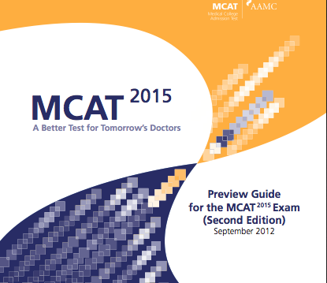
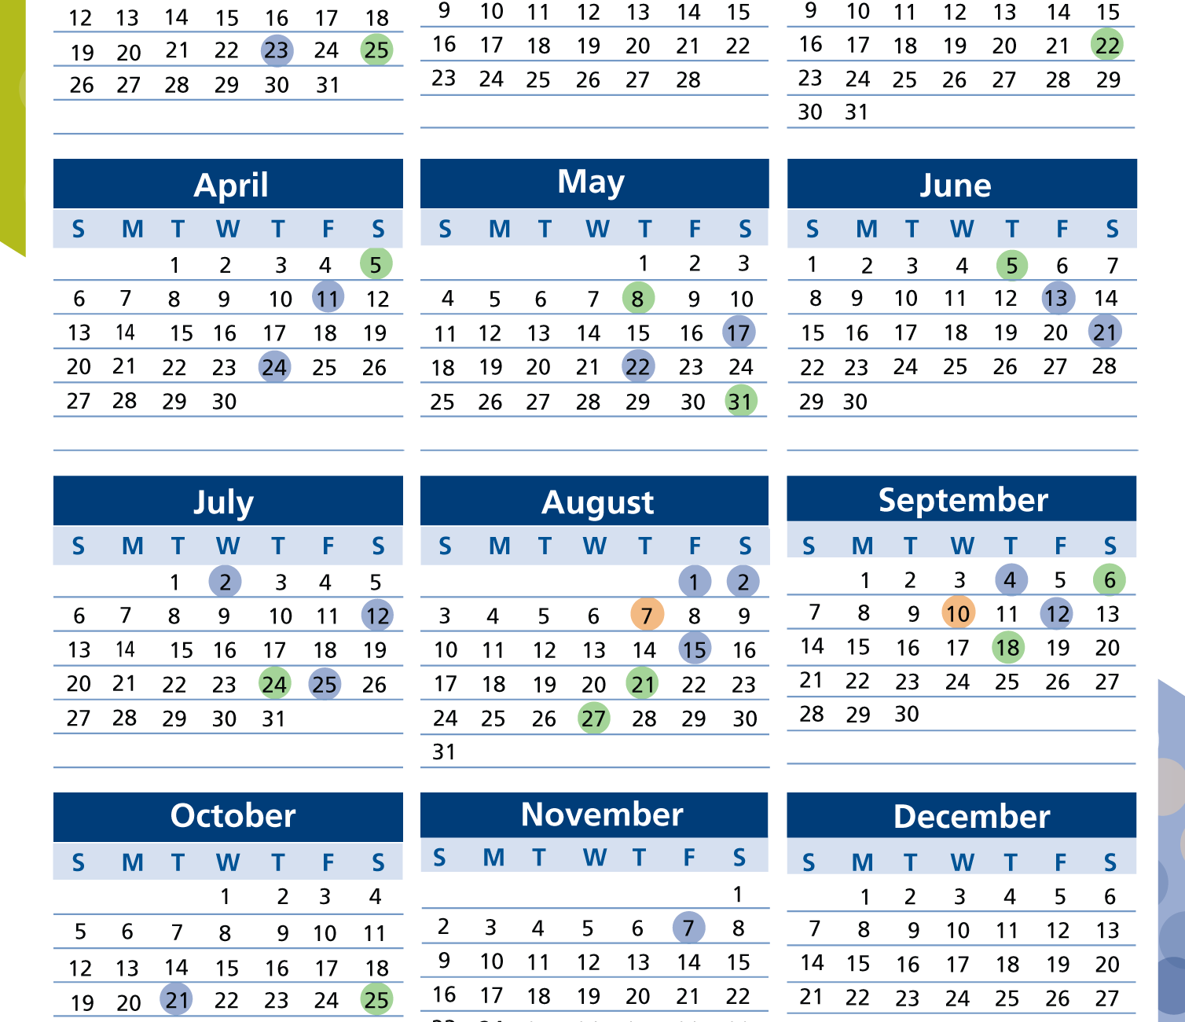
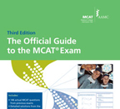
Applying to Medical School in 2019 and Beyond
MCAT
The MCAT exam, registration and preparation
When/where/which? Cost? ($315)
How to prepare? MCAT-AAMC link;
D MCAT Survey
Fee Assistance Program (FAP)
Testing Accomodations

Slide 16
INSTITUTIONAL ACTIONS?
AMCAS (and Dental, Vet etc) will ask you if you have ever had an institutional action. If you have—you must say Yes, and explain. Don’t freak out.
PLEASE TALK TO YOUR PRE-HEALTH ADVISORS DIRECTLY ABOUT THIS between now and EARLY SPRING.
We can coach you about: Is an action you’ve experienced one you need to report? What you will say about it; how to bring it forth to your composite writer or one of your support writers to give it context relative to your overall application and character.

Slide 17
The Med School Application (DO+Dental are very alike, Vet similar)
STRONGLY RECOMMENDED:
MCAT SCORE (DAT for Dental, Gre for Vet) IN HAND FIRST!
AMCAS application
Personal information (issue of institutional action/misdemeanor/felony)
Grades from all institutions (with transcripts (paper))
Personal statement
Activities & Experiences
School list (how to decide?)
$$$ ($170 (one school); $39 for each additional school)
Fee Assistance Program (FAP)
THEN:
Letters of evaluation are added separately Late June-Late Aug
Secondary applications-July-Aug/Sept (more essays; more $$)
Interview invitation (Aug to early-March)

Slide 18
Applying to Medical (or other) Schools in 2019-2020 Cycle and Beyond
Should I apply in 2019?
When should I take the MCAT exam and how should I prepare for it?
When should I begin to ask for letters of evaluation and how does the Dartmouth letter system work?
How does the actual AMCAS application process work and what dates am I aiming for to complete it?

Slide 19
Applying to Medical School in 2019 and Beyond A Few More Things
Medical Application Newsletters
Reflection Assignments to prepare you and provide material to letter writers
Fall/Winter/Spring Term Workshops
The Composite Letter of Evaluation
Getting Started on a Personal Statement
Filling out the AMCAS Application
Choosing Schools
Interviewing
Post-Bacc/Gap Year Options
Investment of your time to do all of this

Slide 20
THE DARTMOUTH COMPOSITE LETTER OF EVALUATION
What is it? What do YOU need to know and do?
What does the Health Professions program do?

Slide 21
The“Composite Letter” Dartmouth’s Letter of Evaluation For MD, DO, and Dental Schools
A unique, comprehensive letter of evaluation that shares a cohesive narrative about the applicant. It includes information about an applicant’s academic/intellectual background, their extracurricular experience, and their personal/professional qualities.

Slide 22
How does it work?
You choose a Composite Writer, from the Dartmouth Community (including Geisel and DHMC) most often a faculty member, sometimes staff, PI, etc.
They are your main writer
You choose 3-5 Support Writers
Using information from support letters, and including their own evaluation, the Composite Writer creates one cohesive letter “presenting you,” from Dartmouth.

Slide 23
How does all that happen
You will ask several people to be your writers
You will fill out a few specific forms for The Health Professions Program
You will write/provide some useful material for your writers to help support and composite writer
Support writers will upload their letters
The Health Professions Program will work directly with the Composite Writer to send them those support letters and the material you wrote

Slide 24
Who are Your Writers?
You choose your Composite and (3-5) Support Writers?
Your composite writer is a part of the Dartmouth community.
Your Writers (including Composite) will be from among these categories:
2 faculty who have taught you in a science class (one can be science-based neuro or engineering) (no, they don’t both need to be from Dartmouth)
Often one faculty from major (if other than science), and/or from another type of class that was meaningful for you
Experience outside the classroom, such as a research supervisor (PI), coach, internship supervisor, job supervisor, FSP faculty, conductor, etc. (this can include individuals outside of Dartmouth as well)
The best combination of writers = different facets of you (a prism) and your experiences.

Slide 25
The completed COMPOSITE LETTER OF EVALUATION document is created by the Health Professions Program staff. HPP ensures confidentiality, integrity, and quality of the letter.

Slide 26
The Composite Process Download copy of instructions on website

Slide 27
OVERVIEW
Choose and ask a “Composite Writer”
Choose and ask 3-5 supporting letter writers
Create deadlines for your writers
Submit a Timeline Agreement Form to HPP
Submit a “Composite Worksheet” to HPP
Start an “Interfolio” account-use our specific instructions
Input (only) your support writers’ contact info into Interfolio
Write an autobiographical sketch
Update your resume
Submit auto sketch and resume to support writers
Upload your auto sketch, resume, and transcript onto Interfolio
Submit a “Release to Composite” form: HPP then delivers support letters plus auto sketch, resume etc, to Composite Writer
Your Tasks for your Writers and
Your Tasks for Health Professions Program
YOU CAN CONSULT YOUR HPP ADVISORS ABOUT CHOOSING WRITERS; HOW TO ASK; SETTING DEADLINES…

Slide 28
HPP Forms to submit online Here :
TIMELINE AGREEMENT: Submit Fall through Mid-Winter Terms (target)
Confirms that you have an understanding of your responsibilities and the steps throughout the process
Let’s the HPP office know who is anticipating applying in that cycle
COMPOSITE LETTER WORKSHEET: Submit Fall through Mid-Winter (target)
This lets HPP know and review who your intended support and composite writers will be
COMPOSITE LETTER RELEASE: Submit Spring-Early Summer (target)
Submitted when all your support letters have been uploaded on Interfolio along with your own documents. “Release” notifies us that your file is ready to be sent to your composite writer, and gives us identifying information so that we match the correct support letters.

Slide 29
Choosing & Asking Your Writers: Begins this Fall
Reflect on your possible writers:
You can meet with your HPP Advisors, Chelsea Rule or Sarah Berger, to discuss your choices or if you have any concerns about choices
YES-it’s really okay to ASK.
Faculty and Staff understand that part of working in a college setting is that they will get asked to be writers
How..? Discuss

Slide 30
Timeline for ASKING Your Writers
TARGET TIMELINE for ASKING WRITERS (and submitting Composite Worksheet):
NOW (October)- February1st-February-15TH
The sooner the better:
Writers may get multiple requests and their roster may fill
It can be helpful for them to know now that this task is on their calendar
It allows you to give them a generous deadline while still having letters completed in a timely fashion so that HPP can support the process in a timely fashion—beneftting your application cycle.
HPP Deadline: March 20
(Exceptions):
You are still getting to know faculty and staff that you hope to ask
Something changes
Your decision to apply came late (if so, please discuss with Advisor)

Slide 31
Creating Deadlines for Your Support Writers:
TARGET Deadline for Support Letters
April 1-15
HPP Deadline:
May 30
While these deadlines are IDEAL in order for things to happen in a timely fashion, there is some flexibility and exceptions based on writer needs and changes in your own timeline
CLEARLY DISCUSS DEADLINES W/ WRITERS: MUST TAKE THE WRITER’S SCHEDULE INTO ACCOUNT. Do they need to write sooner? Later? How does that change support letter timeline, or Composite Letter timeline.
Ultimately the letters must be completed in a timely fashion to most fully benefit your own application timeline. Discuss with HPP if you have timeline questions or concerns.

Slide 32
Start an Interfolio Account
Go to our HPP Pre-health Advising website for SPECIFIC INSTRUCTIONS for signing into Interfolio associated with Dartmouth Health Professions Program
https://www.dartmouth.edu/prehealth/applying/evaluation_letters/interfolio.html
Submit Letter Request forms for Each Writer (Interfolio will send them a link for uploading letters)
Let Writers know they will be receiving that link

Slide 33
What else do YOU DO for your writers?
You thank them for agreeing to write, and share the deadline dates you’ve agreed upon.
You will write an Autobiographical Sketch (a GREAT exercise on path to writing essays for Applications)
You will update your resume
You will send those documents to your support writers, ideally by February 15 and definitely by March 15. If your writers plan to write sooner then act accordingly.
You will also upload these documents PLUS a transcript onto Interfolio. When all your support letters are in, those documents will be part of the file HPP sends to your Composite writer.
You can update them with any news along the way
You can send them a gentle reminder about the letter 2-3 weeks before due date, and again, 5-7 days before do date. Emphasize gentle.

Slide 34
Support Letters are All In? It’s up to you to monitor
SUBMIT YOUR RELEASE TO COMPOSITE FORM TO HPP

Slide 35
Creating Deadline for Your Composite Writer
HYPOTHETICAL:
Your support writers agreed to an April 1st Deadline
You want your Composite Writer to have at least 4-6 weeks to write their letter
You Submit your Release to Composite to HPP on April 3rd
It takes HPP up to 1-3 weeks to process depending on different factors
Composite Writer gets material on April 20
In this scenario: Good Due Date for Composite Writer=June 5-15
CLEARLY DISCUSS DEADLINES W/ WRITER: MUST TAKE THE COMPOSITE WRITER’S SCHEDULE INTO ACCOUNT. Do they need to write sooner? Later? How does that change support letter timeline?

Slide 36
HPP has the Composite Release, now what?
HPP staff send File that includes your support letters + your personal documents, along with explicit instructions to your Composite Writer
4-6 Weeks later (typically), Writer sends letter directly to HPP
HPP Staff review letter: Works directly with composite writer for any revisions. 3-4 weeks. (often sooner, but it can take that long)
HPP Staff takes final letter and creates
COMPLETED COMPOSITE LETTER OF EVALUATION

Slide 37
THE FINAL COMPOSITE…
The final Composite product is one single PDF.
It includes the Composite Letter itself, followed by your 3-5 support letters along with a cover letter from our HPP office that explains some unique aspects of Dartmouth College.
The HPP office works closely first with you, and then with your Composite writer directly.
The Letter is usually completed between late spring to mid-summer of the year you are applying.
Once the Composite Letter of Evaluation is completed, you will receive notification from our office with instructions for how to send it to AMCAS (MD), AACOMAS (DO) or AADSAS (Dental) Application service.

Slide 38
Timing of Letter Submissioin
IMPORTANT NOTE:
Applicants submit their Composite Letter of Evaluation AFTER they have submitted their primary application.
IE: You don’t have to wait to submit your primary application for the letter to be completed. It is typical for the Composite Letter (and Committee Letters from other schools) to be added later.

Slide 39
And… you’re done
Along with AMCAS Primary App
Your MCAT Score
Your Completed Secondary A
The 4th part of a complete application is done!

