Slide 1

e-Forms Process Flow
Submitter
Approver
OSP & Finance Center
Official College
Record Retention
Complete e-Form
Attach required documentation
Submit for approvals
Receive email notification with Request ID
Receive email to approve e-Form
Select link in email
Review form and Approve/Deny/Re-route to other approver
Receive form in Unity
Review and process e-Form
Mark as Complete in Unity
All OnBase Users must establish a VPN connection before starting the Unity Client in order to connect to OnBase
Submitters can access their saved or submitted e-Forms using the email notification links
Approvers can access forms they were asked to review/approve using the email notification link
Department Administrators can access all requests made against chart strings they have access to by using the OnBase Unity Client
OSP can access e-Forms they were asked to review/approve using either the email notification link or logging into the Unity Client
Finance Centers can access e-Forms they were asked to review/process using either the email notification link or logging into the Unity Client

Slide 2


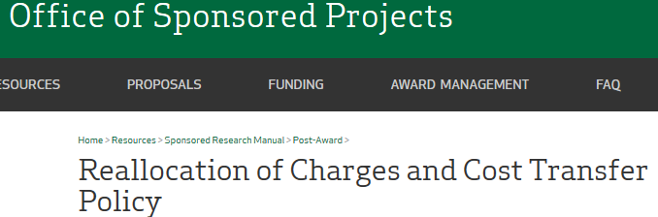

How Do I Submit an e-Form Request?
http://www.dartmouth.edu/~fincenter/forms.html
Select which e-form you would like to prepare.
Single Sign-on: Use your Net ID by using Web Authentication
e-Forms work best in the following browsers:
Internet Explorer 9 or 10
Google
Firefox 19-29
http://www.dartmouth.edu/~osp/resources/manual/postaward/untitled.html
The Basics about the e-Forms
Required Fields Indicated by *
Ghost Text (gray field) provides hints on information the form is seeking
Names – Begin typing the Last Name and select from the list of available names

Slide 3
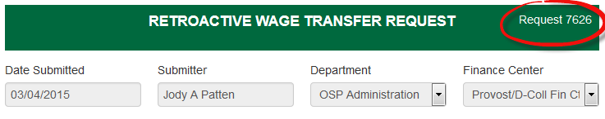
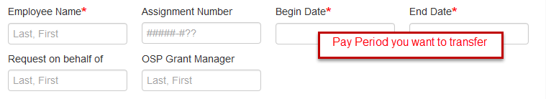
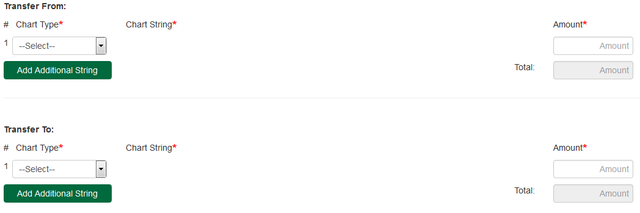
Preparing a Wage Transfer e-Form
OnBase assigns a unique Request # for every transaction
Single Sign on - fields are prepopulated based on your Net Id
* Are required fields
Assignment Number Field
If you have the assignment number, please enter it as it is very helpful.
NOTE: Wage Transfers cannot cross fiscal years. You would need
to prepare 2 wage transfers.
IMPORTANT: Always fill in the OSP Grant Manager name when the transfer involves a PTAEO account.
TIP: If you have an appointment/assignment for multiple areas, you need to select the department that you are submitting by using the Department pull down.
“Transfer From” will produce a CREDIT transaction
“Transfer To” will produce a DEBIT transaction
Select the chart type (G/L or PTAEO)
Fill in the chart string (G/L or PTAEO)
Amount you want to transfer
NOTE: Must be a balanced entry (debits = credits)

Slide 4

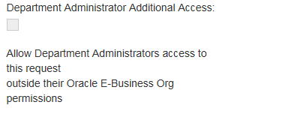


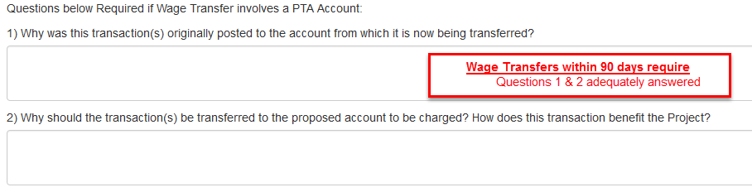
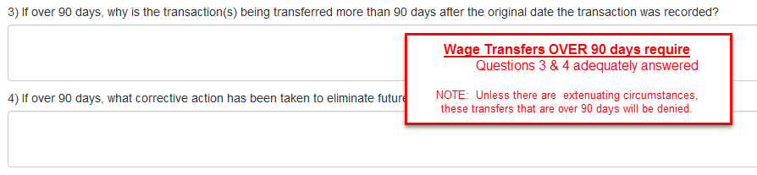


Preparing a Wage Transfer, cont’d
Special Viewing Access
If you are submitting an e-Form and using a chart string that your administrator does not have access to, and the administrator needs to be able to access the form.
Drop down – select Security GL Org OR PTAEO Award
Enter the appropriate ORG
The ‘reason’ provides the details as to why this transfer is being done.
Regardless of whether this Wage Transfer is a ‘simple re-class’ or a ‘non-simple re-class’, you still need to fill in the ‘Reason for Transfer’.
When the e-Form is for a Wage Transfer (non-simple re-class) you must answer the following:
Unless there are extenuating circumstances, any transfer that is over 90 days will no be approved.
REMINDER: There has been NO change in the OSP Reallocation policy

Slide 5
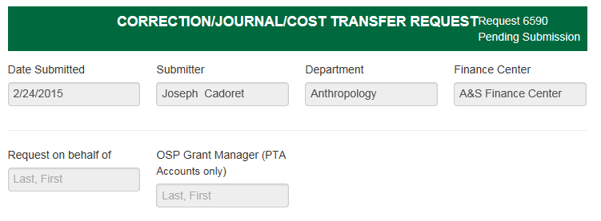




Preparing a Simple Re-class e-Form
or Cost Transfer e-Form
OnBase assigns a unique Request Number on each e-Form Request. This Request Number needs to be added under the Batch Name Column on the excel version of your Simple Re-Class and Cost Transfer SPUD Journals. You should fill in your initials, then space, then the Request Number, then space, then today’s date. It should look like:
ARC 6590 061715
Single Sign on - fields are prepopulated based on your Net Id
If you know who the OSP Grant Manager is, add their name here. If it involves multiple OSP Grant Managers, you only need to list one.
NOTE: You also need to add the OSP Grant Manager as an Approver near the bottom of the e-Form.
Who is preparing this e-Form (your name here)?
When your e-Form involves a PTAEO account
Prepare and attach the Excel file for either a Simple Re-class or a Cost Transfer (these forms have not changed)
You do not need to enter in the e-Forms document
  ‘Transfer From’
  ‘Transfer To’
  ‘Chart String’
  ‘Amount’
NOTE: Must be a balanced entry (debits = credits)

Slide 6
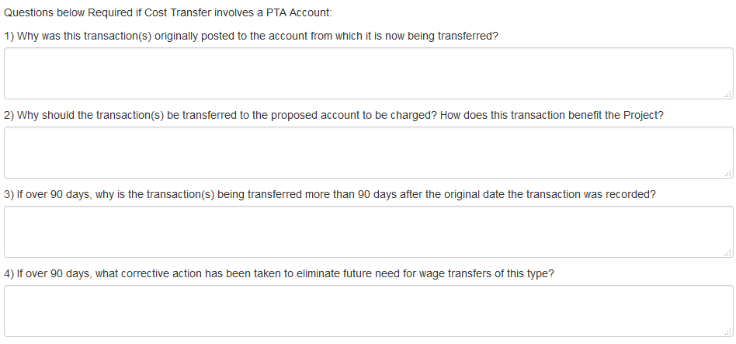
Preparing a Simple Re-class e-Form
or Cost Transfer e-Form, cont’d
Special Viewing Access
If you are submitting an e-Form and using a chart string that your administrator does not have access to, and the administrator needs to be able to access the form.
Drop down – select Security GL Org OR PTAEO Award
Enter the appropriate ORG
IMPORTANT: You must check the Department Administrator Additional Access Box and put in an ORG that you have access to in order to avoid filling in chart strings when submitting Simple Re-class and Cost Transfers.
The ‘Reason’ provides the details as to why this transfer is being done.
Regardless of whether this ‘Simple Re-class’ or a ‘Cost Transfer’, you still need to fill in the ‘Reason for Transfer’.
Cost Transfers within 90 days require
Questions 1 & 2 adequately answered
Unless there are extenuating circumstances, any transfer that is over 90 days will no be approved.
Cost Transfers OVER 90 days require
Questions 3 & 4 adequately answered
REMINDER: There has been NO change in the OSP Reallocation policy

Slide 7
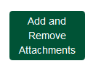
Preparing a Simple Re-class e-Form or Cost Transfer e-Form
How & What should I attach for documentation?
How do I ‘Attach Supporting Documentation’?
Click ‘Add and Remove Attachments’
Select a Document Type from the available list
Always choose ACCT – SPUD Journal when uploading the excel Simple Re-class SPUD Journal and the excel Cost Transfer SPUD Journal
Always choose ACCT – Financial Reports when attaching IRA Reports, invoices … etc.
Browse to your attachment
Upload
Select Done when all attachments are uploaded
If you need to add more additional documents repeat the steps
Documentation and Excel file requirements for e-Forms involving a PTAEO
Simple Re-class Journal
Excel version of the Journal must be uploaded into the e-Form document
Supporting documentation not required
Cost Transfer (non-simple)
Excel version of the Journal must be uploaded into the e-Form document
Attach supporting documentation for the transactions that are being moved. This would provide confirmation that the original charge hit the account you are ‘Transferring From’.(i.e., copies of invoice(s), IRA transaction report, etc.)
Wage Transfer (simple and non-simple)
Supporting documentation for the transactions that are being moved. This would provide confirmation that the original charge hit the account you are ‘Transferring From’. (i.e., copies of the IRA Transaction Report, Labor Distribution Report)

Slide 8



Preparing a Simple Re-class e-Form or Cost Transfer e-Form
Who needs to Approve this e-Form?
When a PTAEO string is involved…
E-Forms can be routed to single or multiple Approvers
  Begin typing last name in the Approver field, once the name appears in the list click on it to enter it.
  Click Add This Approver at the bottom of the form
  To add an additional Approver repeat the steps above
  Select the sequence of approvers in which you want the e-Form to be routed to (first, second, third, etc.)
  Once the e-Form is submitted, the approver(s) you added will receive an email notification requesting their review & approval
  Following their approval, the e-Form will be routed to the next approver and then onto OSP/Finance Center for final review/processing
Who needs to approve Simple Re-class Journal and Simple Re-class Wage Transfer?
OSP Sponsored Research Manager(s)
  - Add their name at the top of the form as OSP Grant manager and in the Approver section
Who needs to approve Cost Transfers & Wage Transfers (non-Simple Re-class) within days?
Principal Investigator(s)
  - Add their name in the Approver section
OSP Sponsored Research Manager(s)
  - Add their name at the top of the form as OSP Grant manager and in the Approver section
Who needs to approve Cost Transfers & Wage Transfers (non-Simple Re-class) OVER days?
Principal Investigator(s)
  - Add their name in the Approver section
OSP Sponsored Research Manager(s)
  - Add their name at the top of the form as OSP Grant manager and in the Approver section
Director of OSP or OSP Assistant Director, Post Award or OSP Operations Manager
Comments
Enter any helpful information for your request, regardless of type.
REMINDER: There has been NO change in the OSP Reallocation policy

Slide 9
Submitting and Approving Choices
The preparer’s choices…
Save transfer to return later
You will receive an email notification with a link to access your saved e-Form when you are ready to continue
Submit
The e-Form will be routed to the approver(s) you added prior to OSP/Finance Center receiving for processing
If no approvers are included the e-Form will be routed to OSP/Finance Center for processing
Cancel your request
No information is saved
The approver’s choices…
Wage Transfer
Correction/Journal/Cost Transfer
Approve
The e-Form will now be routed to the next approver.
Deny
You will be prompted to enter a reason for the denial
Route to Other Approver
You will need to Add the Approver within the e-form
You may also remove yourself as approver, or change the sequence in which you approve, then select Route to Other Approver

Slide 10
Submitting e-Form Issues
If you run into issues submitting the e-Form, you may need to clear your cache in the web browser that you are using.
The following website provides instructions for clearing your cache:
    http://www.refreshyourcache.com/en/home/

Slide 11





What happens after I submit the e-Form?
You’ve got Mail!
From: OnBase.Test@dartmouth.edu [mailto:OnBase.Test@dartmouth.edu]
Sent: Wednesday, February 25, 2015 8:58 AM
To: Rita T. Murdoch
Subject: Wage Transfer submitted by Rita T Murdoch for Berube, Todd J on 2/25/2015 status: Received
Rita T Murdoch,
Admin Finance Ctr has received your request number: 1763 Wage Transfer submitted by Rita T Murdoch for Berube, Todd J on 2/25/2015 status: Received
Submitter of the e-Form
Email will notify you when a request has been submitted to the OSP/Finance Center responsible for processing
Approvers on the e-Form
Email will notify you when an e-Form needs your review and approval
Select the link in the email to view the e-Form
Sign in using your Net Id and Password
Review the e-Form
If necessary, you may ‘Add this Approver’ if this
e-Form needs additional approvals
From: OnBase@dartmouth.edu [mailto:OnBase@dartmouth.edu]
Sent: Thursday, February 12, 2015 12:44 PM
To: Jody A. Patten
Subject: Corrections and Journals submitted by Ann K St Onge on 2/10/2015, status: Pending Approval
Greetings Approver,
The following request number: has been sent to you for approval:
Corrections and Journals submitted by Ann K St Onge on 2/10/2015, status: Pending Approval
Please click the description / name above to review the form and any related documentation. Following review, please approve or deny the request. If necessary, you may add an additional approver, delete an unnecessary approver or change the approver sequence. Thank you,
Tuck/Thayer Fin Ctr
Dartmouth Finance Centers
OSP/Finance Center responsible for Processing of the e-Form
Email will notify you when an e-form needs your review and processing
Select the link in the email to view the e-Form
Sign in using your Net Id and Password
Review the e-Form
If necessary, you may ‘Add this Approver’ if this
e-Form needs additional approvals
TIP for the Submitter: Create rules in Outlook to automatically move e-Form notifications to the same designated folder for easy reference to your submissions
Outlook Ribbon View
Do not forward the email notification to another person.
Why? The email link is specific to the Net Id of the email
recipient and will not work for other individuals.

Slide 12


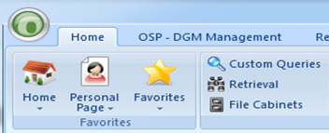
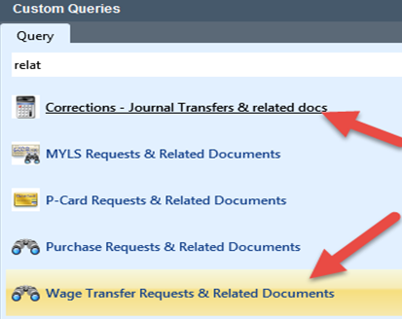

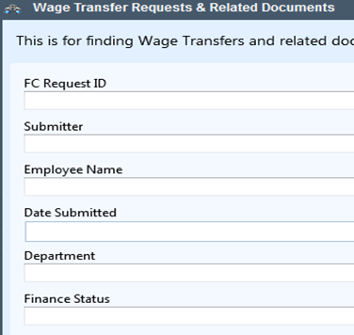
What Happens After I Submit the e-Form?, cont’d
A transaction got selected for Audit!
How do I find the official record and its approvals in OnBase?
Department Administrators can use the Unity Client to access requests.
From the Home Tab of the toolbar
Click on Custom Queries
Double click, the Document Type you are searching for (i.e., Wage Transfer, Correction/Journal/Cost Transfer)
Search using any or all of the fields.
NOTE: The following, you can change by clicking on the button
  = equals to
  < > not equal to
  “ will match exactly
  > greater than
  < less than
  > = greater than or equal to
  < = less than or equal to
IMPORTANT: The wildcard in OnBase is *
You can also use ? for a wildcard if you know you are only missing one character
For Example: * will pull up any number of missing characters
*Huff* will pull up a request from Heather Huff
Sand* will pull up a request from Sandra Brown
? can be used if only one character is missing
*H?ff will pull up a request from Heather Huff
S?nd* will pull up a request from Sandra Brown
TIP: You will most often use the = and *

Slide 13
What Happens After I Submit the e-Form?, cont’d
How do I check the status of my e-Form?
Use the link provided in your email notification to view your e-form
The status of your form appears beneath the Request ID
What does that status mean?
Pending Submission – Requestor started a request but did not finish
Pending Approval – Request has been sent to Approver and is waiting to be approved or denied.
Received – Request has been sent to OSP/Finance Center but is not yet assigned to anyone to work on
In Process – Request has been assigned within OSP/Finance Center
Hold – OSP/Finance Center puts e-Form on hold while waiting for some event
Pending OSP Review - Wage Transfer - Request has been assigned to OSP and is ready for processing
OSP Processing – Corrections and Journals – Request has been assigned to OSP and is ready for processing
Additional Information – Request is held in this queue while waiting for the Submitter to provide additional information
Complete – Request has been completed and has transitioned out of the process
Cancelled – Request has been canceled after being submitted by the requestor

