Slide 1
New NIH Data Sharing Plans: What You Need to Know to Support Your Researchers
Jill Mortali, Abby Fellows
Dartmouth College Office of Sponsored Projects

Slide 2
Presentation Overview
Requirements
  Definition
  Scope
Dartmouth's Approach
  Web Site Resources
    Division of labor with the Library
  OSP Feedback in the Early Days
    Proposal development
Case Study
  Specific Elements
    Examples of feedback to faculty
  Budgeting
    Specific requirements
    Science-based dialogue with faculty

Slide 3
Budgeting
Present a fun case study
How budgeting relates to proposed science
Providing guidance to faculty
What everyone wants to know

Slide 4
Scope: Proposals submitted on or after Jan 25th 2023
Applies to all research, funded or conducted in whole or in part by NIH, that results in the generation of “scientific data”
Scientific data: “the recorded factual material commonly accepted in the scientific community as of sufficient quality to validate and replicate research findings, regardless of whether the data are used to support scholarly publications.”
Notes:
The new data sharing plan is required for proposal submitted on Jn 25th and later. This applies to all....
Proposals this applies to are
'Scientific data includes any data needed to validate and replicate research findings.
Scientific data does not include laboratory notebooks, preliminary analyses, completed case report forms, drafts of scientific papers, plans for future research, peer reviews, communications with colleagues, or physical objects such as laboratory specimens
Provide your researchers with definition of Scientific data as well and point them to NIH FAQ.

Slide 5
Application of Policy
Included:
Research Projects (Rs)
Certain Career Development Awards (Ks)
Small Business SBIR/STTR
Research Centers
Not included:
Training grants (T’s)
Fellowships (F’s)
Construction (C06)
Conference (R13)
Resource (Gs)
Research-Related Infrastructure Programs (e.g., S06)
Policy applies to:
Competing grant applications
Proposals for contracts
NIH Intramural Research Projects
Other funding agreements
Policy does not apply to:
Non-Competing renewals
Administrative Supplements
Notes:
The new data sharing plan is required for proposal submitted on Jn 25th and later. This applies to all....
Proposals this applies to are
'Scientific data includes any data needed to validate and replicate research findings.
Scientific data does not include laboratory notebooks, preliminary analyses, completed case report forms, drafts of scientific papers, plans for future research, peer reviews, communications with colleagues, or physical objects such as laboratory specimens
Provide your researchers with definition of Scientific data as well and point them to NIH FAQ.

Slide 6
Data Management Plan vs. Resource Sharing Plan
Data Management & Sharing Plan
Required for all applications subject to the DMS Policy
Resource Sharing Plan
Required depending on proposed science
Describe Data Sharing, including Genomic Data Sharing (GDS)
Respond to IC or program-specific requirements in FOA
Respond to IC or program-specific requirements in FOA
Use the new "Other Plan(s)" attachment
Use "Resource Sharing Plan(s)" attachment
Describe Model Organisms and/or Research Tools

Slide 7
What data needs to be shared?
Data that is of sufficient quality to validate and replicate research findings
May include qualitative data or data produced using fundamental basic science techniques
Findings can include unpublished and/or negative/null results
End of award:
  data underlying unpublished key findings, developments, and conclusions
  findings documented within preprints, conference proceedings, or book chapters
Notes:
Data sharing should be maximized (with justifiable limitations)

Slide 8
Data that does not need to be shared
All data should be managed; not all must be shared
Lab notebooks
Preliminary analyses
Case report forms
Data from optimizing a protocol that does not support a research finding
Data obtained from a repository that is already available

Slide 9
Limitations on sharing
The DMS plan describes what data will and will not be shared and why
Ethical, legal, and technical factors:
  Informed consent will not permit or limits sharing or use
  Privacy or safety of research participants would be compromised
  Explicit federal, state, local, or Tribal law, regulation, or policy prohibits disclosure
  Restrictions imposed by existing or anticipated agreements with other parties
  Datasets cannot practically be digitized with reasonable efforts
Additional considerations:
  NIH respects Tribal sovereignty and management of American Indian/Alaska Native data
  SBIR/STTR Program Policy Directive permits withholding data for 20 years
Notes:
NIH does not expect you to share all your data, but if there is data you are not sharing, you need to provide justification
Policy does not change any of the federal regulations or compliance. The intent is not to have your research scooped, not erode patent protection, the goal is to make all data available that is ethical and legal to share.

Slide 10
Repositories
NIH strongly encourages subject-specific, open access Data Sharing Repositories as a first choice.
If no repository is specified by NIH:
Prioritize repositories that are discipline or data-type specific to support effective data discovery and reuse. NIH recommended repositories are provided.
Evaluate repositories on desired characteristics, such metadata, access, security, preservation, etc.
Human subjects data requires additional considerations.
If no appropriate discipline or data-type specific repository is available:
Submit smaller datasets (less than 2 GB) to PubMed Central as supplemental information
Select a generalist repository (Dryad, Figshare, OSF, etc)
Use local institutional repository like Dataverse
The use of Unique Persistent Identifiers (PID) is encouraged, and their use is a desirable characteristic of data repositories

Slide 11
DMS Plan Stages
Plan Separate from Application
Peer Reviewers will not see plan
Reviewers will evaluate budget
JIT Review
PO will review plan
Plan incorporated into NOA
Reporting
Include in RPPR
Compliance affects future funding
Plan Changes
Prior approval required
Revised NOA will note updated plan
Non-compliance can terminate award

Slide 12
DMS Plan changes: When to contact the Program Officer?
Significant changes to the DMS Plan require the investigator to contact the PO before the RPPR including:
Changes in the timeline of sharing the data
Scientific direction changes that affect data sharing plans
Changing repositories

Slide 13
Dartmouth OSP DMS Plan web page
Overview
Description of 6 elements
Budget
Resource sharing plan
NIH review of DMS plan
Institutional Resources
Helpful Links

Slide 14
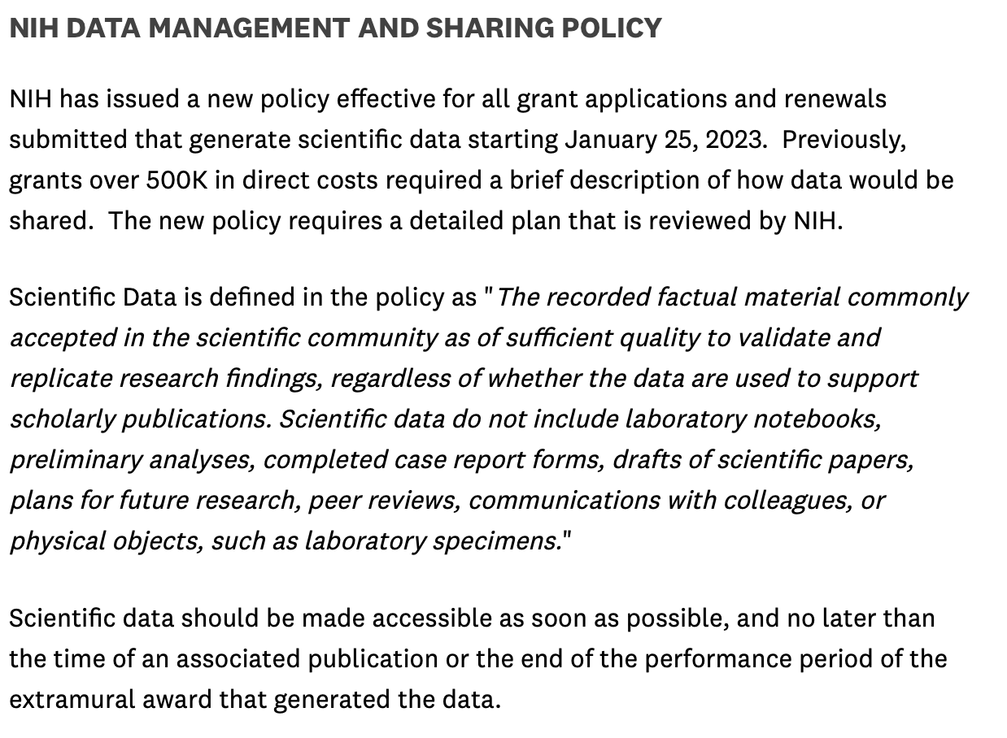

Slide 15
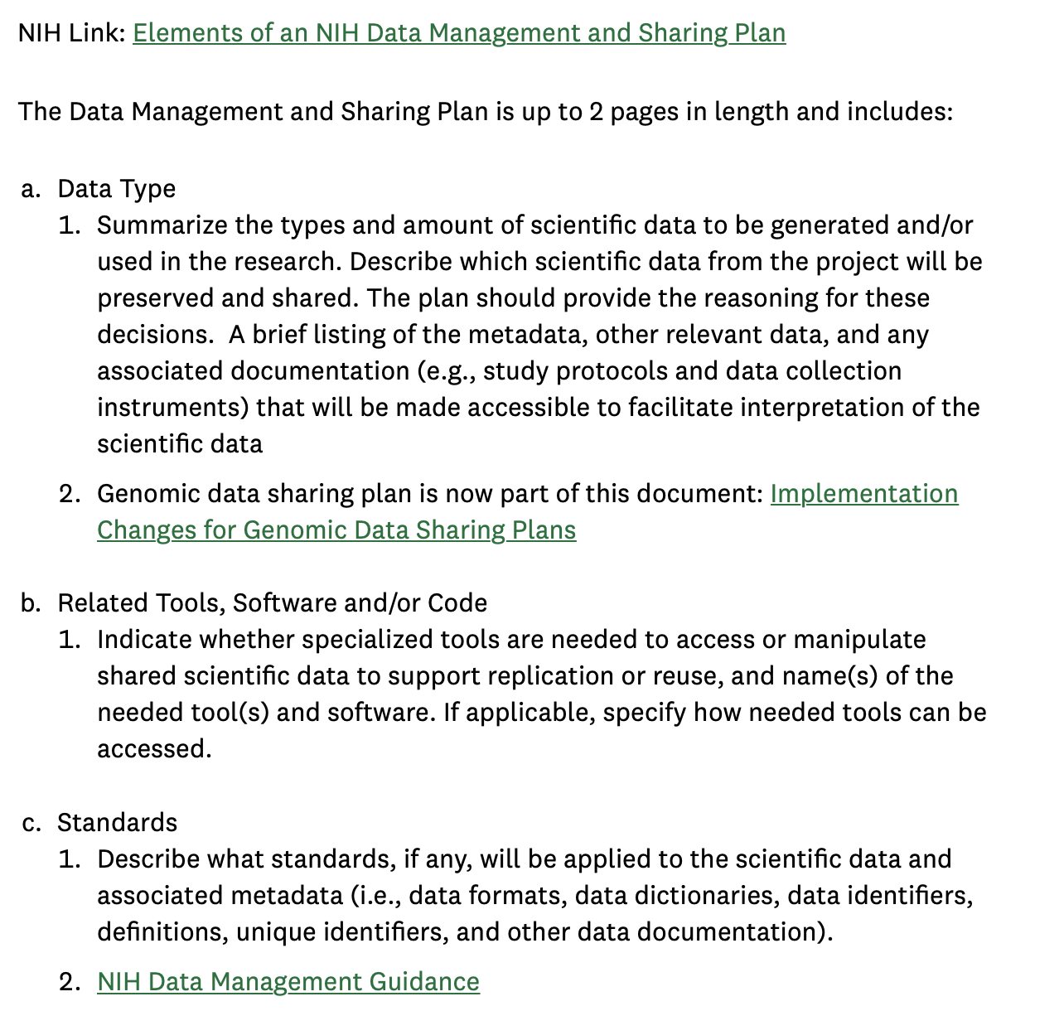
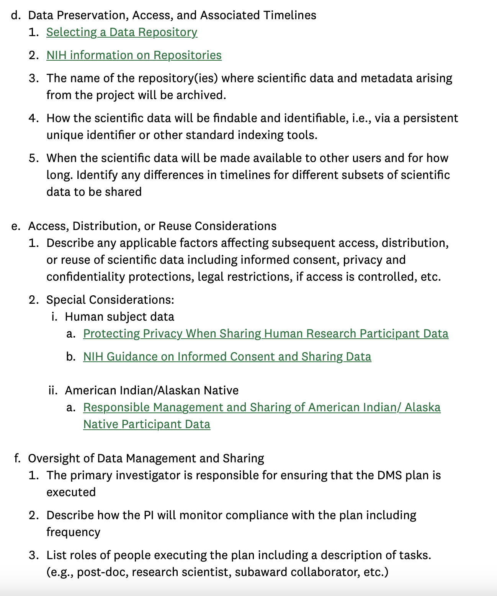

Slide 16
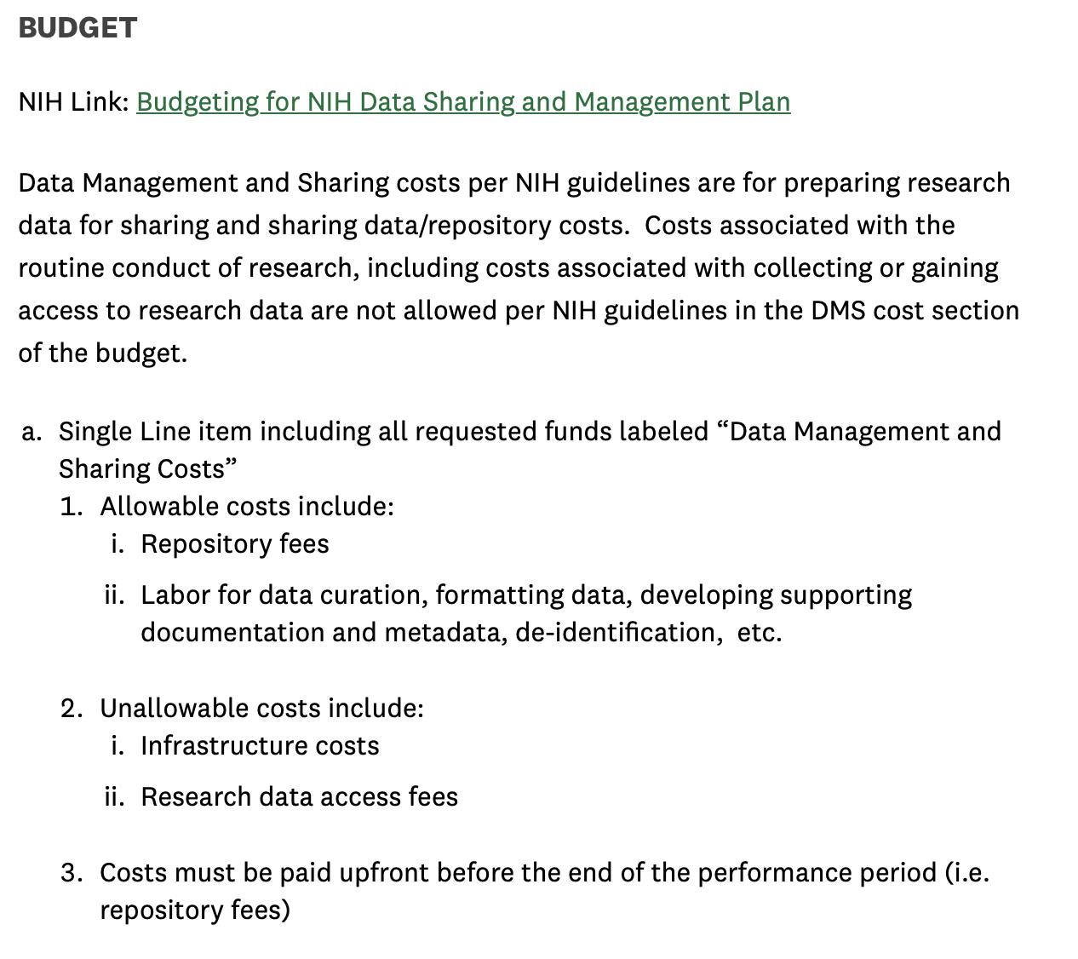
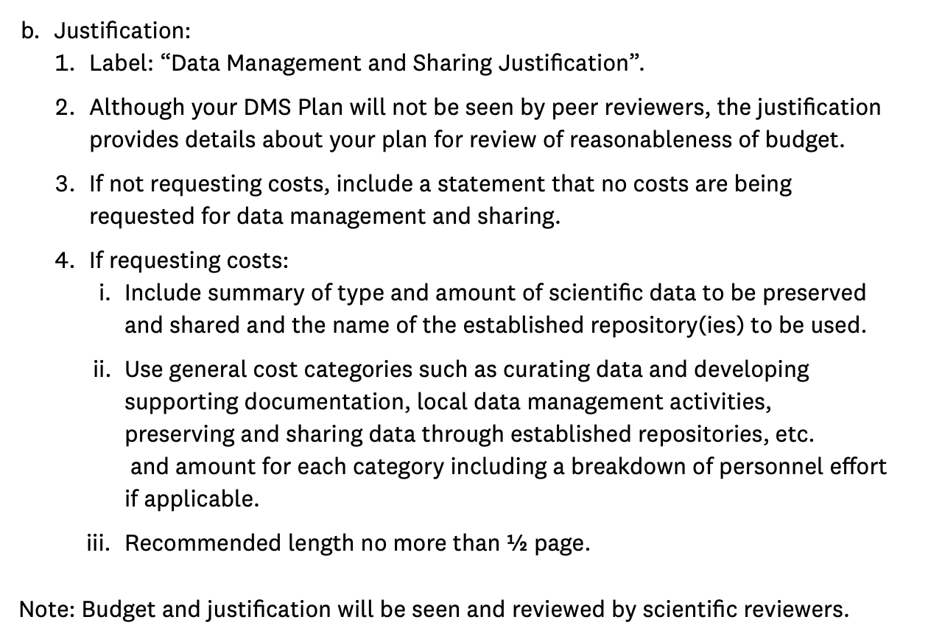

Slide 17
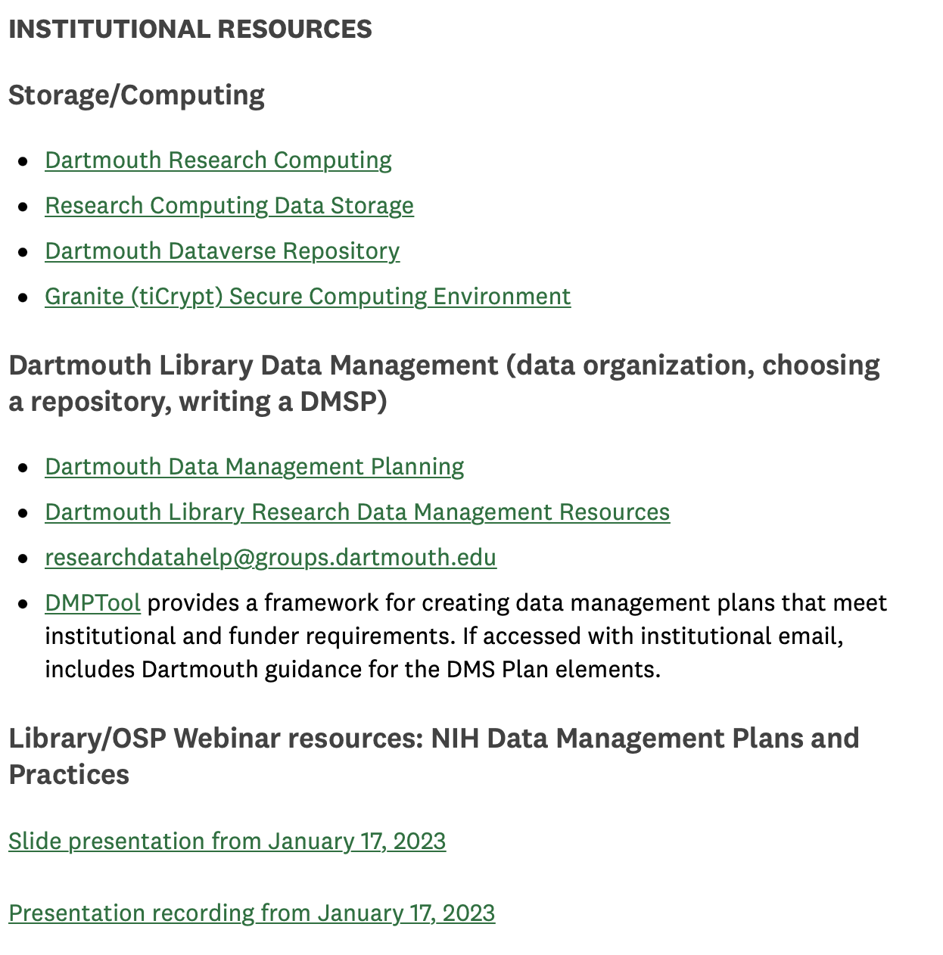
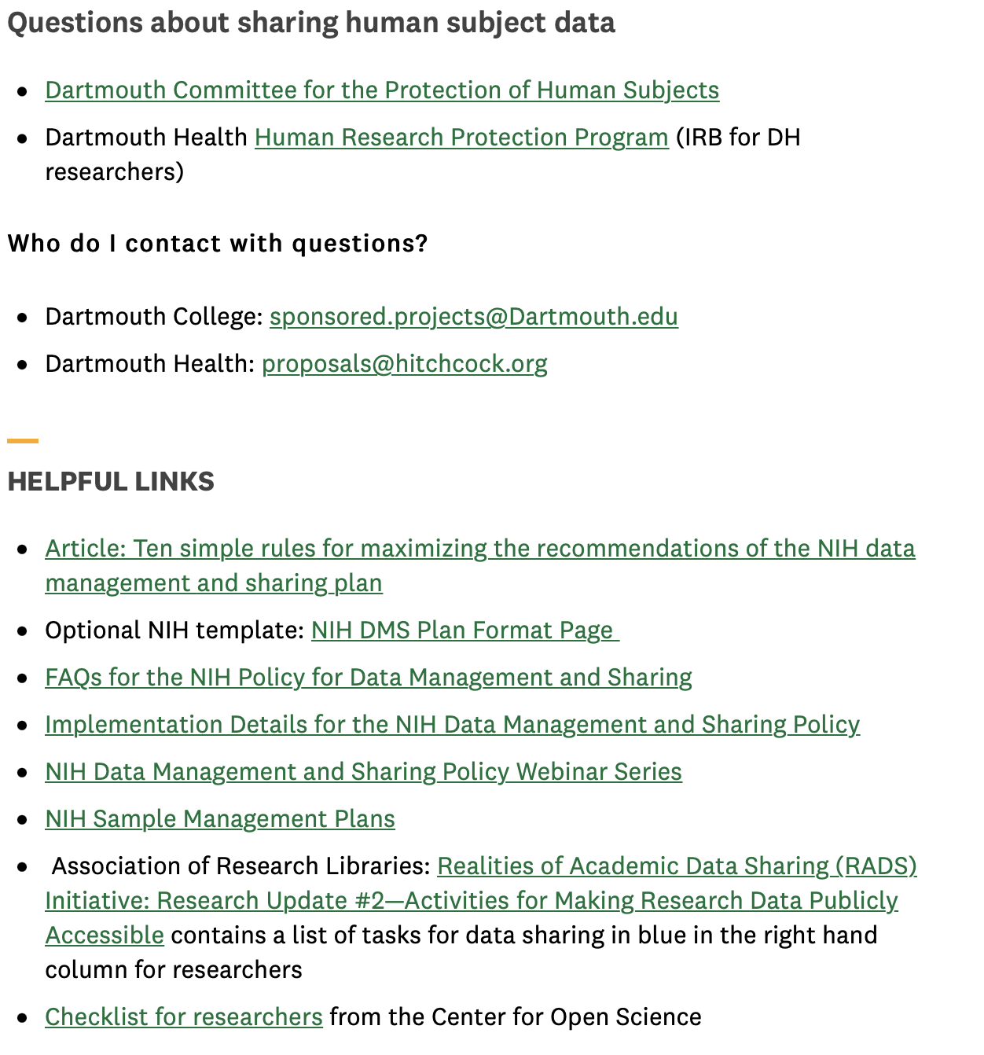

Slide 18
Institutional resources available at Dartmouth:
OSP
Institutional guidance
Web site
Meet with individual PIs
DMS Plan review
  Compliance check
  Review of all elements
DMS Plan seminars
Library
Identifying repositories
DMP Tool
Reviewing DMS Plans
DMS Plan seminars

Slide 19
Where have we provided feedback?
Components have the correct titles:
  Data Management and Sharing Plan
  Data Management and Sharing Costs
Single line item under “other” (detailed budget)
Specific repositories are named
Oversight of data management and sharing
Are they budgeting for any costs?
Time of data sharing:
  Sharing at time of publication
  Sharing of non-published data at end of the performance period

Slide 20
Elements of 2023 NIH Data Management and Sharing Plan
Data type
Related tools, software, code
Standards
Data preservation, access, timelines
Access, distribution, reuse considerations
Oversight of data management
Tools and software needed to access and manipulate data
Plan compliance will be monitored/ managed and by whom
Description of factors for data access, distribution, or reuse
Repository to be used, persistent unique identifiers, and when/ how long data will be available
Standards to be applied to scientific data and metadata
Describe data collected, data to be shared, rational for sharing, and data documentation
Notes:
There are 6 element that need to be addressed in your plan
Data Type
Summarize the types and amount of scientific data generated in the project
Describe what scientific data from the project will be preserved and shared and why
list the metadata, other relevant data, and any associated documentation
Related Tools, Software and/or Code
Do you need specialized tools to access or manipulate the data? Name the tools and how they can be accessed
standards:
State what common data standards will be applied to data and metadata to enable interoperability of datasets and resources
Data Preservation, Access, and Associated Timelines
Provide name of specific repositories
persistent unique identifier or other standard indexing tools.
Do not include web addresses
List when you will make the data available and how long?
Access, Distribution, and Reuse Considerations
NIH expects that in drafting Plans, researchers maximize the appropriate sharing of scientific data. Describe and justify any applicable factors or data use limitations.
State if access to data will be controlled
If human subject data, describe how will the privacy, rights, and confidentiality of human research participants will be protected?
Oversight of data management
Describe how activities outlined in your plan will be delegated, who will be responsible for overseeing and monitoring the study, and the frequency of monitoring
There is significant variation between NIH Institute/Center specific requirements. It is critical to understand the requirements of your individual IC before you start writing your plan.
Because this document is specific to your data and research, not Dartmouth policy, boilerplate institutional language will not fulfill NIH requirements. There are templates and “fill in the blank” examples and later we will introduce an online tool as an option to help write your plan.

Slide 21
Case Study and DMS Plan: Project Summary
Dr. Expeditious from The Fantastic Organization for Super Traction (FAST) Wax lab is conducting a research study on the effect of kick wax on athlete physiology and performance across the lifespan to test new formulations of wax. Her research project will test if these new waxes will give better performance in ski races and compare to data from an existing wax repository.

Slide 22
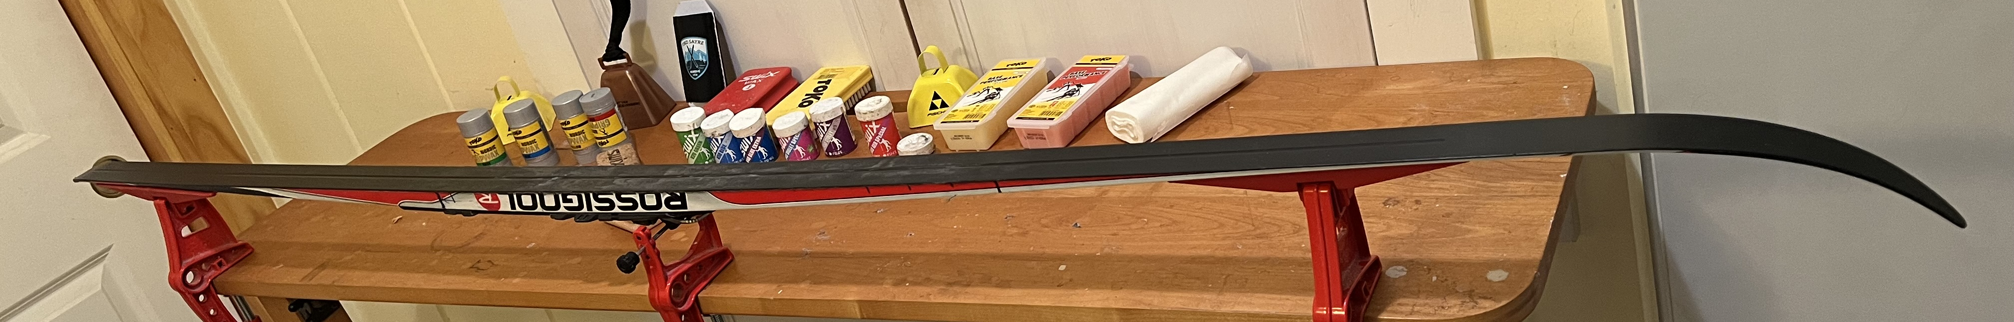
Background information: What is kick wax?
What is kick wax? It is applied to the kick zone on the bottom of smooth Nordic skis to give the athlete traction to push forward in the snow without being too sticky to slow the athlete down. Waxes are made for different temperatures and conditions that vary the level of stickiness/glide.
KICK ZONE

Slide 23
Types and amount of scientific data expected to be generated in the project:
This project will collect data from 200 Nordic skiers ages 8 and older from the Nordic Association of New England with ski abilities from beginner to international level. Data will include age, gender, height, weight, national ranking, heart rate, and breathing rate, while using various formulations of Fantastic Organization for Super Traction (FAST) Wax. The dataset will include outdoor temperature, uphill and downhill speed, elevation gain, and completion time of racecourse with GPS. Survey data will include satisfaction, wax application practices, and cost. Mixed effect models will be used to assess different formulations of FAST wax both within the same participant and across participants.
This data will be compared to existing data from previous wax testing from the US Ski and Snowboard World Acceleration neXus data repository (USWAX).
Description contains size of dataset and variables collected
Notes:
Description contains size of dataset. Variables collected. This project involves human subject data, proprietary information, and pre-existing datasets

Slide 24
Scientific data that will be preserved and shared, and the rationale for doing so:
Personally identifiable information will be removed from survey data and summary data will be shared when this is not possible. All data collected from the study apart from height, weight, BMI, age national/international ranking, and GPS location data will be shared as these variables allow for reidentification of study participants due to the limited dataset. The composite scores from these variables will be shared. Formulations of FAST wax are proprietary and will not be shared.
Sharing limitations in this example: ability to re-identify participants and proprietary information
List what data can and can’t be shared and why
Notes:
Description of what can and can’t be shared and why.
Collecting identifiable human subject data.

Slide 25
Metadata, other relevant data, and associated documentation:
Data dictionaries, data collection instruments, study protocols, metadata, and statistical analysis plans will be created, and deposited into the repository along with all shared datasets. A README file will summarize the overall methods, and the data dictionary will define and describe all variables in the dataset.
Describe documentation that will help another researcher understand the data
Notes:
Description of what can and can’t be shared and why.
Collecting identifiable human subject data.

Slide 26
Issues observed so far: Suggested Resolution:
Poor rational for data sharing (data too small, data not widely used)
Not being specific about data collected or sharing a subset of data
Use guided discovery to help researchers describe what data they are collecting
Highlight guidelines for technical, legal, and ethical reasons data cannot be shared
Broad restriction of data sharing based on small component of proprietary information.
Results from testing a proprietary compound can be shared without sharing compound structure.
Confusion that this is only for the Genomic Data sharing
Provide templates and links to NIH examples

Slide 27
All data will be collected in the electronic data capture system (REDCap) and will be made available in a csv format. Data will not require specialized tools to be accessed or manipulated. Programming code for processing and analyzing data will be distributed as open source written in R through our GitHub lab website.
What software is needed to read and work with the data? Is it specialized or open access?

Slide 28
Data will be labeled according to the format requirements of the USWAX which are also consistent with international wax data repositories standards. There are no formal scientific data standards regarding questionnaire measures. A README file detailing the structure of the data will be made available.
List standards applied to ensure data can be used across studies and across researchers
Use Common Data Elements that allow data to be used across datasets
Notes:
Standards allow data to be used across projects and allow for aggregate data use across labs

Slide 29
A. Repository where scientific data and metadata will be archived:
The data and metadata will be archived in the US Ski and Snowboard World Acceleration neXus data repository (USWAX).
List specific established repositories
Academic libraries can be very helpful to identify which to use
Check Funding Agency Web site for Institute specific requirements

Slide 30
B. How scientific data will be findable and identifiable:
Data will be findable using a Digital Object Identifier (DOI) and by standard data indexing tools in USWAX. We will reference the DOI for our dataset(s) in all relevant publications.
Use Fair Principles (Findable, Accessible, Interoperable, and Reusable)
Persistent unique identifiers and other standard indexing tools are highly encouraged

Slide 31
C. When and how long the scientific data will be made available:
Shared data will be made available as soon as possible. Results will be published and shared publicly approximately 6 months following the end of field testing. To maintain fairness in competitions, interim results will be deposited into USWAX three months prior to World Cup or Olympic events. Data not published will be made available at the end of the funding period.
There is no plan to delete or retire datasets. Data will be available for as long as USWAX retains the dataset.
Data must be shared at the time or publication or end of performance period, whichever comes first
Data should be shared as soon as possible!!!
Pre-prints do not trigger requirement for data sharing

Slide 32
Issues observed so far: Suggested Resolution:
All data shared will be supplemental information through publications
A publicly available repository
List the specific repository you will use. If this changes, contact the NIH, have them approve your new plan and a new NOA will be issued
Repository should be identified for “scientific data” that is unpublished at end of project.
Listing the URL of the repository web site
URLs are not allowed in the DMS Plan
Research Librarians are great resources for identifying repositories

Slide 33
Factors affecting subsequent access, distribution, or reuse of scientific data:
Although the dataset will be stripped of any identifiers prior to release for sharing, we believe that there is a possibility of determining subject identification due to the national/international ranking and age of subjects. We will therefore only make the composite score available for height, weight, age and ranking. GPS data shared will not include location of test site. All questionnaire data will be shared in summary format. All other data collected in the FAST wax testing will be shared.
Comparison data from USWAX is available through the repository and will not be re-shared as part of this project. FAST wax formulations are proprietary and will not be made available.
The goal is to maximize the appropriate sharing of scientific data
Describe and justify any applicable factors or data use limitations

Slide 34
Whether access to scientific data will be controlled:
Access to scientific data will be made available by the data repository only after approval by USWAX.
Protections for privacy, rights, and confidentiality of human research participants:
Participants in the FAST wax study will be made aware of which data will be shared in a repository in the informed consent document. Data collected from children will require of consent from the parent and assent from the child. Physiological measures will be collected with a Fitbit which will transmit data directly to study database via participant code to protect confidentiality. Data that cannot be de-identified will be shared as a composite measure. Participant’s identifying information is only accessible by approved staff as part of project responsibilities. All participant data that will be shared will be de-identified.
Describe human research protections, legal protections like Certificates of Confidentiality, etc.
Informed Consent
List other considerations why data can’t be shared
De-identification

Slide 35

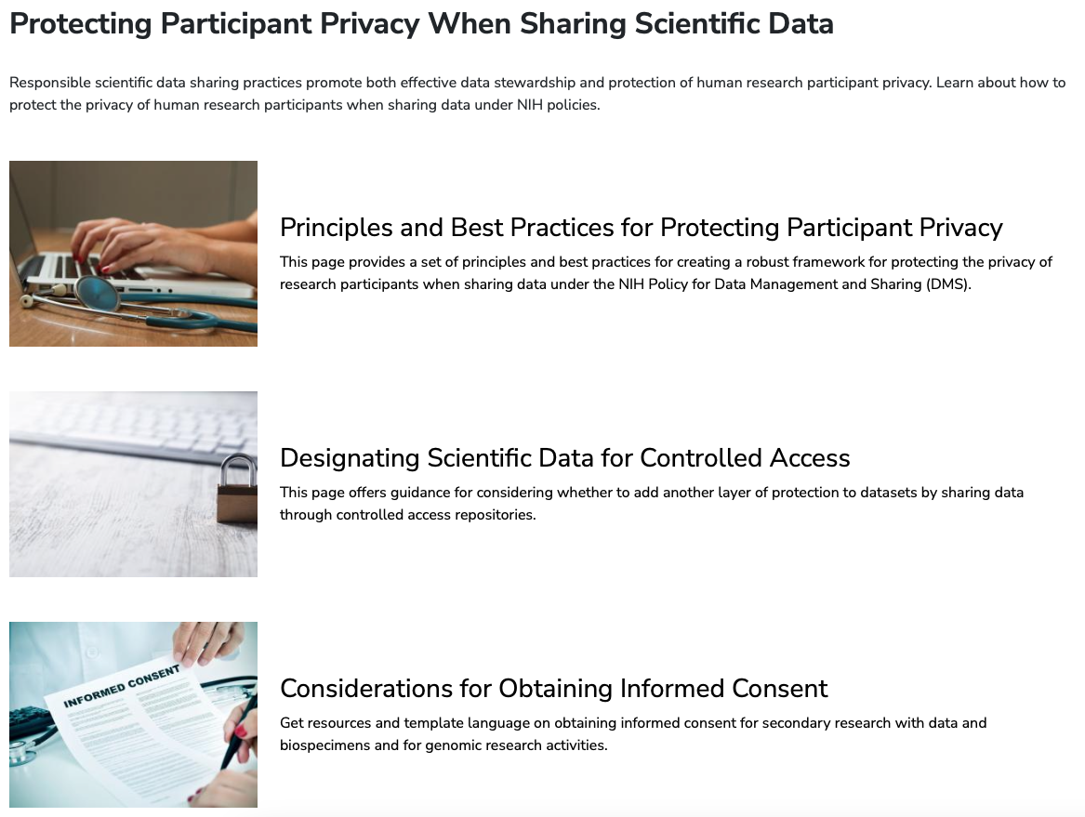
NIH web site resources: collecting, protecting, and controlling human subject data
https://sharing.nih.gov/data-management-and-sharing-policy/protecting-participant-privacy-when-sharing-scientific-data
Notes:
We don’t have compliance examples. Most researchers are already familiar with doing this.

Slide 36

NIH informed consent considerations
Points to consider and sample language for informed consent for research studies which plan to share data and/or biospecimens for future use
https://osp.od.nih.gov/wp-content/uploads/Informed-Consent-Resource-for-Secondary-Research-with-Data-and-Biospecimens.pdf

Slide 37
(From NIH example)
Data will be submitted by a project data manager from Dr. Expeditions' FAST wax lab team. The data manager will oversee data collection, analysis, storage, and sharing. Compliance with the plan will be monitored by the PI routinely. The PI will conduct monthly meetings with key study personnel to ensure the timeliness of data entry and will review data to ensure quality of data entry. The PI will ensure data are submitted and shared according to this DMSP.
The primary investigator is responsible for ensuring that the DMS plan is executed
Describe how the PI will monitor compliance with the plan including frequency
List roles of people executing the plan including a description of tasks. (e.g., post-doc, research scientist, subaward collaborator)
Notes:
We have not been recommending that researchers use names (other than the PI) in this section as it becomes part of the terms and conditions of the NOA and may need to be revised if someone leaves.

Slide 38
Allowable Data Management and Sharing Costs:
Curating data
Developing supporting documentation
Formatting and transmission of data and repository storage for long-term preservation and access
De-identifying data
Preparing metadata
Local data management considerations
Preserving and sharing data via repositories, such as data deposit fees
Personnel may be listed twice, if they conduct the science and data sharing
IMPORTANT: Costs Must be incurred during the performance period

Slide 39
Unallowable Data Management and Sharing Costs:
Costs associated with the routine conduct of research
  Costs associated with collecting data
  Research data access fees
Infrastructure costs that are included in institutional overhead (for instance, Facilities and Administrative costs)

Slide 40
Personnel Costs in Budget & Justification
Budget Section A & B
Scientific personnel
Do not include data-related effort
DMS Justification
Personnel supporting Data Sharing Costs
Include individual proportional effort

Slide 41
Personnel Descriptions in Justification vs Plan
Data Management & Sharing Plan
General description by project role
Avoid naming individuals other than the PI
Scientific effort for Key and Other Personnel
Name data sharing personnel
Prevents having to update plan for staff changes
Budget and justification are peer reviewed
Budget Justification

Slide 42
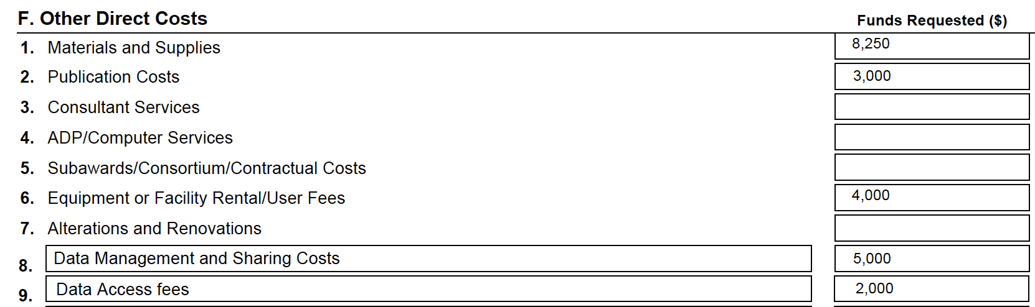
Budget
Single line item labeled “Data Management and Sharing Costs”
Costs are for preparing research data for sharing and sharing costs including repository fees
Line item may include personnel effort required for data management and sharing
Fees for accessing existing data sets as part of research are budgeted as research costs, not DMS costs

Slide 43
Detailed budget with no costs
If you do not have DMS Costs:
R&R budget under “Other” section “Data Management and Sharing Costs with a 0
Budget Justification: Data Management and Sharing Justification:
“No costs will be incurred for Data Management and Sharing”
  Optional explanation
Notes:
Encouraging researchers to add costs

Slide 44
Modular Budget
Additional Narrative Justification attachment with heading “Data Management and Sharing Justification”
If no costs requested: One line stating, “No costs will be incurred for Data Management and Sharing” with optional explication.
If costs requested, justification elements are the same as for a Detailed Budget

Slide 45
DMS Plan Budget Justification
Label: Data Management and Sharing Justification
If no costs are requested, state this in the justification
Include an amount for each category and a brief explanation
Include summary of type and amount of data to be preserved and shared and the name(s) of the established repository(ies)
Use cost categories such as: curating data and developing supporting documentation, local data management activities, etc.
Include a breakdown of personnel effort for named personnel
Recommended length no more than ½ page
Notes:
Peer Reviewers will see this as part of review to comment on appropriateness.

Slide 46
Data management and sharing justification:
Need this exact label
Summary of type of data and name of repository
This study will collect demographic, physiological, and performance data from 200 Nordic athletes as they test new formulations of kick wax and will be compared to existing wax performance data. The data will be deposited in the US Ski and Snowboard World Acceleration neXus data repository (USWAX).
We are requesting $5,000 per project year.
Mr. Relentless (4% effort, $4000/year) will be responsible for preparing consent documents, curating data and developing supporting documentation, deidentifying data, uploading data to USWAX.
USWAX data deposit fee ($1,000/year). USWAX has a data deposit fee of $500 per deposit and 2 data uploads are anticipated per year.
Breakdown of effort for personnel
General cost categories
Repository fees

Slide 47
Subawards and DMS Plan
One DMS Plan for all sites
  Describe in compliance section what each site is responsible for and how PI will oversee compliance of all sites
Subaward budget may contain DMS costs
If Subaward has costs, subaward budget contains single line item in Other
Subaward budget justification contains Data Management Costs request

Slide 48
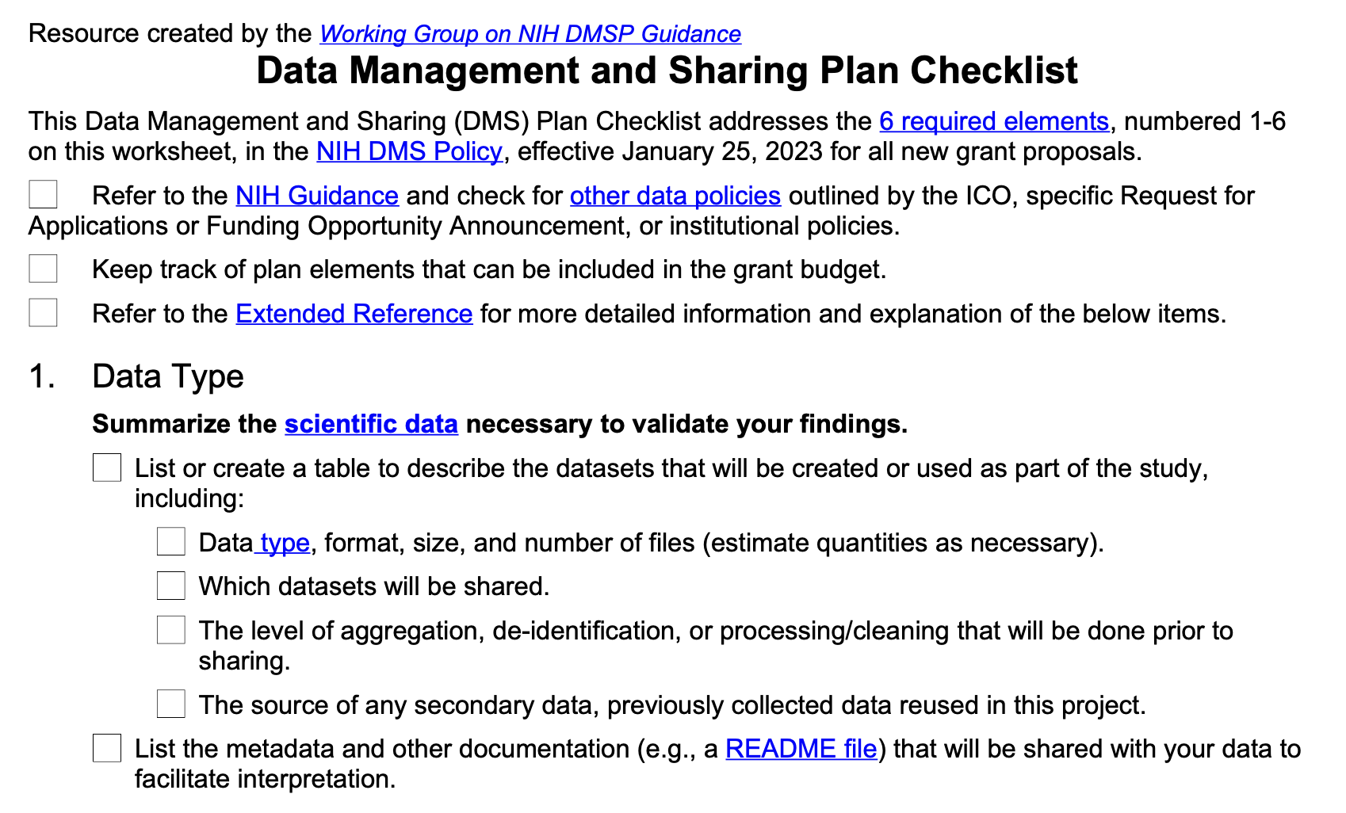
Center for Open Science DMS Plan checklist:
https://osf.io/awypt

Slide 49
Other considerations and reminders
Check for FOA and NIH Institute specific instructions
URLs and Hyperlinks are NOT allowed in the plan
Plans may be more than 2 pages
Investigators will work with NIH during the JIT process to address any changes or additional information required

Slide 50


Slide 51
Questions?
Notes:
For Dartmouth College researchers, please contact the Office of Sponsored Projects
For Dartmouth Hitchcock researchers, please contact awards@Hitchcock.org

