Slide 1
OSP
Jill Mortali, Abby Fellows
sponsored.projects@dartmouth.edu
Dartmouth Library Research Data Services
Lora Leligdon
ResearchDataHelp@groups.dartmouth.edu
Research Computing @ ITC
Research.Computing@dartmouth.edu
Upcoming events:
dartgo.org/RRADworkshops

Slide 2
NIH DMS Plans and Practices
NIH DMS policy introduction
Overview of the elements of DMS
Highlights of a couple of important sections (data repositories, budget, compliance, etc.)
DMPTool
Writing and reviewing plans
RDM guidance
Templates
Institutional resources
OSP
Library
Research Computing
Notes:
Lora: may be good to put in the introduction motivation from NIH for implementing this

Slide 3
Scope
Applies to all research, funded or conducted in whole or in part by NIH, that results in the generation of “scientific data”
Data Sharing: The act of making scientific data available for use by others (e.g., the larger research community, institutions, the broader public), for example, via an established repository.
Scientific data: “the recorded factual material commonly accepted in the scientific community as of sufficient quality to validate and replicate research findings, regardless of whether the data are used to support scholarly publications.”
Notes:
The new data sharing plan is required for proposal submitted on Jn 25th and later.
'Scientific data includes any data needed to validate and replicate research findings.
Scientific data does not include laboratory notebooks, preliminary analyses, completed case report forms, drafts of scientific papers, plans for future research, peer reviews, communications with colleagues, or physical objects such as laboratory specimens
Provide your researchers with definition of Scientific data as well and point them to NIH FAQ.

Slide 4
Why does NIH want data to be shared?
Advance rigorous and reproducible research
Promote public trust in research
Allows for validation of research results
Makes datasets accessible
Accelerates scientific progress
Opportunities for increased collaboration
Making data available to public or larger research community
Increases transparency and accountability
Demonstrates stewardship of taxpayer funds
Allows research participants’ contributions to be used in multiple ways
Notes:
Benefit to researcher: Shared data can be cited as products of awards anywhere research products are cited (e.g., bibliography, biosketch, progress report)

Slide 5
Application of Policy
Included:
Research Projects (Rs)
Certain Career Development Awards (Ks)
Small Business SBIR/STTR
Research Centers
Not included:
Training grants (T’s)
Fellowships (F’s)
Construction (C06)
Conference (R13)
Resource (Gs)
Research-Related Infrastructure Programs (e.g., S06)
Policy applies to:
Competing grant applications
Proposals for contracts
NIH Intramural Research Projects
Other funding agreements
Policy does not apply to:
Non-Competing renewals

Slide 6
Data Management Plan vs. Resource Sharing Plan
Data Management & Sharing Plan
Required for all applications subject to the DMS Policy
Resource Sharing Plan
Required depending on proposed science
Describe Data Sharing, including Genomic Data Sharing (GDS)
Respond to IC or program-specific requirements in FOA
Respond to IC or program-specific requirements in FOA
Use the new "Other Plan(s)" attachment
Use "Resource Sharing Plan(s)" attachment
Describe Model Organisms and/or Research Tools

Slide 7
Elements of 2023 NIH Data Management and Sharing Plan
Data type
Describe data collected including amount, data to be shared, rational for sharing, and data documentation
Related tools, software, code
Commercial or open-source? If not is there a plan to share tools/software?
Standards
Standards to be applied to scientific data and metadata – list common data standards
Data preservation, access, timelines
Specific repository(ies) to be used, persistent unique identifiers, and when/ how long data will be available
Access, distribution, reuse considerations
Description of factors for data access, distribution, or reuse: Justify what can’t you share or limit sharing on
Oversight of data management
Plan compliance will be monitored/ managed and by whom
Notes:
There are 6 element that need to be addressed in your plan
Data Type
Summarize the types and amount of scientific data generated in the project BE specific
Describe what scientific data from the project will be preserved and shared and why
list the metadata, other relevant data, and any associated documentation
Related Tools, Software and/or Code
Do you need specialized tools to access or manipulate the data? Name the tools and how they can be accessed
standards:
State what common data standards will be applied to data and metadata to enable interoperability of datasets and resources
Data Preservation, Access, and Associated Timelines
Provide name of specific repositories
persistent unique identifier or other standard indexing tools.
Do not include web addresses List when you will make the data available and how long?
Access, Distribution, and Reuse Considerations
NIH expects that in drafting Plans, researchers maximize the appropriate sharing of scientific data. Describe and justify any applicable factors or data use limitations.
State if access to data will be controlled
If human subject data, describe how will the privacy, rights, and confidentiality of human research participants will be protected. Include information about data sharing language in informed consent
Oversight of data management
Describe how activities outlined in your plan will be delegated, who will be responsible for overseeing and monitoring the study, and the frequency of monitoring
There is significant variation between NIH Institute/Center specific requirements. It is critical to understand the requirements of your individual IC before you start writing your plan.
Because this document is specific to your data and research, not Dartmouth policy, boilerplate institutional language will not fulfill NIH requirements. There are templates and “fill in the blank” examples and later we will introduce an online tool as an option to help write your plan.

Slide 8
What data needs to be shared?
Data that is of sufficient quality to validate and replicate research findings
May include qualitative data or data produced using fundamental basic science techniques
Findings can include unpublished and/or negative/null results
End of award share data underlying:
unpublished key findings, developments, and conclusions
findings documented within preprints, conference proceedings, or book chapters
Notes:
Data sharing should be maximized (with justifiable limitations)

Slide 9
Data that does not need to be shared
All data should be managed; not all must be shared
Lab notebooks
preliminary analyses
case report forms
data from optimizing a protocol that does not support a research finding
Data obtained from a repository that is already available

Slide 10
Limitations on sharing
NIH expects that researchers will maximize scientific data sharing. Certain factors (i.e., ethical, legal, or technical) may necessitate limiting sharing to some extent.
Justify deviations from the policy of why it’s not possible or reasonable to share data:
Human subjects- describe IRB’s role in determination
Informed consent will not permit or limits scope of sharing or use
Privacy or safety of research participants would be compromised and available protections insufficient
Explicit federal, state, local, or Tribal law, regulation, or policy prohibits disclosure– cite the law
Restrictions imposed by existing or anticipated agreements with other parties
Datasets cannot practically be digitized with reasonable efforts
NIH respects Tribal sovereignty and supports responsible management/sharing of American Indian / Alaska Native participant data
Give specifics
Notes:
NIH does not expect you to share all your data, but if there is data you are not sharing, you need to provide justification
Policy does not change any of the federal regulations or compliance. The intent is not to have your research scooped, not erode patent protection, the goal is to make all data available that is ethical and legal to share.

Slide 11
When should I share my data?
As soon as possible!
At time of publication:
Data must be shared no later than the article is available in electronic format or print.
Release of pre-print does not trigger the NIH data sharing requirement
At the end of the performance period:
Data not shared through publications must be shared at the end of the performance period unless the grant enters a no-cost extension or is renewed.
NIH expects sharing of null and negative results.
When applying for a renewal, sharing data from the previous performance period should be addressed.
Make sure your plan lists data sharing timing for both at the time of publication or end of the performance period, whichever comes first.

Slide 12
NIH is expecting Data Management and Sharing costs
Per NIH: Please budget costs!!!
Notes:
Costs include preparing the data for sharing and sharing it. This includes formatting data with common data standards, etc.

Slide 13
Allowable Data Management and Sharing Costs:
Costs are for preparing research data for sharing and sharing it:
Personnel effort:
Curating data
Developing supporting documentation
Formatting and transmission of data and repository storage for long-term preservation and access
De-identifying data
Preparing metadata
Preserving and sharing data via repositories, such as data deposit fees
IMPORTANT: Costs Must be incurred during the performance period

Slide 14
Unallowable Data Management and Sharing Costs:
Costs associated with the routine conduct of research
Costs associated with collecting data
Research data access fees
Infrastructure costs that are included in institutional overhead (for instance, Facilities and Administrative costs)

Slide 15
Budget considerations:
Determine repository costs
Repository specific
May include data deposit and/or long term storage fees
Range from free to $1000s
Based on dataset size, security/permissions, curation levels
Preparing data, metadata, de-identification, etc: Budget personnel effort
External service
Member of the project team
Resources to help with costs to consider:
OpenAIRE Estimating Costs RDM Tool (this is in Euros and needs conversion to USD)
NIMH Data Archive (NDA)’s budgeting guide and NDA Data Submission Cost Estimation Tool
Notes:
Are there repository specific costs?
Do they charge for data curation?
Large datasets may have transfer costs
are there specific security requirements you have to pay for?
For data specific costs, consider if this will involve effort of someone on your project team or if you are hiring an outside service.
costs for developing supporting documentation
Formatting data to community or repository standards
Support services or service center?
Deidentifying data
Certification service?
Preparing metadata
There are some resources available to consider costs
OpenAIRE is a European estimation tool that gives some hard examples of costs of data management and sharing
The NIMH has a budgeting guide and data submission cost estimation tool specific to their data archive

Slide 16
Budget format
DMS costs must be included with other costs in the appropriate cost categories (e.g., personnel, equipment, supplies, other expenses), following standard form instructions.
Personnel costs associated with data management and sharing activities are entered in Senior/Key person or Other Personnel as part of their overall effort
Justification will include a total of the data sharing costs

Slide 17
DMS Plan Budget Justification
If no costs: ”No costs incurred for Data Management and Sharing”
Recommended length no more than ½ page
Include summary of type and amount of scientific data to be preserved and shared and the name of the established repository(ies) to be used
Use general cost categories such as curating data and developing supporting documentation, local data management activities, preserving and sharing data through established repositories, repository costs, etc.
Include a breakdown of personnel effort.
Include an amount for each category and a brief explanation.
Detailed Budget: Include separate section in justification labeled, “Data Management and Sharing Justification”
Modular Budget: A separate upload named ”Additional Narrative Justification” with the header in the document, “Data Management and Sharing Justification”
Notes:
Peer Reviewers will see this as part of review to comment on appropriateness.

Slide 18
Data Management and Sharing justification:
Need this exact label
Total request
Summary of type of data and name of repository
The total cost for Data Management and Sharing is $5,000 per year.
This study will collect demographic, physiological, and performance data from 200 Nordic athletes as they test new formulations of ski wax and will be compared to exis6ng wax performance data. The de-identified data will be deposited in the US Ski and Snowboard World Acceleration neXus data repository (USWAX).
The cost includes $750 per year for data deposit and repository fees and $4250 for personnel effort to develop supporting documentation, format the data, and deposit in the repository.
.
Repository fees
General cost categories

Slide 19
Oversight of Data Management
The primary investigator is responsible for ensuring that the DMS plan is executed.
Establish a regular interval for data review and management.
Describe how the PI will monitor compliance with the plan including frequency.
List roles of people responsible for implementing the plan (e.g., Post-Doc, Research Scientist, Research Assistant, etc.)
List description of tasks (e.g., metadata creation, formatting data for sharing, de-identifying data, etc.)
NIH expects compliance will be reported annually in the RPPR

Slide 20
DMS Plan Stages
Plan Separate from Application
Peer Reviewers will not see plan
Reviewers will evaluate budget
JIT Review
PO will review plan
Plan incorporated into NOA
Reporting
Include in RPPR
Compliance affects future funding
Plan Changes
Prior approval required
Revised NOA will note updated plan
Non-compliance can terminate award

Slide 21
DMS Plan changes:
When to contact the Program Officer? Significant changes to the DMS Plan require the investigator to contact the PO before the RPPR including:
Changes in the timeline of sharing the data
Scientific direction changes that affect data sharing plans
Changing repositories

Slide 22
Changes to plan are reported to NIH through the Prior Approval Module on Commons:
In the Prior Approval Module, recipients must Select “Prior Approval – Other Request” and follow the instructions provided to complete the required entry. This functionality may only be used for revised DMS Plan prior approval requests.
The request must be submitted by a Signing Official.
Prior Approval – Other Request Instructions
Description: Enter “DMS Plan Revision” (without quotations).
Effective Date: Enter the effective date of the requested changes.
Justification Document: Provide the rationale and justification for the requested changes.
Budget Document: Provide if the revised DMS Plan impacts the budget. Include information for current and future budget periods. Note: This is not a supplement request.
Other Supporting Documents: Attach the revised DMS Plan.
All uploaded documents must be in PDF format.

Slide 23
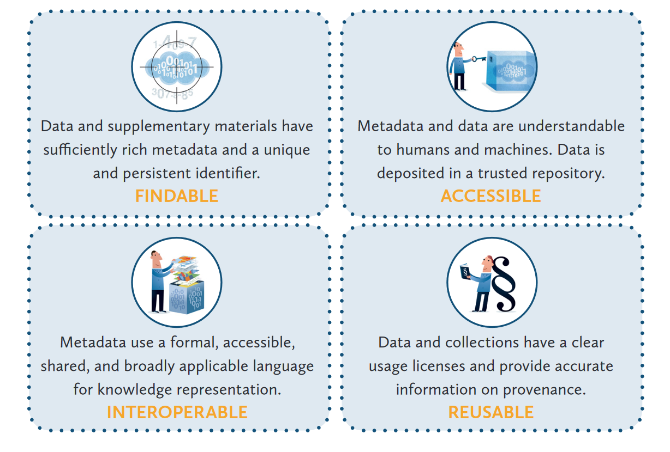
Collecting data with sharing in mind
Reproducible Research using FAIR Data
LIBER Implementing FAIR Data Principles: https://libereurope.eu/wp-content/uploads/2020/09/LIBER-FAIR-Data.pdf

Slide 24
Choosing a repository: Be specific
NIH strongly encourages subject-specific, open access Data Sharing Repositories as a first choice.
Researchers should review the specific guidance to determine designated data repository(ies).
If no repository is specified by NIH,
Primary consideration should be given to repositories that are discipline or data-type specific to support effective data discovery and reuse. NIH recommended repositories are provided.
Evaluate repositories on desired characteristics, such metadata, access, security, preservation, etc.
Human subjects data requires additional considerations.
If no appropriate discipline or data-type specific repository is available:
Submit smaller datasets (less than 2 GB) to PubMed Central as supplemental information
Select a generalist repository (Dryad, Figshare, OSF, etc)
Use Dartmouth Dataverse, our institutional repository
The use of Unique Persistent Identifiers (PID) is encouraged, and their use is a desirable characteristic of data repositories

Slide 25
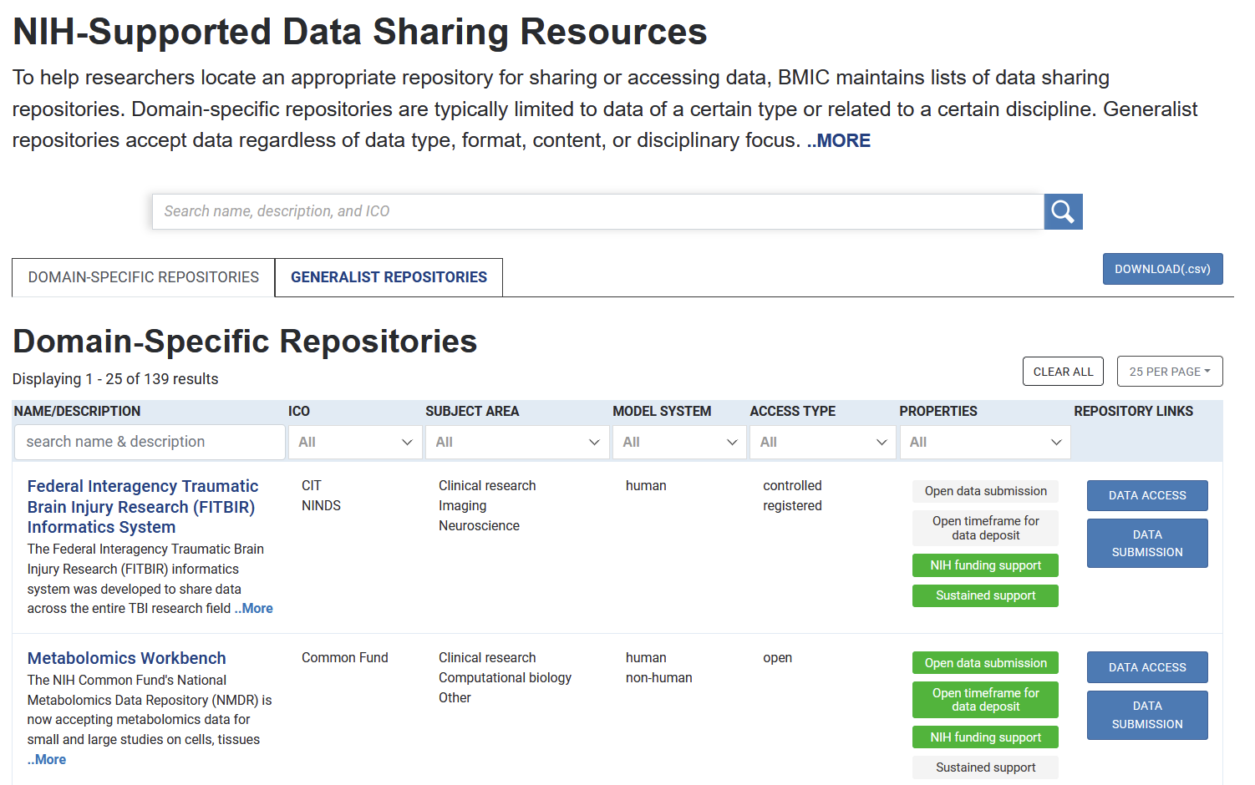

Slide 26
Writing your DSM Plan
Write
DMPTool.org for templates and guidance
Draft Data Management and Sharing Plan Template
NIH Sample Data Management Plans available
Review
Data Management and Sharing Plan Checklist
Contact: ResearchDataHelp@groups.dartmouth.edu

Slide 27
https://dmptool.org/

Slide 28
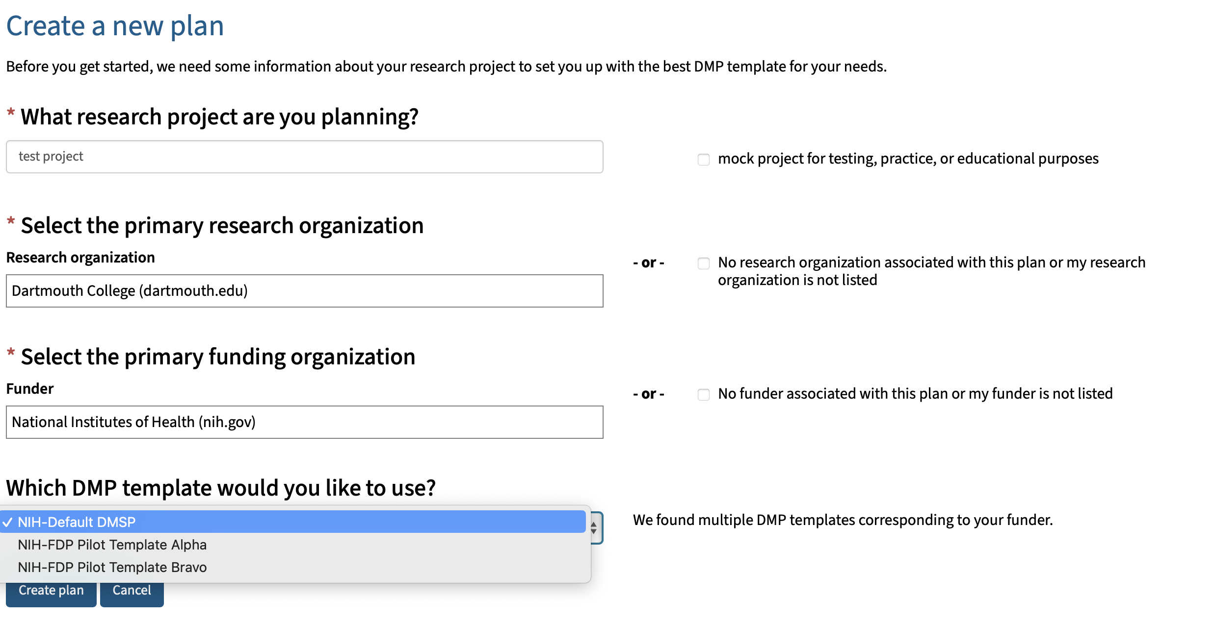
https://dmptool.org/plans/new
Type NIH here
Choose NIH-Default

Slide 29
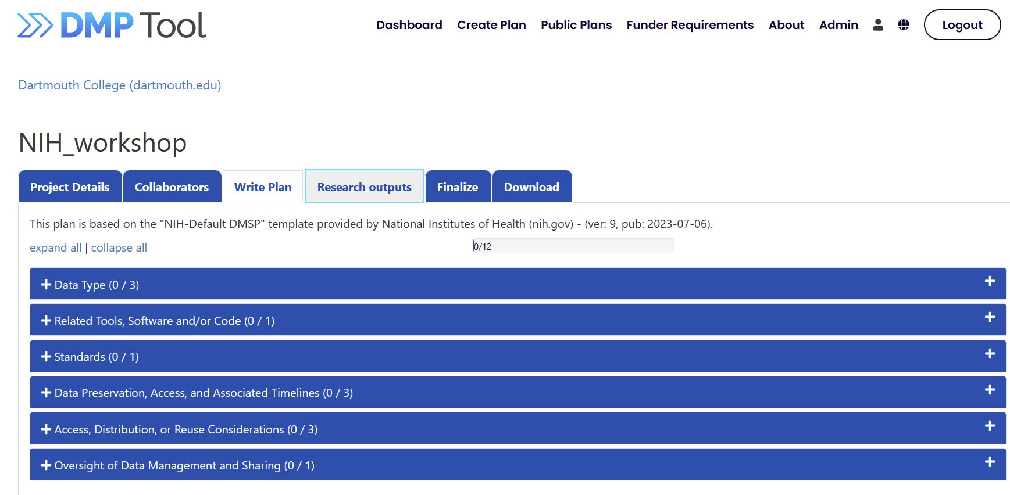
Write your plan

Slide 30
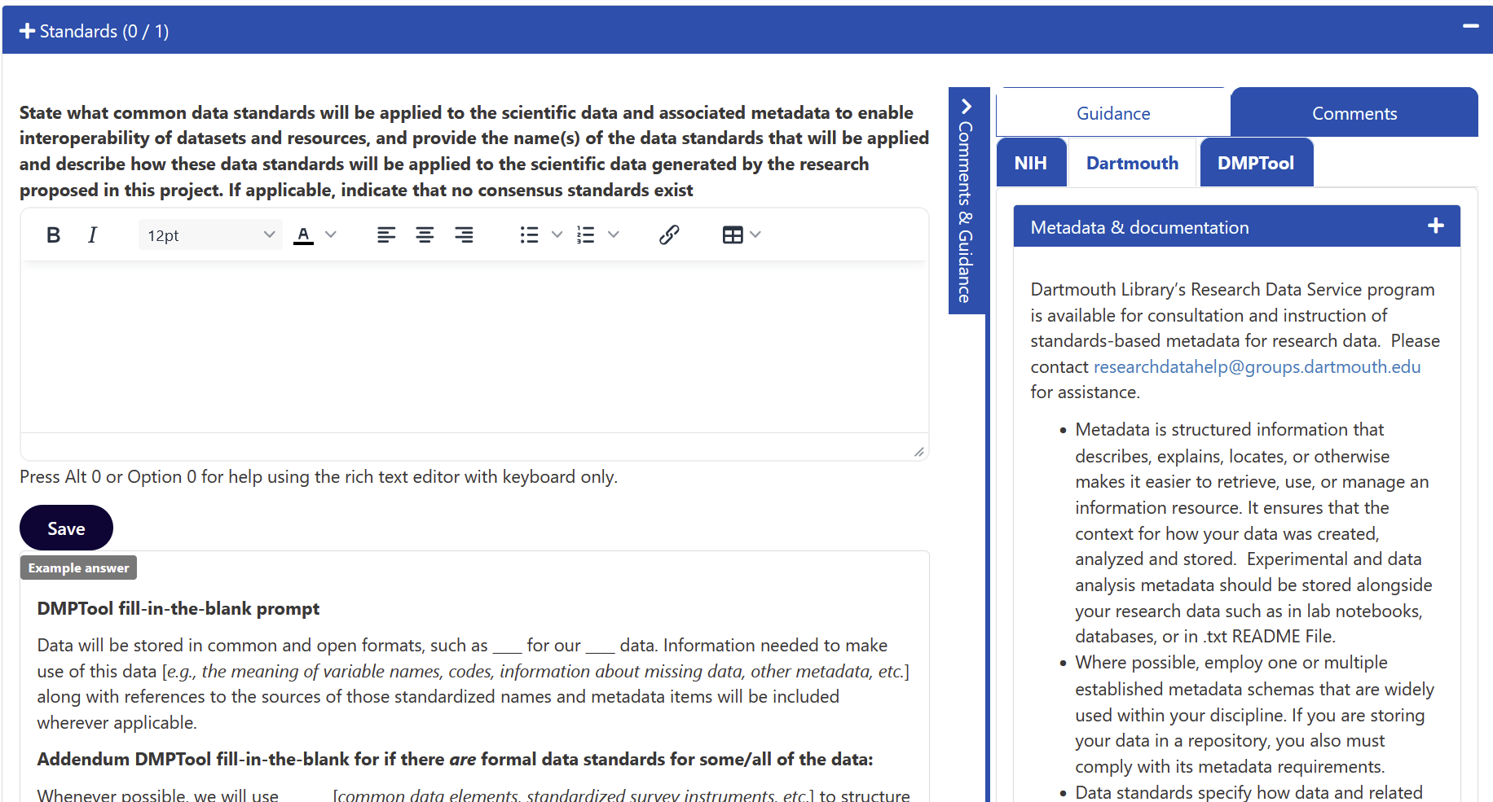
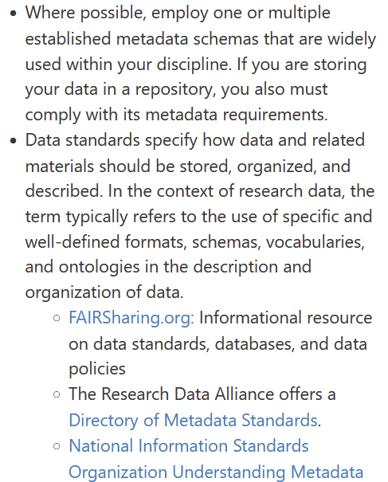

Slide 31
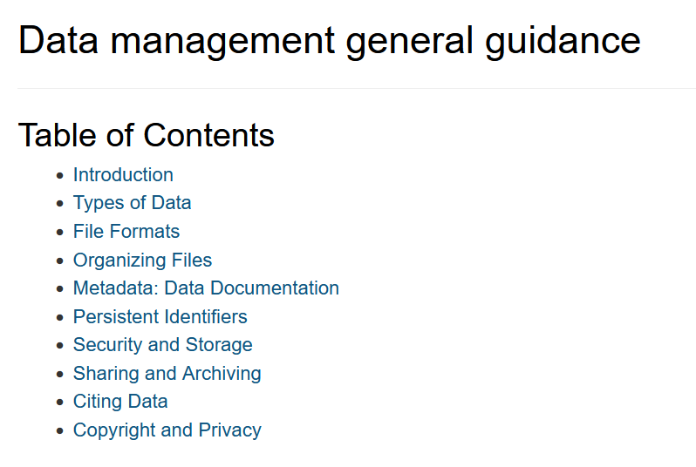
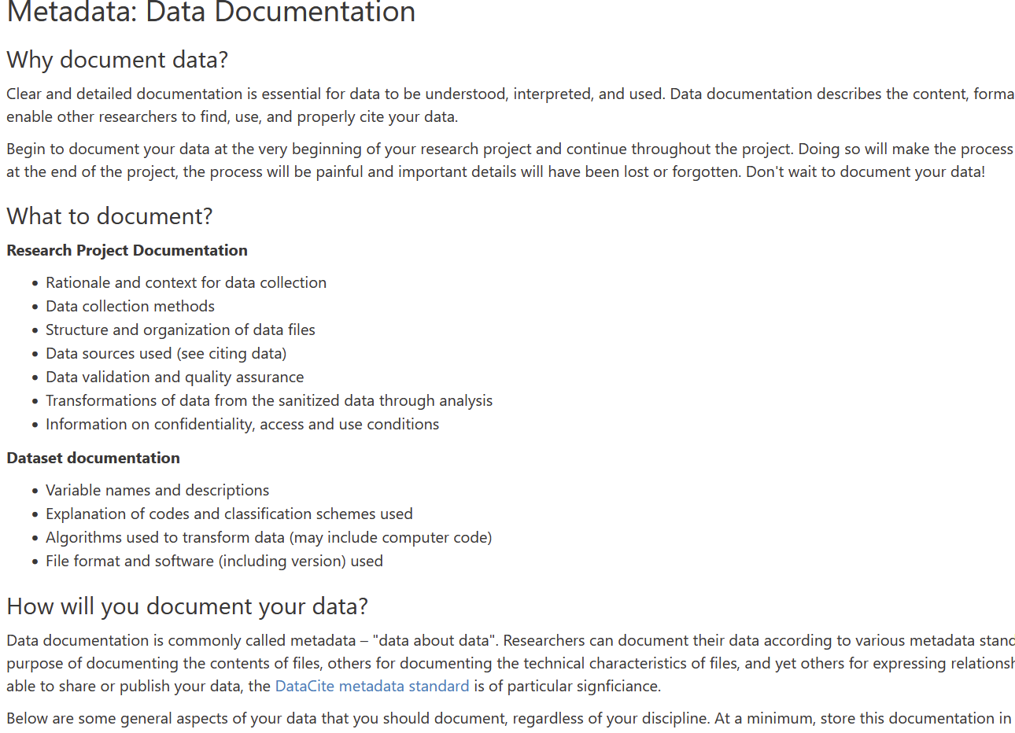
https://dmptool.org/general_guidance

Slide 32
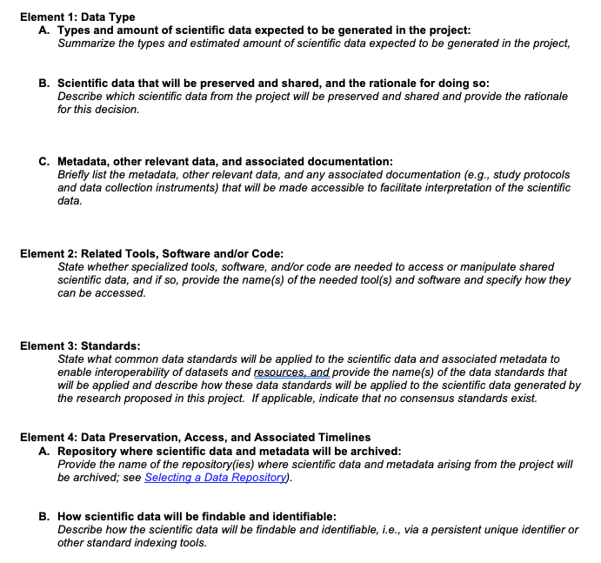
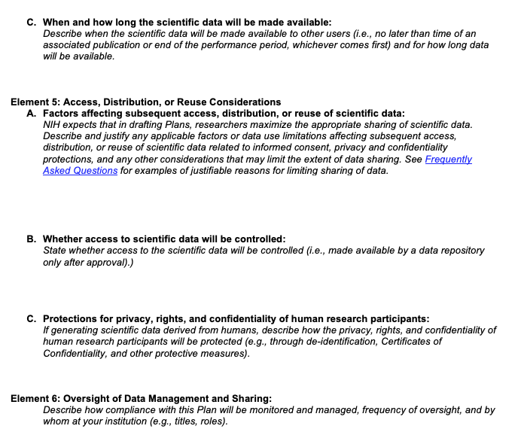
Templates: NIH

Slide 33
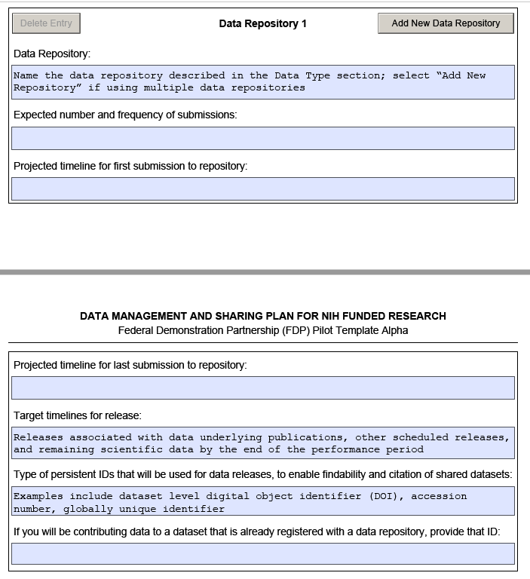
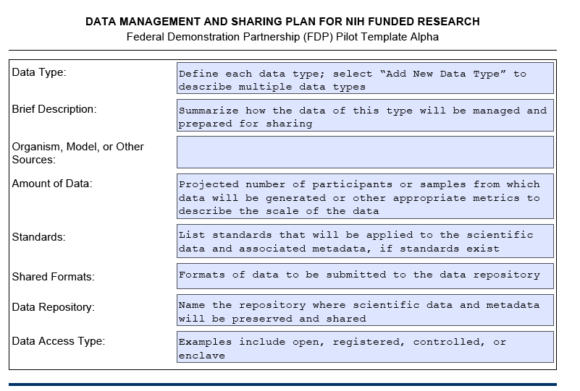
FDP Alpha

Slide 34
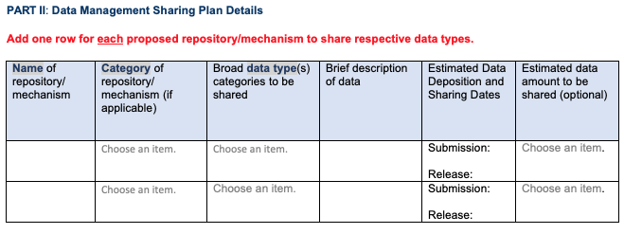
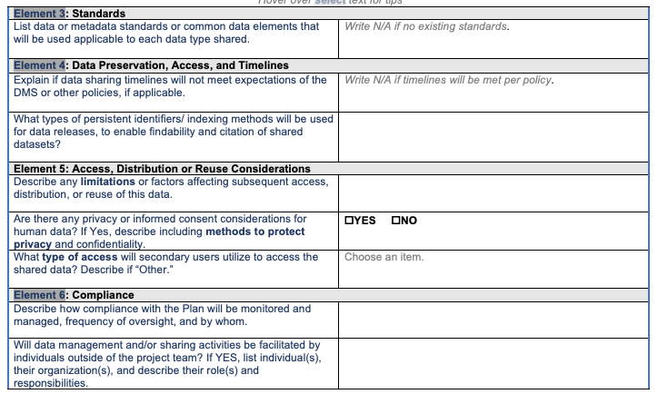
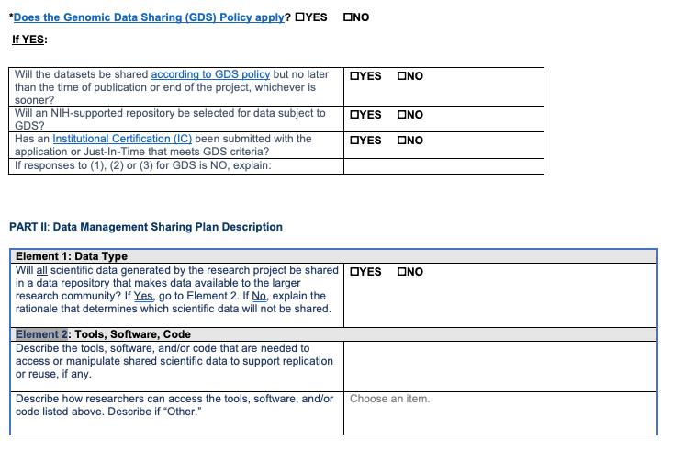
FDP Bravo

Slide 35
Reoccurring Issues identified by NIH
Not clear of what is generated vs. shared. Both need to be described
Species/source, formats shared, amount, metadata
Using a table is recommended
Incomplete information for Genomic Data Sharing
Not listing an established repository or not listed which data goes into what repositories listed. Using generalist repositories when specific ones exist
Confusion of local data storage vs. repository
Sharing “by request” or with PI-control. Use a repository that has an established control processes when needed
DMS budget justifications are missing or not clear, no explicit support for DMS plan activities like personnel effort for preparing submissions.
No costs budgeted for DMS

Slide 36
Other considerations and reminders
Be clear about which data, when, where, and how
Justify anything that deviates from Policy expectations and guidance (Why it’s not possible or reasonable to share)
Check for Funding Announcement and NIH Institute specific instructions!!!
URLs and Hyperlinks are NOT allowed in the plan
List Specific repositories, you may have more than one
Investigators will have the opportunity to work with NIH during the JIT process to address any changes or additional information required.

Slide 37
Questions? Your feedback is important to us: Dartgo.org/feedback
Notes:
For Dartmouth College researchers, please contact the Office of Sponsored Projects
For Dartmouth Hitchcock researchers, please contact awards@Hitchcock.org

