Slide 1
OSP
Abby Fellows
sponsored.projects@dartmouth.edu
Dartmouth Library Research Data Services
Lora Leligdon
ResearchDataHelp@groups.dartmouth.edu
Research Computing @ ITC
Elijah Gagne
Research.Computing@dartmouth.edu
Upcoming events:
dartgo.org/RRADworkshops

Slide 2
NIH DMS Plans and Practices
NIH DMS Policy introduction
Overview of the Elements of DMS
Highlights of a couple of important sections (data repositories, budget, compliance, etc.)
DMPTool
Writing and reviewing plans
RDM guidance
Institutional resources
OSP
Library
Research Computing
Notes:
Lora: may be good to put in the introduction motivation from NIH for implementing this

Slide 3
Scope: Proposals submitted on or after Jan 25th 2023
Applies to all research, funded or conducted in whole or in part by NIH, that results in the generation of “scientific data”
Included:
Research Projects (Rs)
Certain Career Development Awards (Ks)
Small Business SBIR/STTR
Research Centers
Not included:
Training grants (T’s)
Fellowships (F’s)
Construction (C06)
Conference (R13)
non-Research Career Awards (e.g. KM11)
Scientific data: “the recorded factual material commonly accepted in the scientific community as of sufficient quality to validate and replicate research findings, regardless of whether the data are used to support scholarly publications.”
Findings can include unpublished and/or negative/null results
Notes:
THe new data sharing plan is required for proposal submitted on Jn 25th and later. This applies to all....
Proposals this applies to are
'Scientific data includes any data needed to validate and replicate research findings.
Scientific data does not include laboratory notebooks, preliminary analyses, completed case report forms, drafts of scientific papers, plans for future research, peer reviews, communications with colleagues, or physical objects such as laboratory specimens

Slide 4
Why does NIH want data to be shared?
Advance rigorous and reproducible research
Promote public trust in research
Allows for validation of research results
Makes datasets accessible
Accelerates future directions
Opportunities for increased collaboration
Increases transparency and accountability
Demonstrates stewardship of taxpayer funds
Allows research participants’ contributions to be used in multiple ways
Notes:
Benefit to researcher: Shared data can be cited as products of awards anywhere research products are cited (e.g., bibliography, biosketch, progress report)

Slide 5
Elements of 2023 NIH Data Management and Sharing Plan
Data type
Describe data collected, data to be shared, rational for sharing, and data documentation
Related tools, software, code
Tools and software needed to access and manipulate data
Standards
Standards to be applied to scientific data and metadata
Data preservation, access, timelines
Repository to be used, persistent unique identifiers, and when/ how long data will be available
Access, distribution, reuse considerations
Description of factors for data access, distribution, or reuse
Oversight of data management
Plan compliance will be monitored/ managed and by whom
Notes:
There are 6 element that need to be addressed in your plan
Data Type
Summarize the types and amount of scientific data generated in the project
Describe what scientific data from the project will be preserved and shared and why
list the metadata, other relevant data, and any associated documentation
Related Tools, Software and/or Code
Do you need specialized tools to access or manipulate the data? Name the tools and how they can be accessed
standards:
State what common data standards will be applied to data and metadata to enable interoperability of datasets and resources
Data Preservation, Access, and Associated Timelines
Provide name of specific repositories
persistent unique identifier or other standard indexing tools. List when you will make the data available and how long?
Access, Distribution, and Reuse Considerations
NIH expects that in drafting Plans, researchers maximize the appropriate sharing of scientific data. Describe and justify any applicable factors or data use limitations.
State if access to data will be controlled
If human subject data, describe how will the privacy, rights, and confidentiality of human research participants will be protected?
Oversight of data management
Describe how activities outlined in your plan will be delegated, who will be responsible for overseeing and monitoring the study, and the frequency of monitoring
There is significant variation between NIH Institute/Center specific requirements. It is critical to understand the requirements of your individual IC before you start writing your plan.
Because this document is specific to your data and research, not Dartmouth policy, boilerplate institutional language will not fulfill NIH requirements. There are templates and “fill in the blank” examples and later we will introduce an online tool as an option to help write your plan.

Slide 6
Limitations on sharing
NIH expects that researchers will maximize scientific data sharing. Certain factors (i.e., ethical, legal, or technical) may necessitate limiting sharing to some extent.
The DMS plan should describe what data will and will not be shared and why.
Ethical, legal, and technical factors for limiting sharing of data include:
Informed consent will not permit or limits scope of sharing or use
Privacy or safety of research participants would be compromised and available protections insufficient
Explicit federal, state, local, or Tribal law, regulation, or policy prohibits disclosure
Restrictions imposed by existing or anticipated agreements with other parties
Datasets cannot practically be digitized with reasonable efforts
Additional considerations:
NIH respects Tribal sovereignty and supports responsible management/sharing of American Indian / Alaska Native participant data
SBIR/STTR Program Policy Directive permits withholding data for 20 years, as stipulated in agreements and consistent with program goals
Notes:
NIH does not expect you to share all your data, but if there is data you are not sharing, you need to provide justification
Policy does not change any of the federal regulations or compliance. The intent is not to have your research scooped, not erode patent protection, the goal is to make all data available that is ethical and legal to share.

Slide 7
When should I share my data?
As soon as possible!
At time of publication:
Data must be shared no later than the article is available in electronic format or print.
PMC can be proposed as part of the plan contingent on NIH approval
Release of pre-print does not trigger the NIH data sharing requirement
At the end of the performance period:
Data not shared through publications must be shared at the end of the performance period unless the grant enters a no-cost extension or is renewed.
NIH expects sharing of null and negative results.
When applying for a renewal, sharing data from the previous performance period should be addressed.

Slide 8
Budget
Budget is entered as a single line item for DMS Plan costs. These costs are separate from existing budget components and are separate from personnel effort.
Allowable Costs:
Curating data/developing supporting documentation
Formatting data for sharing
De-identifying data
Preserving/sharing data through repositories
Local data management considerations
Data repository fees
Unallowable Costs:
Infrastructure costs typically included in indirect costs
Costs associated with the routine conduct of research (e.g., costs of gaining access to research data)
IMPORTANT: Costs Must be incurred during the performance period
Notes:
NIH knows this is new and will continue to fine tune the process in the coming year. This is the area where the guidance is the least clear. We encourage you to budget something.
We are continuing to attend seminars and will provide further guidance as it becomes available.

Slide 9
Budget considerations
Determine repository costs
Repository specific
May include data deposit and/or long term storage fees
Range from free to $1000s
Based on dataset size, security/permissions, curation levels
Preparing data, metadata, de-identification, etc.
External service
Member of the project team
Resources to help with costs to consider:
OpenAIRE Estimating Costs RDM Tool (this is in Euros and needs conversion to USD)
NIMH Data Archive (NDA)’s budgeting guide and NDA Data Submission Cost Estimation Tool
Notes:
Are there repository specific costs?
Do they charge for data curation?
Large datasets may have transfer costs
are there specific security requirements you have to pay for?
For data specific costs, consider if this will involve effort of someone on your project team or if you are hiring an outside service.
costs for developing supporting documentation
Formatting data to community or repository standards
Support services or service center?
Deidentifying data
Certification service?
Preparing metadata
There are some resources available to consider costs
OpenAIRE is a European estimation tool that gives some hard examples of costs of data management and sharing
The NIMH has a budgeting guide and data submission cost estimation tool specific to their data archive

Slide 10
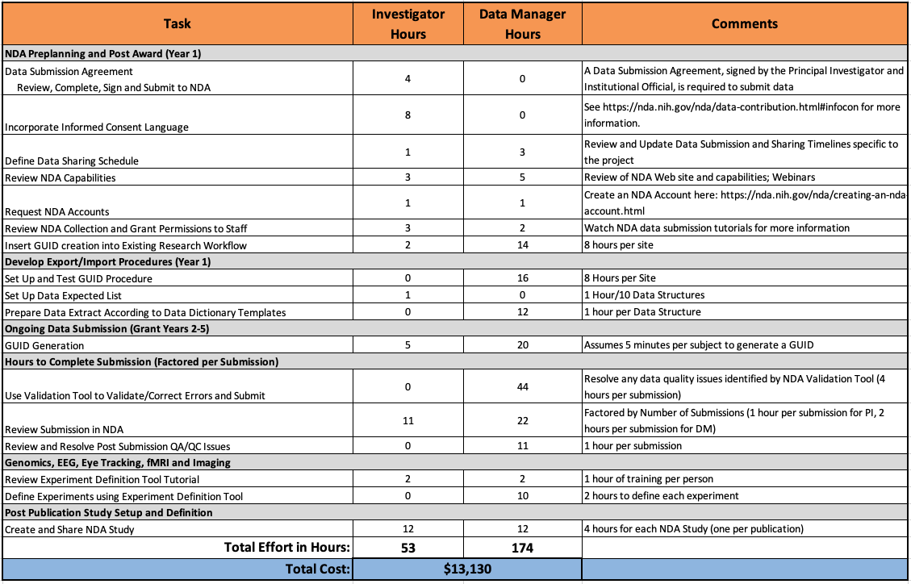
Notes:
NIMH Data Archive (NDA)’s NDA Data Submission Cost Estimation Tool
This is am example available for a template for estimating costs. In a separate part of the spreadsheet not shown, there are cells for entering the equivalent hourly rate of the Investigator and Data manager which the template uses to calculate total cost.
We are not advocating for using this specific template but provide it as an example or framework to think through how to budget these costs.

Slide 11
DMS Plan Budget Justification
Recommended length no more than ½ page
Include summary of type and amount of scientific data to be preserved and shared and the name of the established repository(ies) to be used
Use general cost categories such as curating data and developing supporting documentation, local data management activities, preserving and sharing data through established repositories, etc.
Do not include effort. This is budgeted under cost categories
Include an amount for each category and a brief explanation.
Specify in the justification if no costs will be incurred, if applicable.
Notes:
Peer Reviewers will see this as part of review to comment on appropriateness.

Slide 12
Oversight of Data Management
The primary investigator is responsible for ensuring that the DMS plan is executed.
Establish a regular interval for data review and management.
Provide timeline for frequency of monitoring
Describe how the PI will monitor compliance with the plan including frequency.
List categories of people responsible for implementing the plan (e.g., Post-Doc, Research Scientist, Research Assistant, etc.)
List tasks people are responsible for (e.g., metadata creation, formatting data for sharing, de-identifying data, etc.)
NIH expects compliance will be reported annually in the RPPR

Slide 13
DMS plan review
NIH review at JIT
NIH program staff may request changes
Reporting
Compliance is reported in RPPR
Plan is submitted as a separate document
Peer reviewers will not see plan unless noted in FOA but will consider if budget is reasonable
Review of plan is conducted by NIH
Compliance may affect future funding decisions
Approved plan becomes part of terms and conditions of award
Plan changes?
Work with NIH program officer to review and approve modifications
New NOA will be issued with updated plan
Non-Compliance may lead to award termination

Slide 14
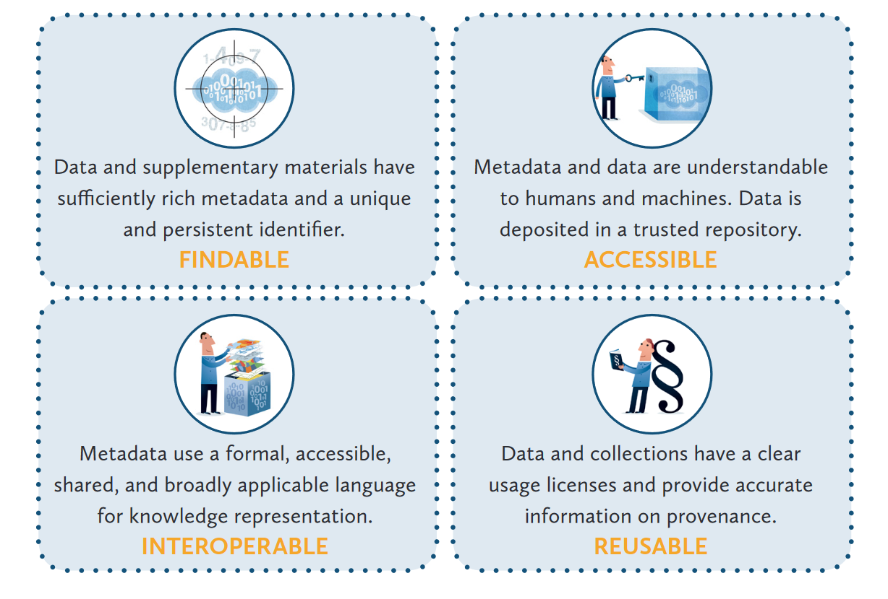
Collecting data with sharing in mind
Reproducible Research using FAIR Data
LIBER Implementing FAIR Data Principles: https://libereurope.eu/wp-content/uploads/2020/09/LIBER-FAIR-Data.pdf

Slide 15
Choosing a repository
NIH strongly encourages subject-specific, open access Data Sharing Repositories as a first choice.
Researchers should review the specific guidance to determine designated data repository(ies).
If no repository is specified by NIH,
Primary consideration should be given to repositories that are discipline or data-type specific to support effective data discovery and reuse. NIH recommended repositories are provided.
Evaluate repositories on desired characteristics, such metadata, access, security, preservation, etc.
Human subjects data requires additional considerations.
If no appropriate discipline or data-type specific repository is available:
Submit smaller datasets (less than 2 GB) to PubMed Central as supplemental information
Select a generalist repository (Dryad, Figshare, OSF, etc)
Use Dartmouth Dataverse, our institutional repository
The use of Unique Persistent Identifiers (PID) is encouraged, and their use is a desirable characteristic of data repositories

Slide 16
Writing your DSM Plan
Write
DMPTool.org for templates and guidance
Draft Data Management and Sharing Plan Template
NIH Sample Data Management Plans available
Review
Data Management and Sharing Plan Checklist
Contact: ResearchDataHelp@groups.dartmouth.edu

Slide 17
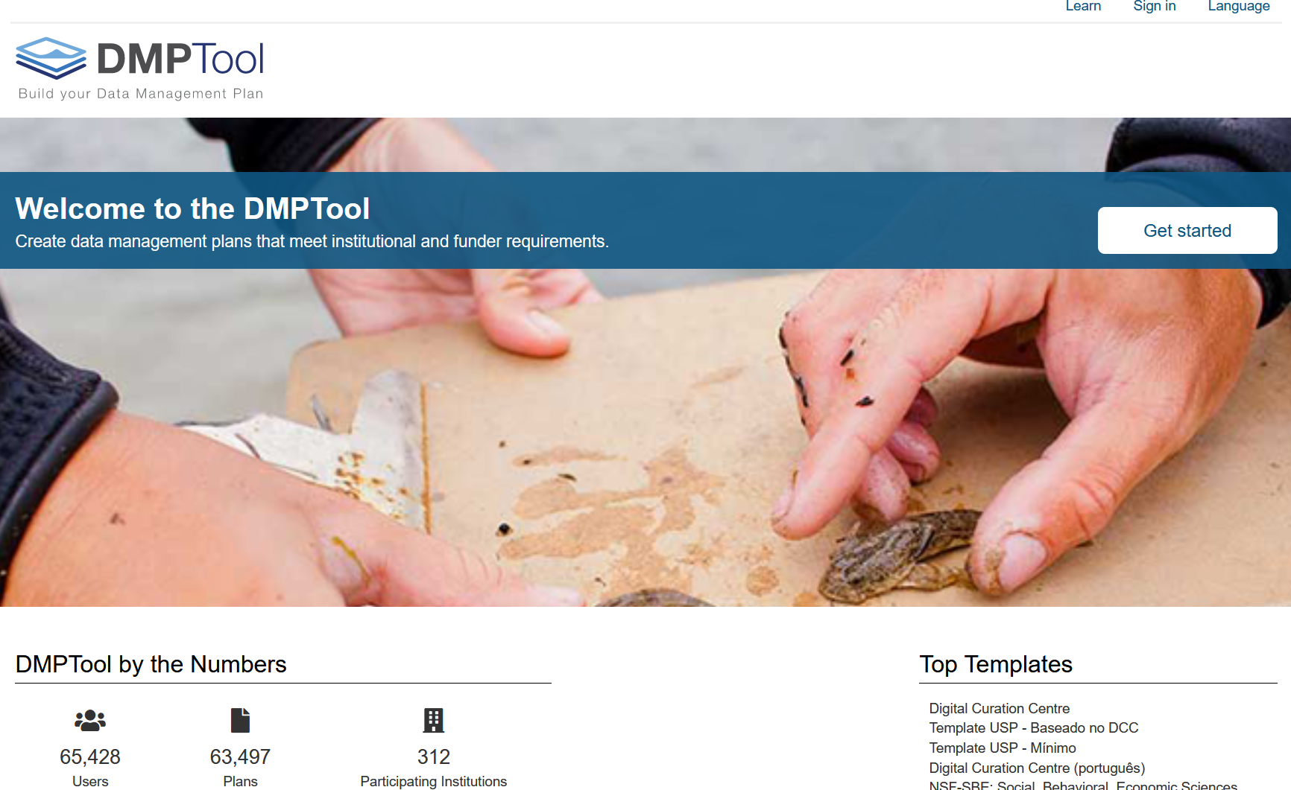
https://dmptool.org/

Slide 18
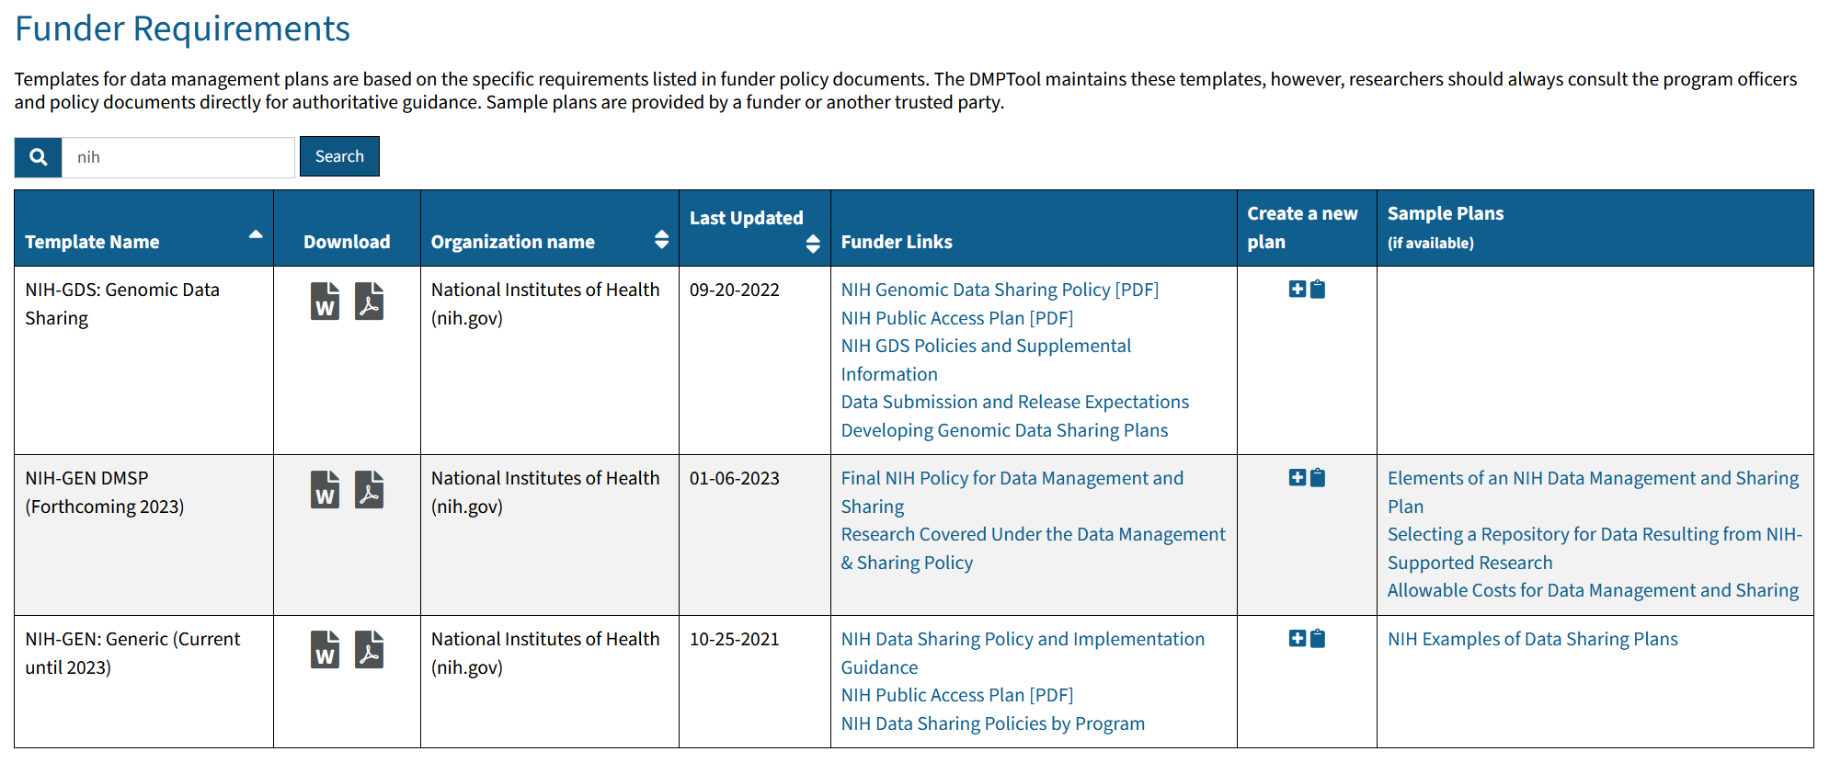
https://dmptool.org/public_templates

Slide 19
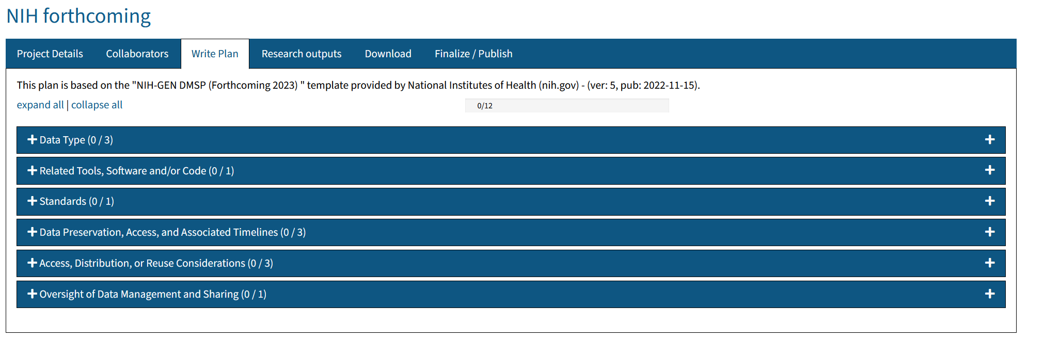
https://dmptool.org/plans/new

Slide 20
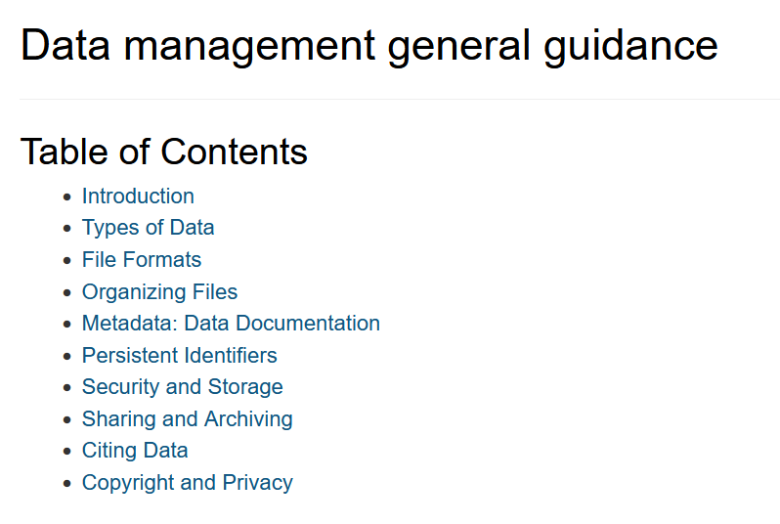
https://dmptool.org/general_guidance

Slide 21
Other considerations and reminders
Check for Funding Announcement and NIH Institute specific instructions!!!
Hyperlinks are NOT allowed in the plan
Although the guidance provides the recommendation that the plan is up to 2 pages, longer plans are allowed
The Genomic Data Sharing Plan is now incorporated in the data sharing plan
This is a new process for all of us including the NIH and the guidance will be evolving
Investigators will have the opportunity to work with NIH during the JIT process to address any changes or additional information required.

Slide 22
Federal Demonstration Partnership (FDP) template Pilot
NIH Institute/Center’s are participating with this pilot and participating in this pilot will give you the opportunity to have a voice in the format going forward
Two templates being trialed
What people are proposing to do and how they are writing it up
Option 1: prescriptive template designed to limit the need for free-text entry:
Option 2: More detailed prompts and provides more option to provide free text
If you are interested, please let OSP know
Notes:
Federal Demonstration Partnership is a longstanding partnership between the federal funding agencies and research institutions that works to reduce the administrative burdens associated with research grants and contracts. They are working with NIH to conduce a pilot study on templates created. One of the outcomes will be to determine which template will reduce the amount of changed required at the just in time phase.
Participation will give institutions and researchers the opportunity to have a voice in creating the format for the document template.

Slide 23
Questions?
Notes:
For Dartmouth College researchers, please contact the Office of Sponsored Projects
For Dartmouth Hitchcock researchers, please contact awards@Hitchcock.org

