Slide 1
Nih FORMS F & COVID REVISIONS
Office of Sponsored Projects
May 20, 2020
Notes:
NOTE:
To change the image on this slide, select the picture and delete it. Then click the Pictures icon in the placeholder to insert your own image.

Slide 2
NIH FORMS F
Purpose: current with OMB Form updates & ‘align data collection with new policies’
Applications due on or before May 24, 2020 will be on current FORMS E
Applications due on or after May 25, 2020 will be on new FORMS F
“Applications prepared using FORMS E packages for due dates on or after May 25, will not be reviewed”
NIH Parent Announcements are being assigned new FOAs
Be mindful that BOTH sets of forms will be active and overlap in availability
NIH Administrative Supplements
Confirm what date your faculty will be submitting
Read the Notice, FOA, and Application Instructions carefully
Determine which FORM set is required
When in doubt, contact your Pre Award Grants Officer

Slide 3
Content of FORMS F Changes
NIH resources include:
- High Level Forms Changes
List of Forms
Specific Changes
- Annotated Form Set
Forms Screen Shots
Instructions per Field

Slide 4
FORMS F HIGHLIGHTS

Slide 5
PHS Human Subjects & Clinical Trial Information
Validation for human specimens and/or data
Default 1.4a to Yes
Inclusion document (WMC) now two uploads – Lifespan; Women & Minorities
Added Title to Enrollment Report
Clinical Trial under FDAAA question added

Slide 7
PHS 398 Cover Page Supplement
Required Question Added

Slide 8
PHS Assignment Request Form
Questions Removed and Added

Slide 9
PHS Fellowship Supplemental Form
New Attachment Added

Slide 10
PHS 398 Career Development Award Supplemental Form
New Attachment Added

Slide 11
NIH COVID Administrative Supplements

Slide 12
What Faculty Need to Know
It starts with the proposed science and how it relates to the parent award
Faculty need to contact the parent award PO
Faculty need to discuss proposed science with NOT/NOSI contact

Slide 13
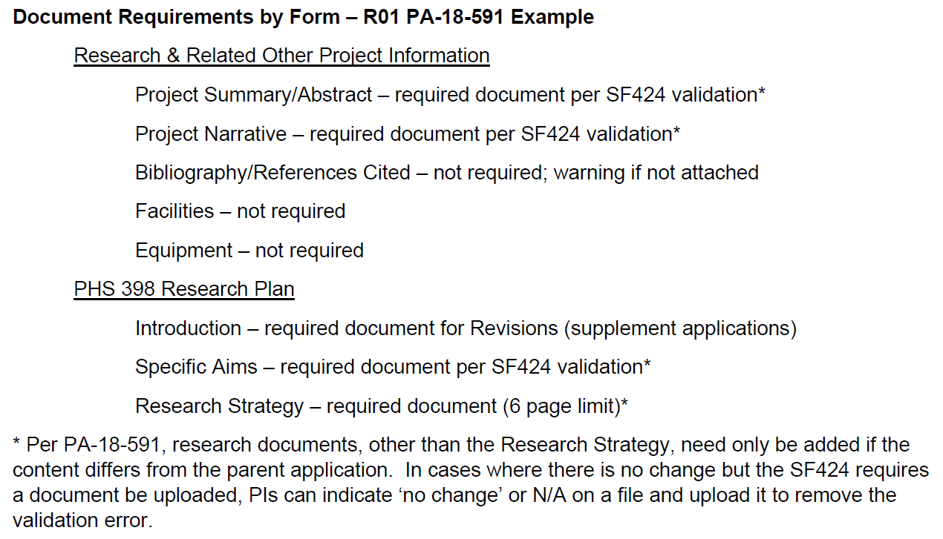
What You Need to Know
NIH Revisions are submitted via Grants.gov (S2S) or email (PHS 398 forms)
System-to-System (S2S) validations for date and required documents requires planning ahead
Project Start Date in the past cannot be submitted
Grants Officer manual update before submission

Slide 14
QUESTIONS
Please do not hesitate to reach out to OSP if you have questions after the Roundtable

