Slide 1
Federal Update
January 21, 2021

Slide 2
NIH
eRA Commons
NSF/ Research.gov
Grants.gov Workspace

Slide 3
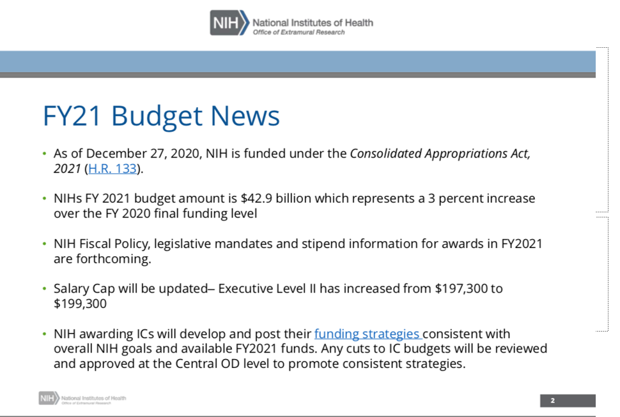
Notes:
Congress has allotted $42.9 billion in funding for the National Institutes of Health (NIH).

Slide 4
NIH Salary Cap
AHRQ has announced under Notice Number NOT-HS-21-007 that effective January 3, 2021, the Executive Level II salary level is $199,300. NIH will also announce this new salary cap.
Please review the guide notices and apply the cap to any new competing proposals.
Please contact OSP if you have any questions.
https://grants.nih.gov/grants/guide/notice-files/NOT-HS-21-007.html

Slide 5
Reminder: NIH Policy on Use of Hypertext in NIH Grant Applications
This notice serves to remind the applicant community about existing guidance that restricts use of hypertext (e.g., hyperlinks and URLs) in NIH applications.
There is no change in the NIH policy on the use of hyperlinks. As a reminder, that policy as articulated in the NIH SF424 (R&R) Application Guide reads:
  Hyperlinks and URLs are only allowed when specifically noted in funding opportunity announcement (FOA) and form field instructions. The use of hyperlinks is typically limited to citing relevant publications in biosketches and publication lists. It is highly unusual for a FOA to allow links in Specific Aims, Research Strategy and other page-limited attachments.
  When allowed, you must hyperlink the actual URL text so it appears on the page rather than hiding the URL behind a specific word or phrase.
  Example: NIH (http://www.nih.gov/)
  https://grants.nih.gov/grants/guide/notice-files/NOT-OD-20-174.html
Notes:
Do include hyperlinks when explicitly requested in application guide, funding opportunity, or NIH Guide notice instructions
Do use hyperlinks in relevant citations and publications included in biosketches and publication list attachments
Don’t use hyperlinks anywhere else in your application

Slide 6
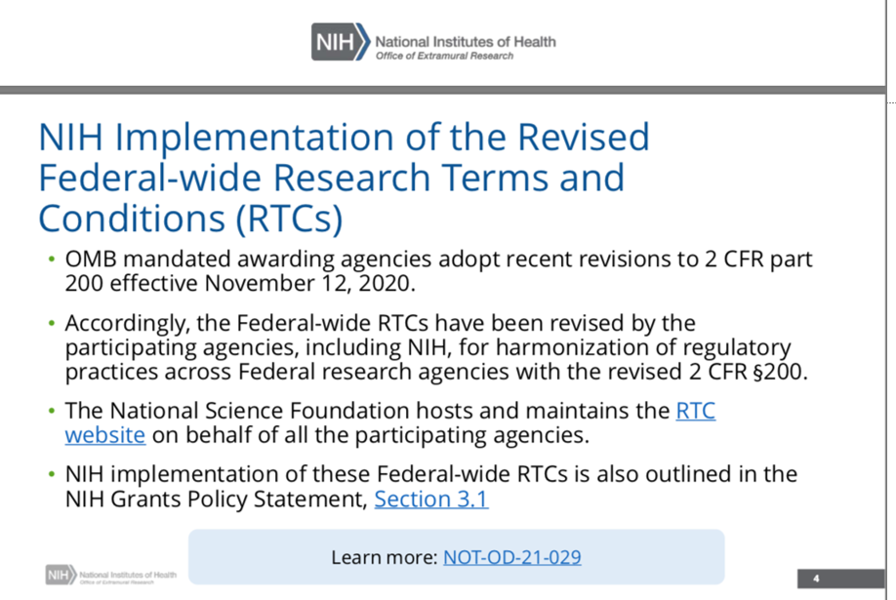
Notes:
The RTCs serve as standard terms and conditions of all NIH awards.

Slide 7
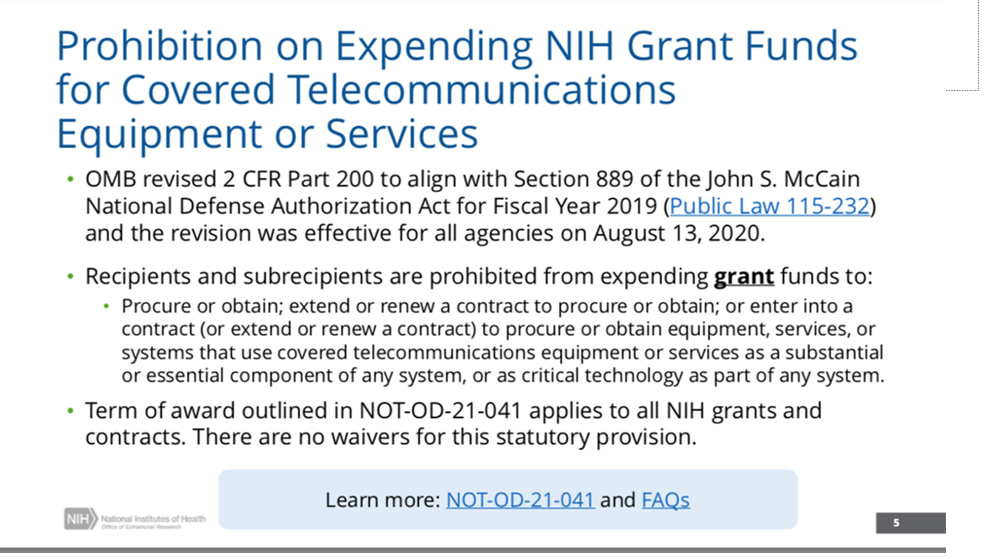

Slide 8
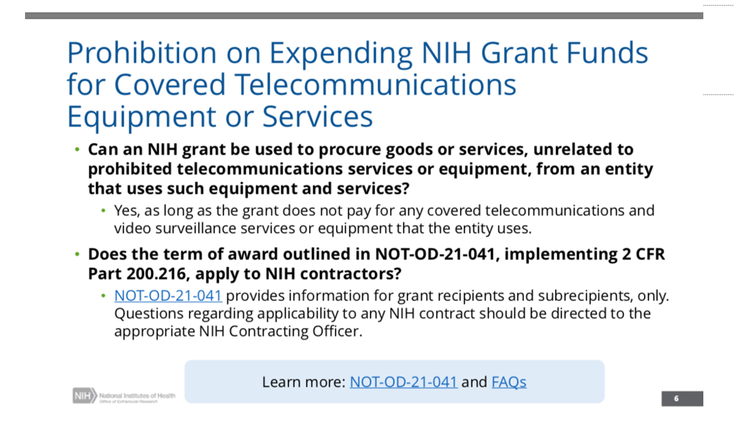

Slide 9
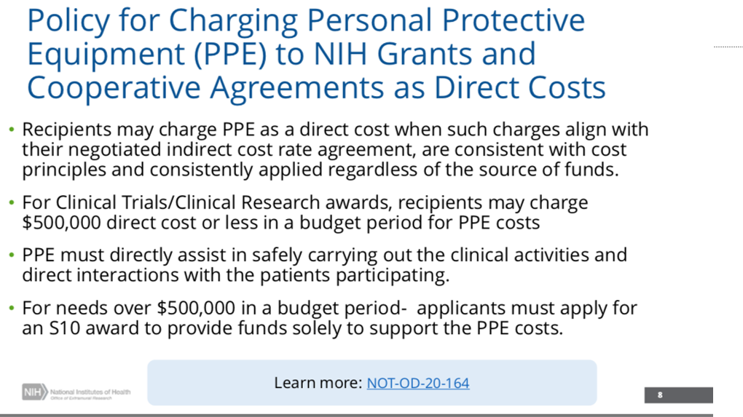

Slide 10
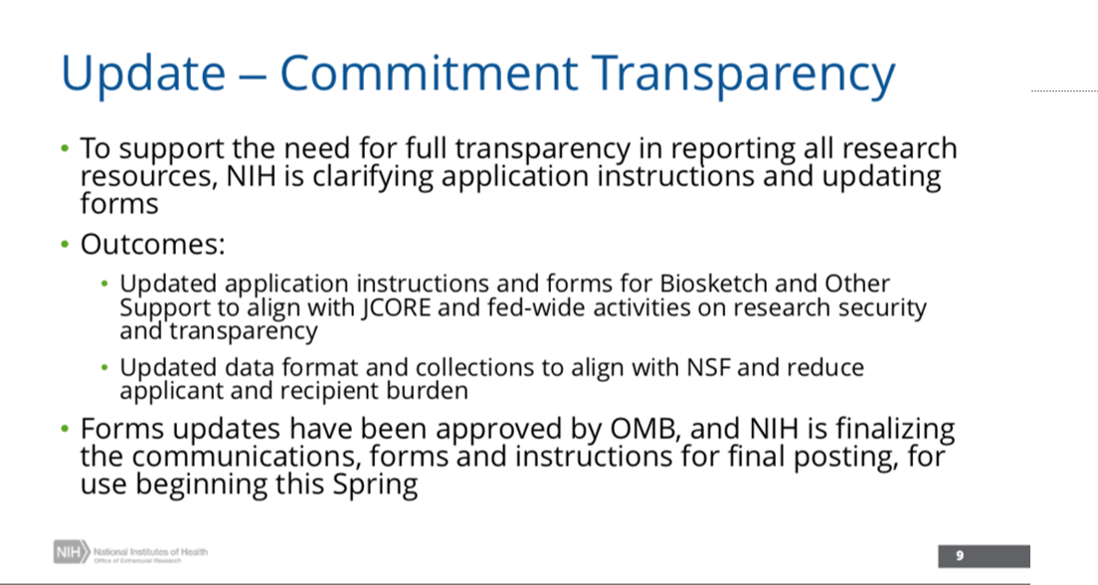

Slide 11
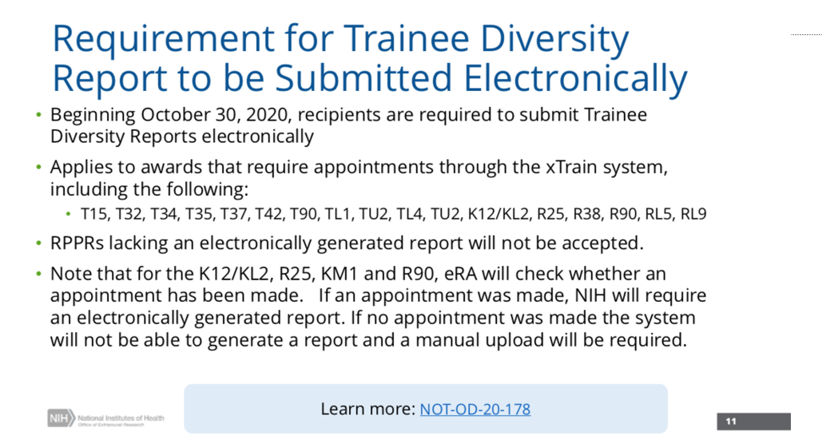
Notes:
Institutional research training, career development and research education awards to submit the Trainee Diversity Report required with Research Performance Progress Reports (RPPRs),
The eRA system will check whether the RPPRs for the specified grant types include an electronically generated Trainee Diversity Report. RPPRs lacking an electronically generated report will not be accepted.

Slide 12
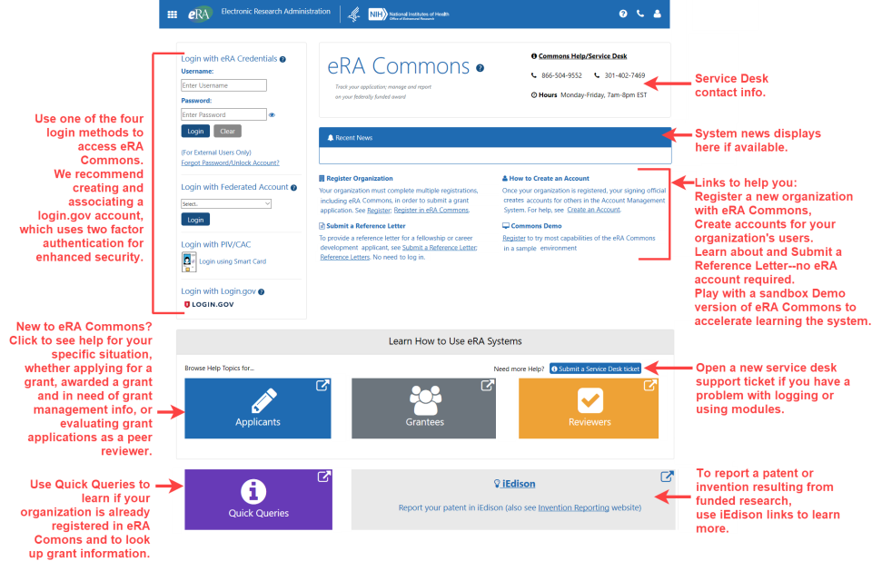
New eRA Commons Home Page & Landing Screen

Slide 13
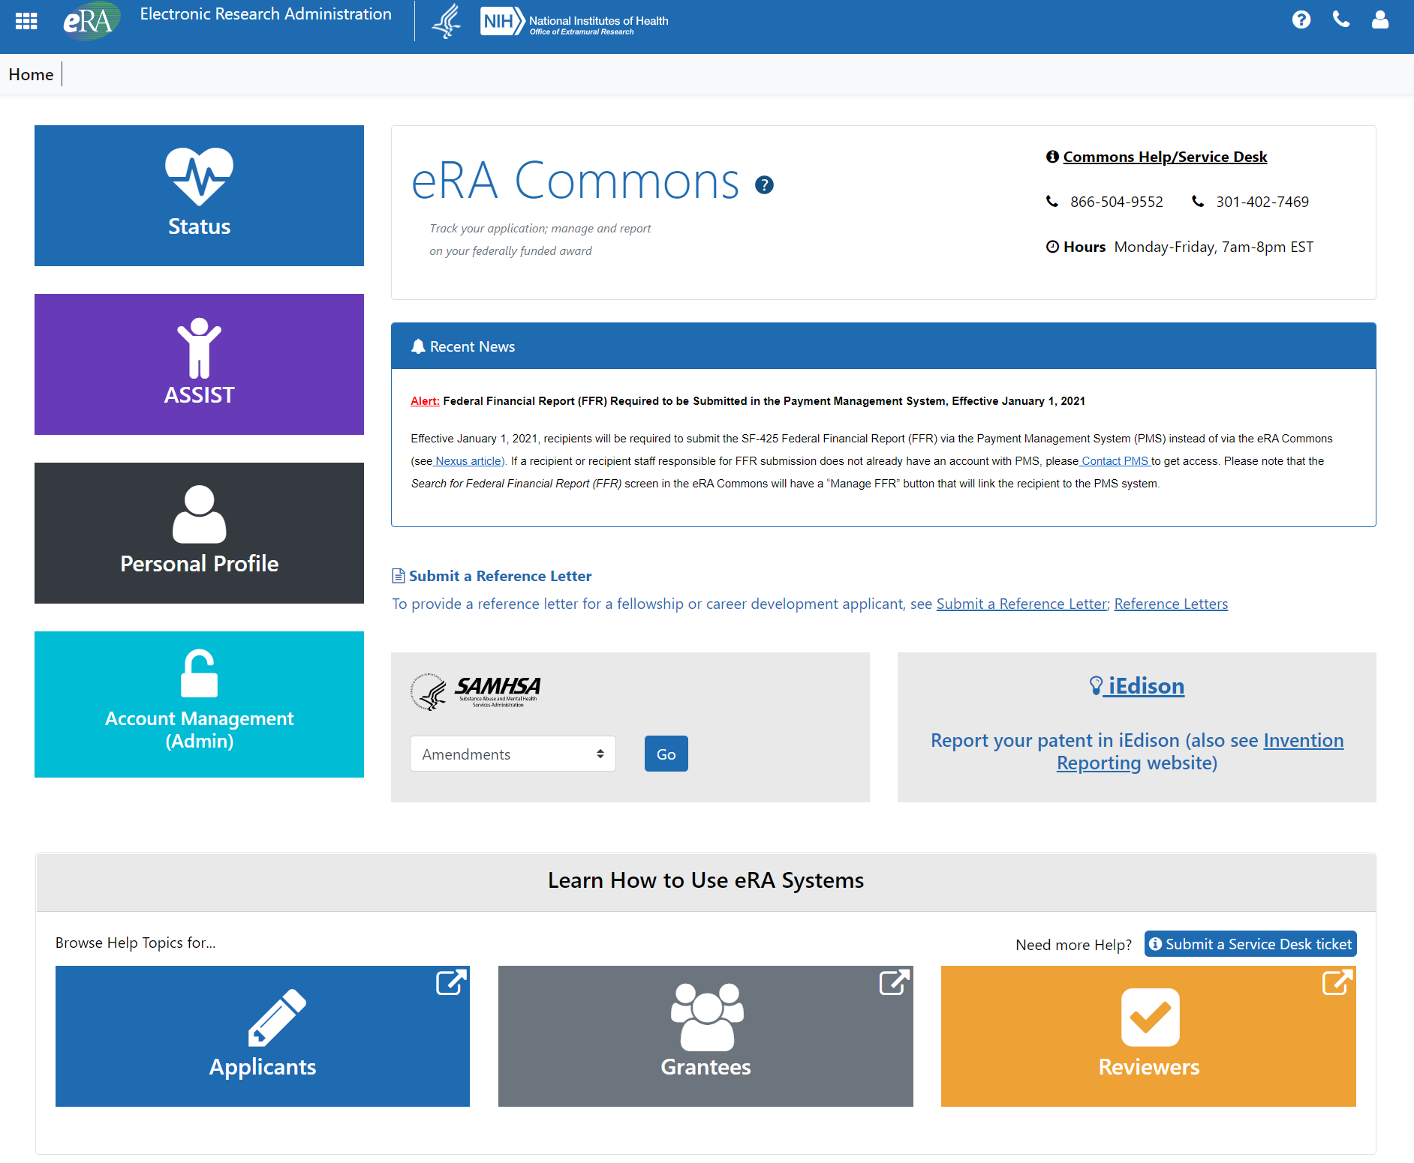

Slide 14
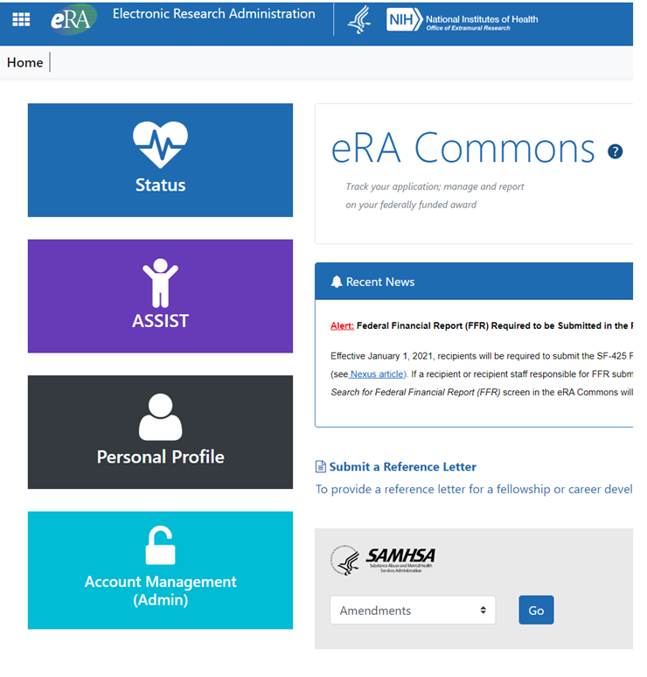
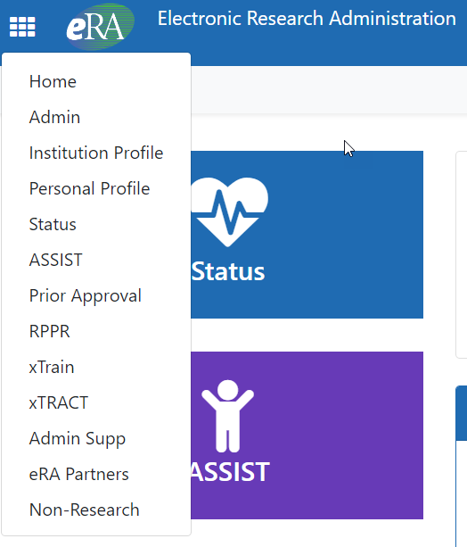
Click the colored tiles to access commonly used modules OR click on the Apps menu to navigate to any module in eRA Commons

Slide 15
JIT* New Real-time Validations
There are now real time validations for both the Institutional Review Board (IRB) date and the Institutional Animal Care and Use Committee (IACUC) date.
  • The IRB Approval Date has a range of the current date going back one year.
    • The IACUC Approval Date has a range of the current date going back three years.
Should a date be entered outside that range, an error message will be displayed when the JIT is saved

Slide 16
Two-Factor Authentication
eRA is moving to two-factor authentication via login.gov. This new log-in method will be required in 2021 for users of eRA Commons, Commons Mobile, IAR and ASSIST.
eRA is first phasing in the requirement for reviewers using IAR. Starting December 14, 2020, the new requirement will be phased in for reviewers, meeting by meeting, effective for review meetings February 1, 2021 and beyond. As reviewers are enabled for meetings, their accounts will be transitioned to require login.gov to access IAR.
Other users are encouraged to make the switch now before the mandatory deadline of Sept. 15, 2021.
https://era.nih.gov/register-accounts/access-era-modules-via-login-gov.htm

Slide 17
Resources:
Guide Notice NOT-OD-21-028
Demonstration Video: New eRA Commons Login and Landing Screens
Note: If users experience an issue with an eRA module after a release, they should completely clear out their browser cache, which will generally resolve the issue. If not, please contact the eRA Service Desk.

Slide 18
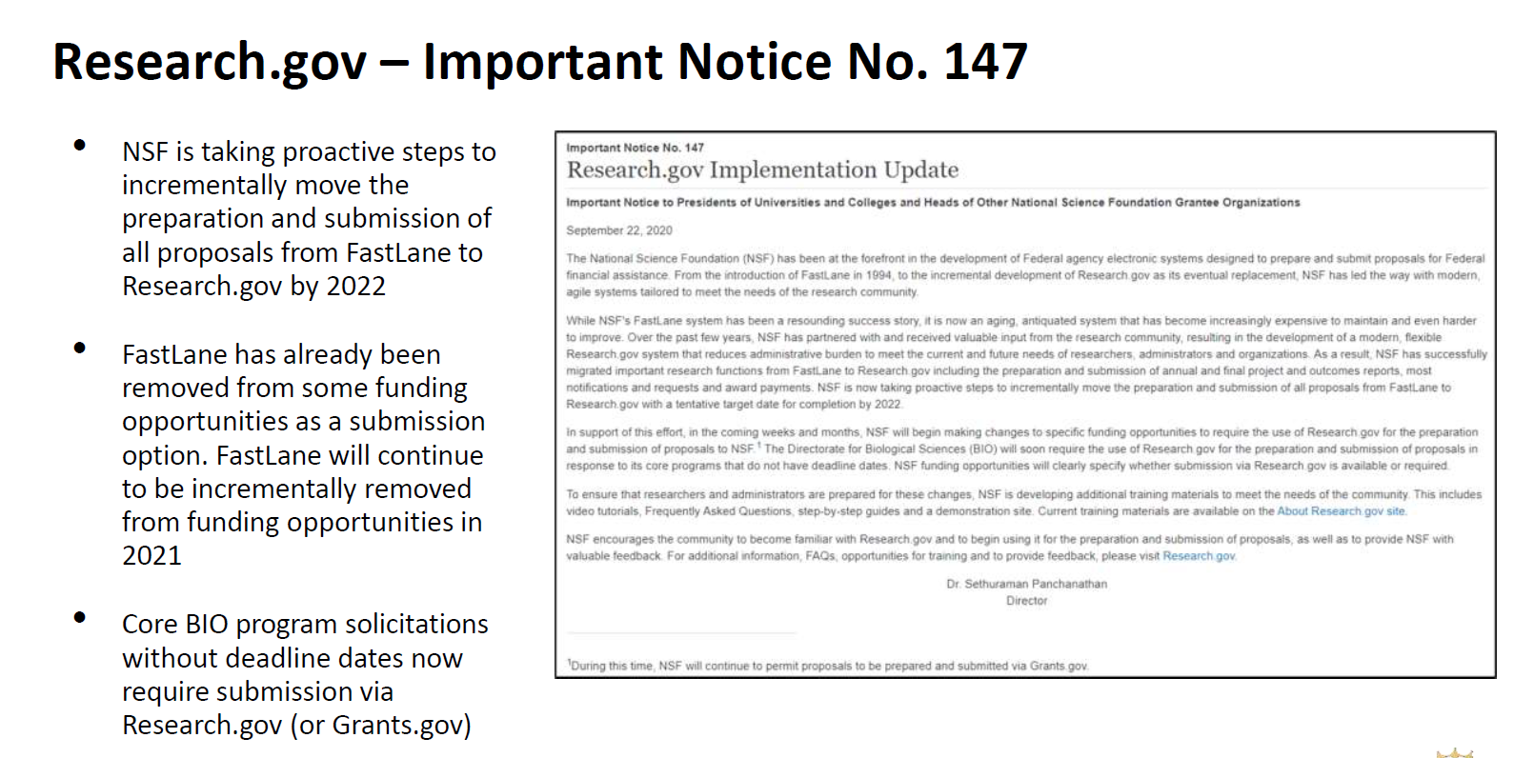
NSF Updates

Slide 19
NSF Updates
RAPID, EAGER, and RAISE Proposals
Proposers can now select a RAPID, EAGER, or RAISE proposal in the Research.gov proposal creation wizard, in addition to the existing Research proposal option. These proposal types are also available in the Research.gov proposal preparation demo site.
New automated compliance checks for RAPID, EAGER, and RAISE proposals have been added to Research.gov and are listed on the updated Research.gov Compliance Checklist dated November 23, 2020 on the Automated Compliance Checking of NSF Proposals page.
NOTE:
Current FOA’s may not be updated to show that Research.gov is now available.
If your PI is interested in using Research.gov, please reach out to your Grants Officer during this transition to confirm application can be submitted this way as Research.gov is being developed incrementally.

Slide 20
Automated Proposal Compliance Checks for Proposals
Automated Proposal Compliance Checks for Proposals Submitted via FastLane - Effective October 5, 2020
http://www.nsf.gov/bfa/dias/policy/autocheck/compliancechecks_oct2020.pdf
Automated Proposal Compliance Checks for Proposals Submitted via Research.gov - Effective November 23, 2020
http://www.nsf.gov/bfa/dias/policy/autocheck/rgovcompliancechecks_nov2020.pdf

Slide 21
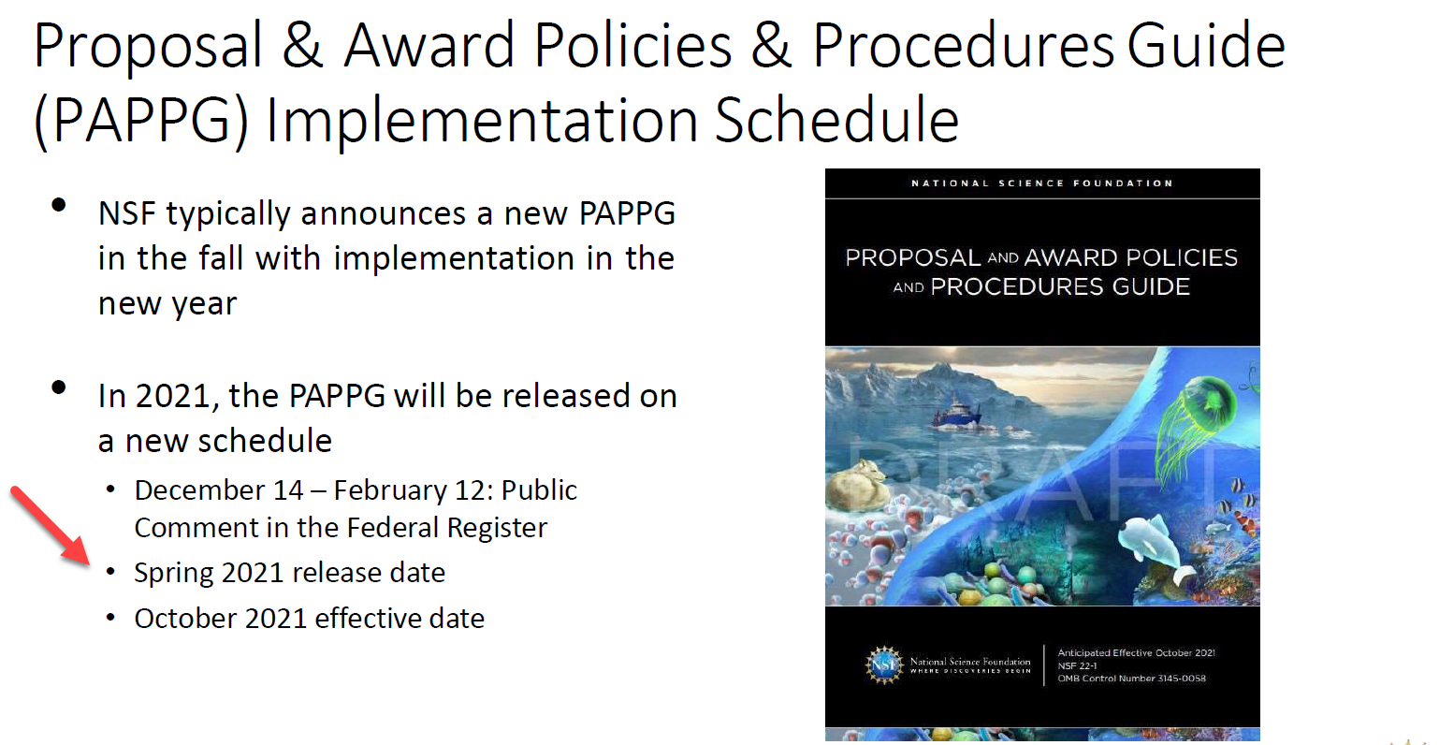

Slide 22
Grants.gov Workspace
Workspace is the standard system for organizations to apply for federal grants directly through grants.gov
A few federal sponsors are now mandating that Workspace must be used for certain applications. In these cases, we cannot submit S2S, even if the grants.gov Opportunity Number passes validation in RAPPORT
Please check the solicitation carefully before initiating proposal in RAPPORT.
Anyone who will be involved in the creation of the application (e.g. PI, DRA) in Workspace will need to register for a grants.gov account:
https://www.grants.gov/web/grants/applicants/registration.html
OSP is planning an overview session to provide guidance on using Workspace. If you have questions in the meantime, please contact your OSP Senior Grants Associate.
Notes:
Rebekah

