Slide 1
Excel Lookup Comparisons
Financial Analyst Forum
May 7, 2021

Slide 2
Agenda
Overview of each method, Pros/Cons
VLOOKUP
HLOOKUP
Index Match
XLOOKUP
Review in Action
Discussion: What do you use most?
Practical uses examples
Next Steps

Slide 3
VLOOKUP (Vertical Lookup)
VLOOKUP(lookup_value, table_array, col_index_num, [range_lookup])
Looks for a value in the leftmost column of a table, and then returns a value in the same row from a column you specify.
Lookup value: Value to be found in first column of table
Table array: Table of where data is retrieved, can be range or range name
Col Index Num: the column number in table_array from which the matching value should be returned. The first column of values in the table is column 1
Range Lookup: A logical value (optional, default to True)
TRUE, 1, or omitted = closest match in first column (ascending order)
FALSE or 0 = Exact match
PROS CONS
Ease of use Left to right only
Awareness/popularity Inserting/moving/deleting may cause issues
Error handling (IFNA, IFERROR)

Slide 4
HLOOKUP (Horizontal Lookup)
HLOOKUP(lookup_value, table_array, row_index_num, [range_lookup])
Looks for a value in the top row of a table or array of values and returns the value in the same column from a row you specify.
Lookup value: Value to be found in top row of table
Table array: Table of where data is retrieved, can be range or range name
Row Index Num: the row number in table_array from which the matching value should be returned. The first row of values in the table is row 1
Range Lookup: A logical value (optional, default to True)
TRUE, 1, or omitted = closest match in first row (ascending order)
FALSE or 0 = Exact match
PROS CONS
Easy to follow similar logic Up to down only
Inserting/moving/deleting may cause issues
Error handling (IFNA, IFERROR)

Slide 5
INDEX MATCH
INDEX(array, row_num, [column num])
Index returns a value of the cell based on a specified row and/or column number.
Array: Where the data is located, can be range or range name
Row num: The row with the value you want returned
Column num: The column with the value you want returned (optional, if row)
MATCH(lookup_value, lookup_array, [match_type])
Match finds a value and returns the position in a row or column.
Lookup_value: Where the data is located, can be range or range name
Lookup_array: Range of cells or an array containing lookup values
Match_type: 0=Exact, 1=Largest, less or equal, -1=Smallest, greater or equal

Slide 6
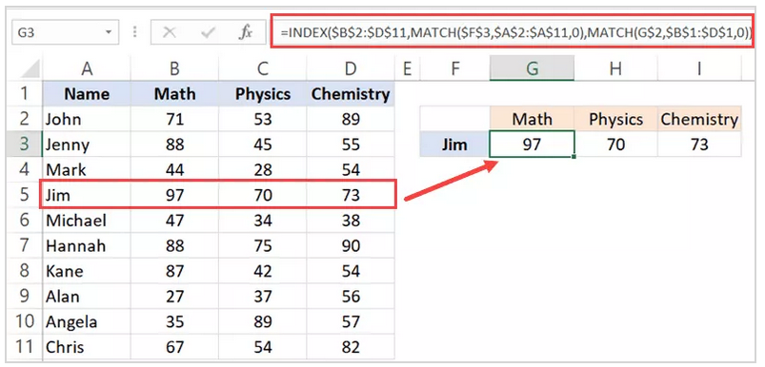
INDEX MATCH
INDEX(array, row_num, MATCH(lookup_value, lookup_array, [match_type])
Combined, the two formulas can look up and return the value of a cell in a table based on vertical and horizontal criteria.
PROS CONS
Return a value to the left of lookup value Less awareness
Handle H & V structured data More “advanced”
Handle row/columns with insert/delete
Faster

Slide 7
XLOOKUP “modern replacement”
XLOOKUP(lookup_value, table_array, return_array, [if_not_found], [match_mode])
Searches a range or array for a match and returns the corresponding item from a second range or array.
Lookup value: Value to search for
Table array: The array or range to search
Return array: The array or range to return
If not found: Value returned if no match is found
Match mode: 0 = exact match (Optional, default)
1 = exact or next larger
-1 = exact or next smaller
2 = wildcard match (*, ?, ~)
PROS CONS
Easy to follow similar logic Newer, not as familiar
Error handling built in
Handle insert/move/deleted columns

Slide 8
Lookup Comparison
GROUP DISCUSSION
Q1: Which method do you use most?
Are there certain applications that one method works better than others?
Q2: What challenges/issues have you faced?
_________________________________________________________________
“Once I read up on index match, I never went back to a lookup.” -Paul Harvey
Additional Resources
Excel Jet, https://exceljet.net/
Corporate Finance Institute, https://corporatefinanceinstitute.com/
Trump Excel, https://trumpexcel.com/
Microsoft Support, https://support.microsoft.com
Other helpful sites?

Slide 9
Next Steps
TODAY
Review excel file for practical uses (as time allows)
WEEKS AHEAD
Try using these new methods with your files
(Less sensitive, non-urgent)
See what works well, what doesn’t
Share findings and observations to FAF Teams chat
NEXT MEETING (Aug/Sept)
Group discussion – who has changed?

