Slide 1
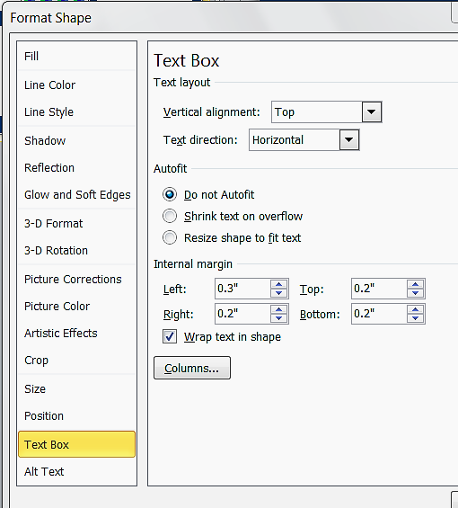
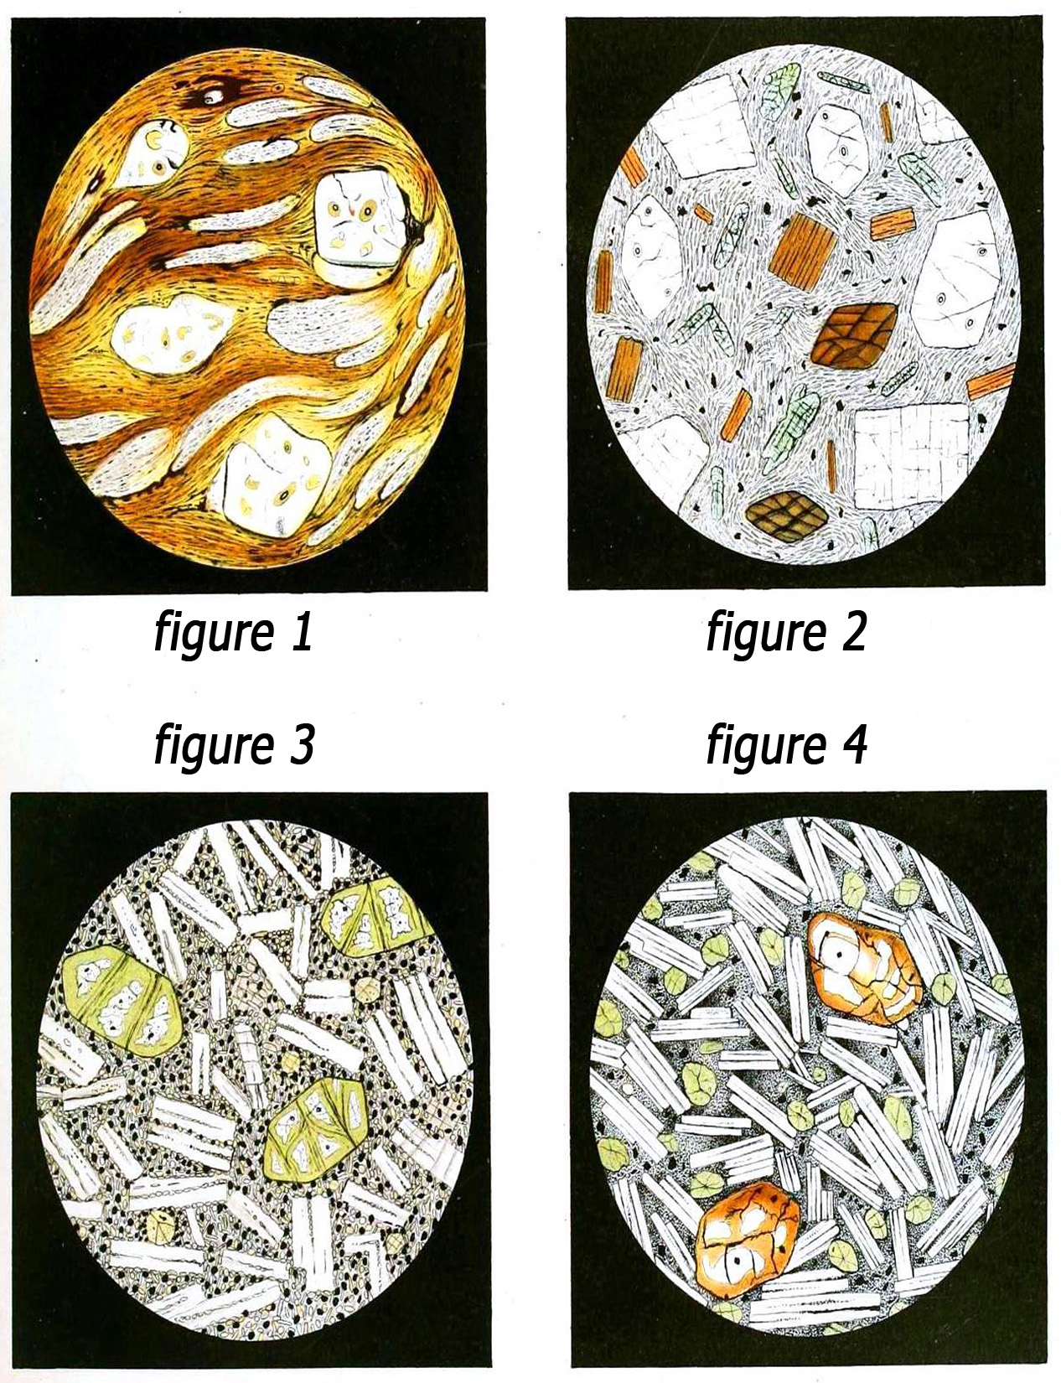
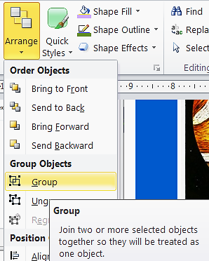
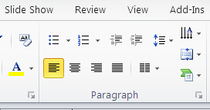
Title of the Research Project Your name, advisors’ name, names of any other collaborators Name of department, Dartmouth College Funding source (you can either put this info here or down towards the bottom in an “acknowledgements” section)
Title. Your title will serve as the main attraction for potential visitors. People will scan titles to identify posters they would like to see in further detail. Make your title not only informative but also easy to read. If your title seems wordy and full of jargon, you will likely turn away potential visitors.
All boxes like this are about content.
Background/Introduction: Your background should provide just enough information for another scientist to be able to understand your poster. Four to eight sentences. Use figures instead of words to communicate ideas whenever possible.
INTRODUCTION
DIAGRAM OR EXAMPLE OF STIMULI
CONCLUSIONS
These boxes are about PowerPoints features and tools.
The content areas of the template are Rectangle Shapes not Text Boxes. Click in each content area to enter text.
Settings: Font; 28 point Times, Margins; 0.2, Alignment; Top left. Change as needed.
Resize each box as needed. Delete boxes as needed. Duplicate a box to add more.
If you use Text Boxes you may have to set their Fill Color if you place them over a colored background, their default is No Fill.
Summary/Conclusion. Briefly re-state the major results of your experiments. Visitors will appreciate seeing all of your major results summarized together. At the end of your summary, you might include one or two sentences about whether your hypothesis was supported or disproved, or whether you sufficiently answered your research question.
Modify charts in Excel or within PPT to eliminate excess detail, axis lines, legend, grids, etc.
Highlight the data that supports the conclusions
Paste Charts as Drawing Objects, Paste text as Unformatted or Using Destination Theme.
Results. Your poster will probably contain four to eight individual results sections. Write a specific, informative title for each section, as opposed to “Result 1,” “Result 2,” etc. Each section may contain several figures that each lead to the same conclusion. To reduce text, write only one or two sentences that state the results of your figures, and let the figures themselves be the most prominent aspect of each results section.
PURPOSE - METHOD
Hypothesis/Question/Purpose/Goal. To highlight your scientific goal, place the question or purpose that drives your science in its own section and not just at the end of your introduction. Ideally, this section will be composed of a single sentence, perhaps accompanied by a diagram.
Methods (optional). A methods section is crucial for a scientific paper, but may not be necessary for a scientific poster. Sometimes a statement on methods can be written immediately following your hypothesis/question (e.g., “To address this question, we…”). For multiple methods refer to each method in the results (e.g., “To determine result X, we used method Y”).
RESULTS
FUTURE DIRECTIONS...
Photographs should be selected or sized to be no less than 100 pixels per inch (ppi). This microphotograph of rock crystals is 1650 pixels high and sized to be 11 inches high so it is displayed at 150 ppi.
Resolutions above 250 ppi don’t usually add any detail but will increase file size. Zoom in to 100% to verify your images are not pixelated.
Figures should be clearly labeled and described.
Powerpoint shapes can be resized and retain sharpness. Grouped objects retain their relative positions when resized or moved.
Shapes do not default to Autofit text like Text Boxes do. Their default vertical alignment is set to the Center, and paragraphs are Centered which you must change in the Text Box settings and in the Paragraph settings. For posters it is also good to adjust the margins.
ACKNOWLEDGEMENTS
References and Acknowledgments. References, acknowledgments, and other details. Try to limit yourself to only three to five key references that are absolutely crucial to the background of your study and/or that visitors might like to consult for further information. Mention specific contributions to the poster, including funding sources, shared reagents, and insightful advice. To de-emphasize the references and acknowledgments and save room for more important items, shrink the font.
Content information source - Designing Science Presentations: A Visual Guide to Figures, Papers, Slides, Posters, and More; Matt Carter

