Slide 1
Advanced PowerPoint
Office 2010
Dave Izzo
Biomedical Libraries

Slide 2
Advanced PowerPoint
Overview of advanced features
Customizing the Application
Hyper Links and Action Buttons
Using Other Applications
Drawing Tools
Graphics and Animations

Slide 3
Advanced Features
Ribbons
  Show and Hide by double clicking
  Keyboard navigation with Alt key
Live Preview
  Rollover galleries to see effects, no more apply and undo
Selection Pane
  Home – Drawing – Arrange – SelectionPane
Window Zoom

Slide 4
Graphics and Animations
Shapes
  Drawing Tools - Format
    Change shapes, Edit points
    Shadows, edges, reflections, glows, 3D…
Text Effects –
  Drawing Tools – Format - WordArt Styles
Smart Art – Insert – Illustrations - SmartArt
Animations

Slide 5
Customizing the Application
Quick Access Toolbar and Ribbons
  Customize the ribbons and can add commands to the Quick Access Toolbar
Custom Layouts and Themes
  Design your own slide layout using multiple masters
  Create and save your own Themes
Notes:
Quick Access Toolbar and Ribbons
Customize the ribbons and can add commands to the Quick Access Toolbar
Custom Layouts and Themes
Design your own slide layout using multiple masters
Create and save your own Themes
Right click open space on Ribbon or look in Options under the File menu.
Mac commands:
Customize the Toolbars and Menus from the View Menu > Toolbars > Customize.

Slide 6
Customizing the Application
Hidden features
  Rulers
    [View Ribbon – Show > Ruler]
  Guides
    [View Ribbon – Show > Guides] or
      [Home Ribbon - Drawing > Arrange > Align > Grid Settings]
  Shortcuts
    [Right Click] – contexual menus
    Slide Show Shortcuts
    Go to slide number: number+ENTER
    Display a blank black slide: B
    Display a blank white slide: W
    Laser Pointer: CTRL+Left Mouse Btn
    Change the pointer to a pen: CTRL+P
    Change the pointer to an arrow: CTRL+A
    Change the pointer to an eraser: CTRL+E
Notes:
To locate commands I am using the notation of [Ribbon – Function Group >Pull Down >Select]
Mac commands:
Ruler and Guides are in the View Menu. There is no setting for the grid spacing
Shortcuts - right click or Ctrl left click

Slide 7
Hyper Links and Action Buttons
Links to other slides, files and URLs
  Select text or object then
    [Insert Ribbon – Links > Hyperlink]
    Right Click > Hyperlink
Onscreen navigation
  [Insert Ribbon - Illustrations > Shapes > Action Buttons]
  Create your own buttons from graphics
    [Insert Ribbon – Links > Action]
Notes:
Mac commands:
Hyperlink is in the Insert Menu. Actions settings are available with a right click (Ctrl click)

Slide 8
Using Other Applications
Word for Outlines
  Use Word’s outlining tools
    Difficult to master
  Copy and paste from Word
    Use Paste Options to paste as “Destination Theme”
    Or paste special, unformatted text
    Then reformat using PPT outline tools
  Excel tables and Charts Copy and Paste Options
    Destination Theme, Source Format; Embed or Link Data
    Picture then Ungroup [Home Ribbon - Drawing > Arrange > Ungroup]
Notes:
Mac commands:
Paste text using the Edit Menu > Paste special > Unformatted Text
Paste Excel Charts using the Menu > Paste special > Microsoft Office Drawing Object
Ungrouping of the chart object is not an option.

Slide 9
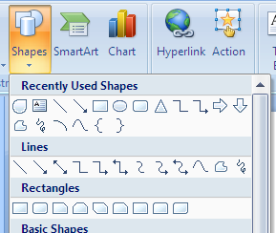
Drawing tools
The really cool drawing tools are in the Shapes palette under Lines.
[Home Ribbon – Drawing > Shapes] or
[Insert Ribbon – Illustrations > Shapes]
The Pencil tool
The Freeform tool
The Curve tool

Slide 10
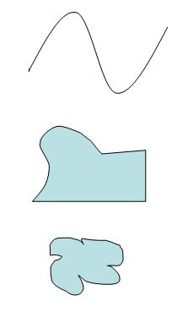
Drawing tools
double click
With the “Curve” tool you click once to set points and it draws a smooth curve through those points. Double click to end the line.
click
click
The “Freeform” tool draws straight lines between mouse clicks and curved lines if you move the mouse with the button down. Click on the start point to make a closed shape.
click
drag
click
click
click
The “Pencil” tools allows you to scribble any shape by drawing with the mouse button held down. Release at the starting point to close the shape outline.
mouse down and drag

Slide 11
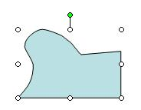
Resizing Shapes
Drag to resize, use the shift key to preserve proportions
Drag to rotate
Each of these tools draw objects that can be resized by or rotated by using their handles, moved, and formatted for line and fill.
[Home Ribbon – Drawing > Shape Outline or Shape Fill
Drag from the interior to move

Slide 12
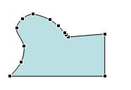
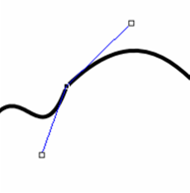
Editing line points
click to select a point
The points that are used to draw objects can also be edited by choosing “Edit Points” from the “Drawing Tools” ribbon which appears when a drawn object is selected
[Drawing Tools - Format – Insert Shapes > Edit Shape > Edit Points.
click line to add a point
Ctrl click to delete a point
Clicking on a point allows you to move it or adjust the angle of the line that goes through it. Clicking on the line itself inserts a new point. Ctrl click a point to delete it.
Point
Using these tools it is possible to create very complex shapes. You might use these tools to trace a part of a image so you could highlight it with a semi-transparent fill or a bright outline.
Drag the end of the blue handles to control direction and length of line at that point
Notes:
Mac commands:
Select object and Right click to Edit Points, Delete Points

Slide 13
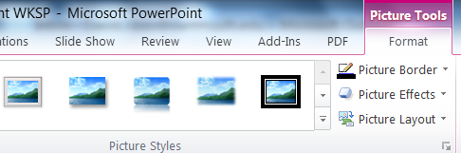
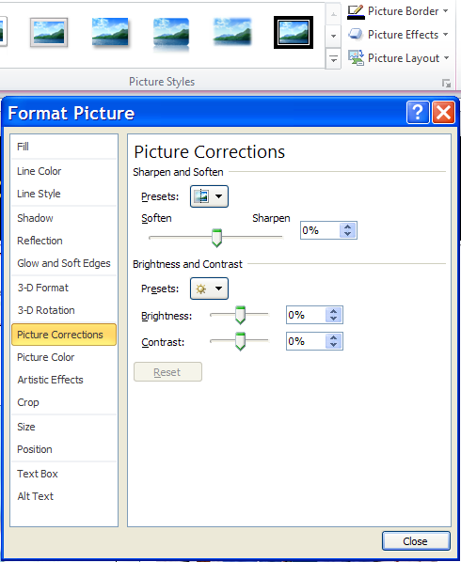
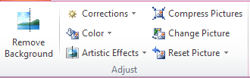



Picture Effects
The Picture Tools / Format
tab is added to the Ribbon
when you select a picture .
Use preset adjustments in
the Adjust section or slider adjustments are available in the Format Picture dialog.

Slide 14
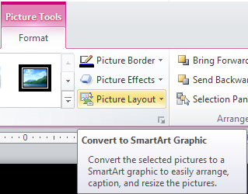
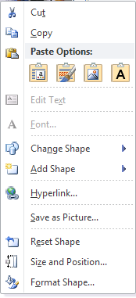
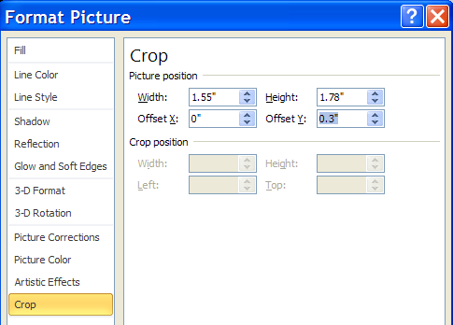
Picture Effects
Right click
Select a group of images and you can use the Picture Layout dialog to quickly convert your images to SmartArt Graphics.
After converting your images use the Picture Format Tools or Format Picture dialog to adjust the Size, Cropping, or Offset.
Notes:
Mac commands:
There is no Picture Layout option. But you can insert a Picture style Smart Art Graphic and then insert pictures.
Cropping, placement and corrections work just about the same from the Format Picture Ribbon, or the Format Picture dialog box.

Slide 15


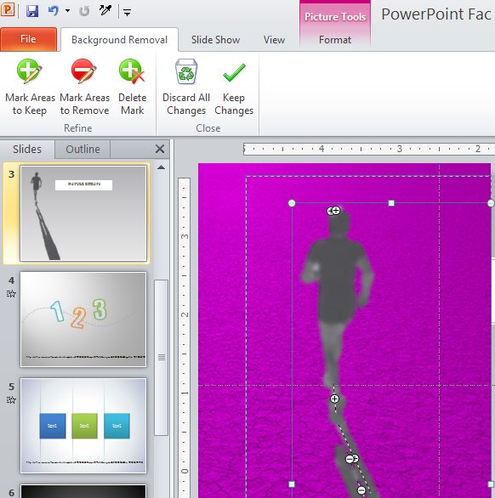
Picture Effects
Picture Tools / Format / Remove Background provides an easy way to remove parts of an image. Using a selection box and a pen tool to mark areas to remove or keep.
Notes:
http://blogs.office.com/b/microsoft-powerpoint/archive/2012/03/26/powerpoint-2010-remove-background.aspx

Slide 16
Animation
Slide Transitions
  Transitions Ribbon – Transition to This Slide
Text Animation - select the text object
  Animations Ribbon – Animation
    Use - Advanced Animation > Animation Pane – for advanced effects
Object Animation – select the object
  Animations Ribbon – Advanced Animation > Add Animation]
    Use - Advanced Animation > Animation Pane – for advanced effects
Notes:
Mac commands:
Add Transitions and Animations using the Ribbons for each. Open the Custom Animation Toolbox from the View Menu to edit the animation effect options.

Slide 17
Animation Examples
Animated GIF image
Flip Book
Animated Objects

Slide 18

Animated GIF
The animated GIF file format is a single file that contains a set of images that are displayed in sequence. Search the web or create with Photoshop or other software.
Notes:
Fly the GIF file across the slide for motion effect.

Slide 19
Flipbook
first meiotic division: prophase: zygotene
chromosome 21
other chromosomes
normal
trisomy 21
© 2003 H. NUMABE M.D.
Basic flipbook technique is to create a starting slide, duplicate that slide and make minor changes, duplicate the new slide and repeat as many times as necessary.
Notes:
Hide all but every third slide of the flip book example when printing a handout. The next slide will start an slide advance transition with a zero seconds after previous timing.

Slide 20
first meiotic division: prophase: zygotene
chromosome 21
other chromosomes
normal
trisomy 21
© 2003 H. NUMABE M.D.

Slide 21
first meiotic division: prophase: pachytene
chromosome 21
other chromosomes
normal
trisomy 21
© 2003 H. NUMABE M.D.

Slide 22
first meiotic division: prophase: pachytene
chromosome 21
other chromosomes
normal
trisomy 21
© 2003 H. NUMABE M.D.

Slide 23
first meiotic division: prophase: diplotene
chromosome 21
other chromosomes
normal
trisomy 21
© 2003 H. NUMABE M.D.

Slide 24
first meiotic division: prophase: diplotene
chromosome 21
other chromosomes
normal
trisomy 21
© 2003 H. NUMABE M.D.

Slide 25
first meiotic division: metaphase I
chromosome 21
other chromosomes
normal
trisomy 21
© 2003 H. NUMABE M.D.

Slide 26
first meiotic division: metaphase I
chromosome 21
other chromosomes
normal
trisomy 21
© 2003 H. NUMABE M.D.

Slide 27
first meiotic division: anaphase I
chromosome 21
other chromosomes
normal
trisomy 21
© 2003 H. NUMABE M.D.

Slide 28
first meiotic division: telophase I
chromosome 21
other chromosomes
normal
trisomy 21
© 2003 H. NUMABE M.D.

Slide 29
first meiotic division: telophase I
chromosome 21
other chromosomes
normal
trisomy 21
© 2003 H. NUMABE M.D.

Slide 30
first meiotic division: telophase I: first polar body
chromosome 21
other chromosomes
normal
trisomy 21
© 2003 H. NUMABE M.D.

Slide 31
first meiotic division: telophase I: first polar body
chromosome 21
other chromosomes
normal
trisomy 21
© 2003 H. NUMABE M.D.

Slide 32
Animated Objects
View in the Slide Show mode to see animation effect
Look at settings in “Custom Animation”
See next slide for details

Slide 33
The trace graphic is made up of of 2 objects drawn with the freeform line autoshape. The 2 objects are then positioned to create the clear space between them and then grouped.
This box is filled with a 2 color gradient.
Top Layer - duplicate the trace enough times and line up end to end to fill width of the screen.
Mid Layer - a 2 color gradient large enough to cover height of the trace cutout. Position off slide to the right. Animate to fly in from the right.
Bottom Layer - a black rectangle to to keep the background from showing through the cutout.

Slide 34




Animation Triggers
Notes:
Moved these slides the Tips and Tricks presentation.

Slide 35
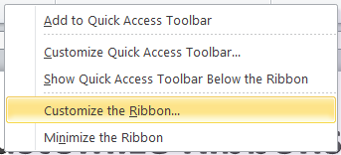

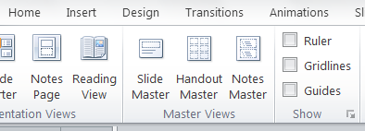
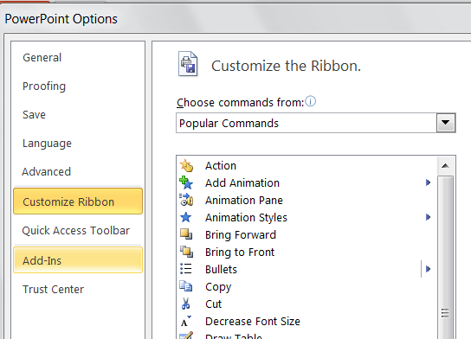
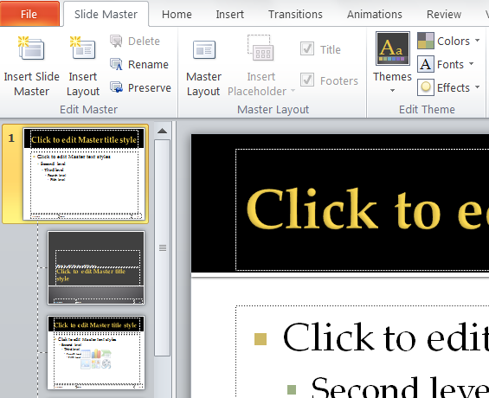
Customize Ribbons, Masters
Use the Slide Masters to customize each Layout. Add new Layouts or create new Themes.
Right Click on the Ribbon to Customize. Or use the Options from the File Menu.
Add Features from the lists of commands.
Notes:
Quick Access Toolbar and Ribbons
Customize the ribbons and can add commands to the Quick Access Toolbar
Custom Layouts and Themes
Design your own slide layout using multiple masters
Create and save your own Themes
Right click open space on Ribbon or look in Options under the File menu.
Mac commands:
Customize the Toolbars and Menus from the View Menu > Toolbars > Customize.

Slide 36
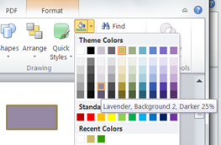
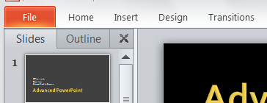
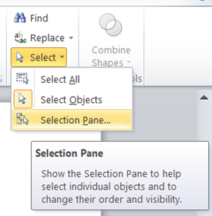
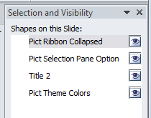
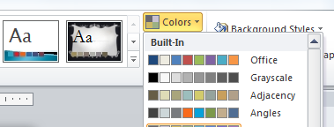

Interface Features
Double Click Tabs to collapse Ribbons. Press ALT key to see keyboard shortcuts.
Many Format choices can be previewed just by rolling the mouse cursor over the color or format options
This applies to Themes in the Design Ribbon as well. Also explore different Theme color schemes.
The Selection Pane provides a way to Select, Hide/Show, and Reorder objects.
Theme Colors from Design tab
Click on text to rename
Use Arrows to Reorder
Notes:
Ribbons
Show and Hide by double clicking
Keyboard navigation with Alt key
Live Preview
Rollover galleries to see effects, no more apply and undo
Selection Pane
Home – Editing – Select - SelectionPane
Window Zoom
Rulers
[View Ribbon – Show > Ruler]
Guides
[View Ribbon – Show > Guides] or
[Home Ribbon - Drawing > Arrange > Align > Grid Settings]
Shortcuts
[Right Click] – contexual menus

Slide 37
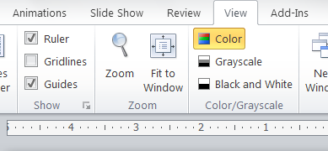
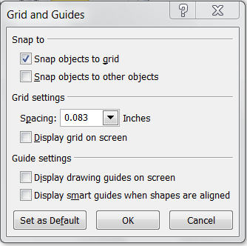
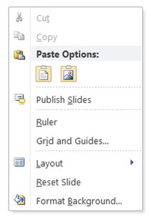
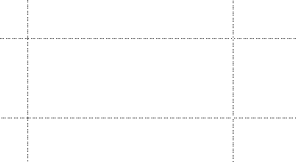
Guides and Shortcuts
Right Click to bring up contextual menus
Drag Guides to position. Drag with Alt Key to duplicate.
    Slide Show Shortcuts
    Go to slide number: number+ENTER
    Display a blank black slide: B
    Display a blank white slide: W
    Laser Pointer: CTRL+Left Mouse Btn
    Change the pointer to a pen: CTRL+P
    Change the pointer to an arrow: CTRL+A
    Change the pointer to an eraser: CTRL+E
Notes:
To locate commands I am using the notation of [Ribbon – Function Group >Pull Down >Select]
Rulers
[View Ribbon – Show > Ruler]
Guides
[View Ribbon – Show > Guides] or
[Home Ribbon - Drawing > Arrange > Align > Grid Settings]
Shortcuts
[Right Click] – contexual menus
Mac commands:
Ruler and Guides are in the View Menu. There is no setting for the grid spacing
Shortcuts - right click or Ctrl left click

Slide 38
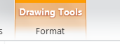
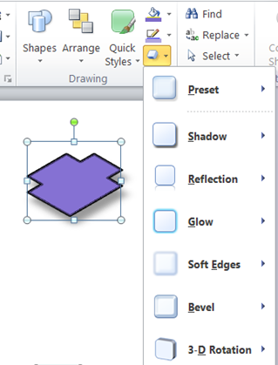
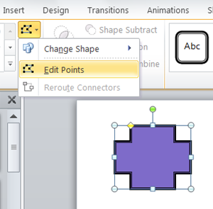

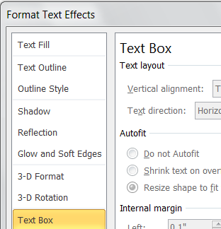
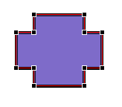
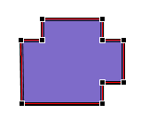
Shapes and Effects
Fill Color
Outline Color
Shape Effects
Select Shapes to modify them.
Use the Format Tab to see options or
Use Shape Effects or
Right Click to quickly access formatting options dialog boxes.
Text Effects
Edit Points
Drag handles to reshape
Drag line segment to add point
Ctrl Click to delete points
Notes:
New Autoshapes
Drawing tools
Edit shapes, convert to freeform, edit points
Graphic Effects
Shadows, edges, reflections, glows, 3D…
Text Effects
Smart Art
Animations

Slide 39
Editing line points
click to select a point
The points that are used to draw objects can also be edited by choosing “Edit Points” from the “Drawing Tools” ribbon which appears when a drawn object is selected
[Drawing Tools - Format – Insert Shapes > Edit Shape > Edit Points.
click line to add a point
Ctrl click to delete a point
Clicking on a point allows you to move it or adjust the angle of the line that goes through it. Clicking on the line itself inserts a new point. Ctrl click a point to delete it.
Point
Using these tools it is possible to create very complex shapes. You might use these tools to trace a part of a image so you could highlight it with a semi-transparent fill or a bright outline.
Drag the end of the blue handles to control direction and length of line at that point
Notes:
Mac commands:
Select object and Right click to Edit Points, Delete Points

Slide 40
Picture Effects
Picture Tools / Format / Remove Background provides an easy way to remove parts of an image. Using a selection box and a pen tool to mark areas to remove or keep.
Notes:
http://blogs.office.com/b/microsoft-powerpoint/archive/2012/03/26/powerpoint-2010-remove-background.aspx

Slide 41
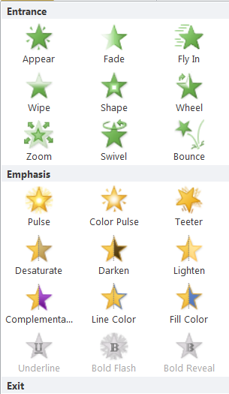
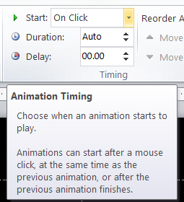
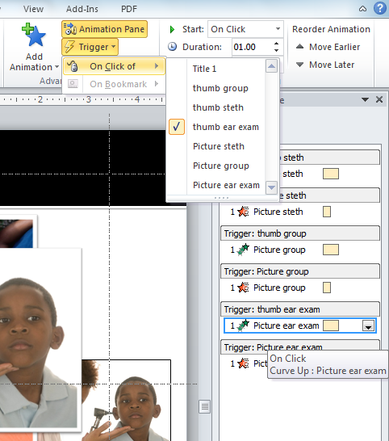
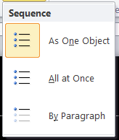
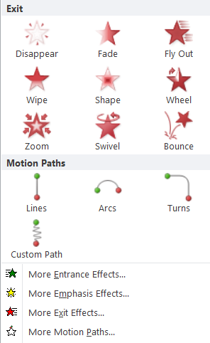
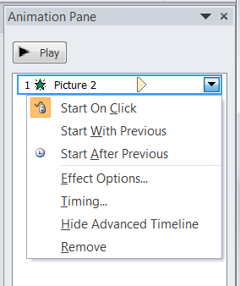
Animation Options
There are many effects to animate text and objects. Each effect has options for timing and duration, some have motion options as well.
Many options can be set directly in the Animation Ribbon. The Animation Pane provides additional options and access to the timeline to fine tune the settings.
The Selection Pane is also useful when constructing complex animations and with layered objects.
Triggered animations can be set up from the Advanced Animations section of the ribbon within the Animation Pane or from the Animation Pane
Text Effect Options
Click here to drop down options menu

Slide 42

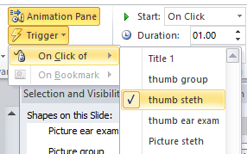
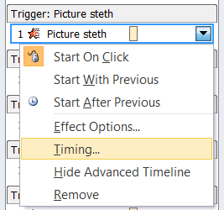
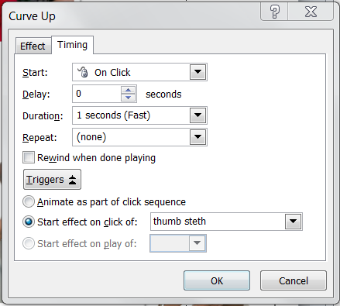
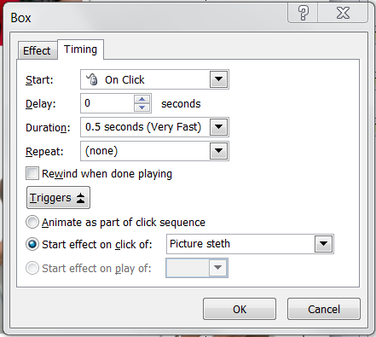
Animation Triggers
Each large image entrance is animated using the thumbnail image as a trigger. The large image triggers itself for the exit.
1
Animate Picture Entrance
2
Animate Picture Exit

Slide 43
Mac Version Commands
Customize the Toolbars and Menus from the View Menu > Toolbars > Customize
Ruler and Guides are in the View Menu. There is no setting for the grid spacing
Shortcuts - right click or Ctrl left click
Hyperlink is in the Insert Menu.
  Actions settings are available with a right click (Ctrl click)
Paste text: Edit Menu > Paste special > Unformatted Text
Paste Excel Charts: Menu > Paste special > Microsoft Office Drawing Object
  Ungrouping of the chart object is not an option.
Edit Points
  Select object and Right click to Edit Points, Delete Points
There is no Picture Layout option
  But you can insert a Picture style Smart Art Graphic and then insert pictures.
  Cropping, placement and corrections: Format Picture Ribbon, or the Format Picture dialog box.
Add Transitions and Animations using the Ribbons for each.
  Open the Custom Animation Toolbox from the View Menu to edit the animation effect options.
Trigger settings are not available on the Mac
  The Mac version can play triggers created by the Windows version

