Slide 1
Letters of Evaluation Contact us: (p) 603-646-3377 Health.Professions.Program@Dartmouth.edu Or schedule a meeting on Calendly, links found on the HPP website: https://www.dartmouth.edu/prehealth/
Notes:
Welcome to HPP’s tutorial on “Letters of Evaluation” in AMCAS. If you have questions about other health professional program applications such as AACOMAS, AADSAS, or others, please contact an HPP advisor.

Slide 2
Letters of Evaluation
Applicants can submit their application before AMCAS receives their letters.
Select “Committee Letter” if submitting a composite.
Notes:
In the Letters of Evaluation section, you are asked to check off which type of letter you are submitting.
Most Dartmouth applicants are submitting a composite letter. On the application, you will check off Committee Letter.
The Dartmouth composite is a type of committee letter. Several perspectives, which form the committee, are represented in your evaluations. The composite letter includes all the support letters as a single .pdf file. This will fill one letter slot in AMCAS.
We want to remind you that you can submit your application before your letter is completed. When it is completed, the HPP office will notify you that it ready to submit, with instructions for how to add it to your application.
Alumni often have a Dartmouth composite letter for up to 2-3 years after graduation, sometimes more depending on the relationships they’ve built.

Slide 3
Dartmouth Composite
Title: Dartmouth Composite Letter of Evaluation
Primary Contact Information: Ms. Rae Stokes
Primary Contact Title: Health Professions Program Coordinator
Primary Contact E-Mail: Rae.L.Stokes@Dartmouth.edu
Primary Contact Phone: 603-646-3377
Organization Name: Dartmouth College
Address: 7 Maynard Street, Parker House, Hanover, NH 03755
Notes:
The letter title for composite letters is “Dartmouth Composite Letter of Evaluation.”
The Primary Contact Information will be our Program Coordinator, Rae Stokes.
We do this so that if there are any administrative questions about the letters, then HPP can respond. We will contact a writer directly if there is a need.
All this information is also available in HPP’s AMCAS FAQ’s.

Slide 4
Letters of Evaluation
Applicants can submit their application before AMCAS receives their letters.
Select “Letter Packet” if not receiving a composite but still working with HPP to collect letters.
Notes:
After 2-3 years an alum may choose to work with the HPP office to produce a letter packet instead. This is a group of individual letters that are collected by our office. In this scenario an applicant would select “Letter Packet.” Use the same contact information as the composite.

Slide 5
Letters of Evaluation
Applicants can submit their application before AMCAS receives their letters.
Select “Individual Letter” if not collecting letters through HPP
Notes:
Alternatively, an older alum might choose to submit individual letters, collected when AMCAS opens for the current application cycle. In that case an applicant does need to be aware of each school’s limit on the number of letters they’ll accept. You will individualize the contact information in this case.

Slide 6
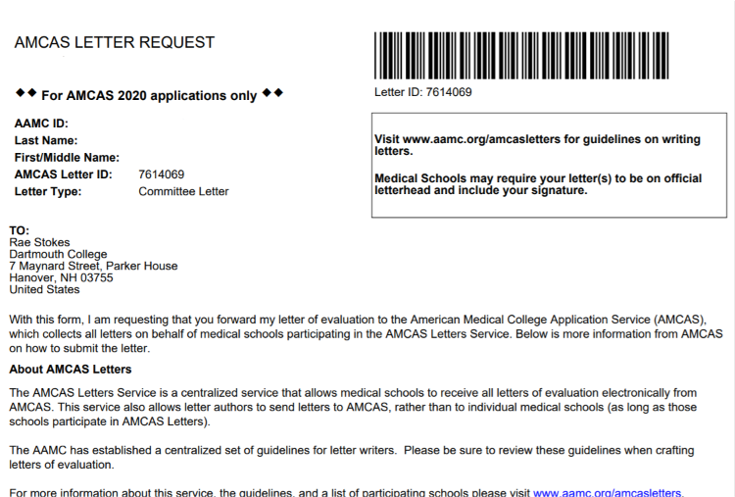
AMCAS Letter Request
Keep Letter ID number
Used to match letters when transmitting from Privatefolio or Interfolio
This is individualized to the letter request.
Notes:
We do not need the AMCAS Letter Request form. However, you will need a copy for yourself. It will generate a Letter ID Number. You will need that number when it’s time to submit your letter from Privatefolio or Interfolio.

Slide 7
Contact Us
(p) 603-646-3377
E-mail: Health.Professions.Program@Dartmouth.edu
Or schedule a meeting on Calendly, links found on the HPP website: https://www.dartmouth.edu/prehealth/
Notes:
Please contact an HPP advisor if you have any additional questions about the process. We are available by phone or e-mail. You can also schedule an appointment via Calendly.

