Slide 1
Institutional Action (under “Schools Attended”) Contact us: (p) 603-646-3377 E-mail: Health.Professions.Program@Dartmouth.edu Or schedule a meeting on Calendly, links found on the HPP website: https://www.dartmouth.edu/prehealth/
Notes:
Welcome to HPP’s tutorial on “Institutional Action” in AMCAS. If you have questions about other health professional program applications such as AACOMAS, AADSAS, or others, please contact an HPP advisor.

Slide 2
Schools Attended
Notes:
As a reminder, under the “Schools Attended” section, we’d like to highlight the “Advisor Release.” We ask that you please check yes.
This gives us access to data about the application cycle. That information helps us help you during the cycle. It also helps us advise future applicants through the aggregate data collected and is the source of the data we’ve used to advise you. We do not share individual information. We do not see your actual application, but we get access to GPA, MCAT, and acceptance data.

Slide 3
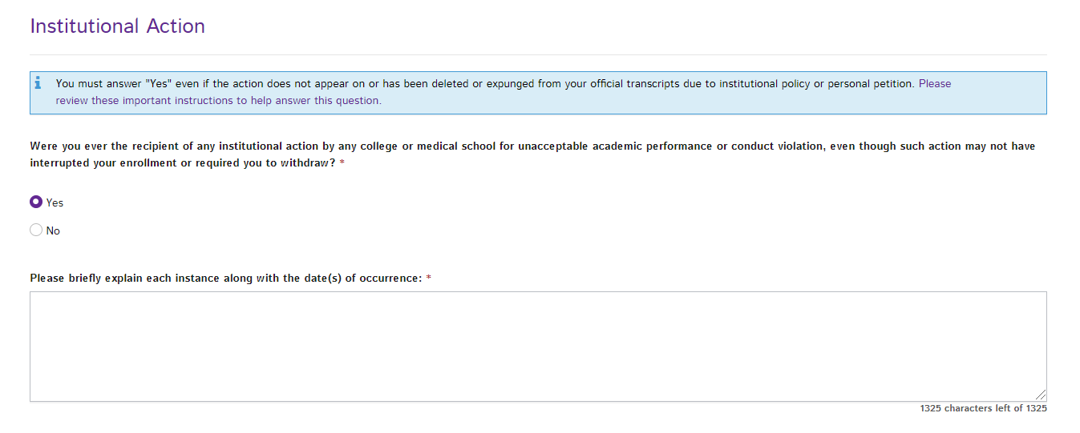
Schools Attended
Notes:
Under the “Schools Attended” section, you will be asked if you have ever had an Institutional Action.
If you have, it is important to check yes.
Self-reporting an institutional action is critical. Dartmouth would not disclose this information. However, if a medical school discovered you had such an experience and did not report it, the consequences could be more impactful than sharing the experience.
You may wonder if you had an institutional action, or if your institutional action rises to the level of reporting. Please touch base with one of the HPP Advisors to clarify your situation.

Slide 4
Schools Attended
Notes:
If you had an institutional action, we are a non-judgmental resource for helping you write your explanation. You will have 1,325 characters to write such details.
It is essential to be honest, straightforward, and simple. It’s also important to express what meaning or learning you may have derived from the experience. We urge you to discuss this with us.
While not required, we also strongly recommend discussing such an experience with your composite writer, or to have a support writer who can give context to the experience, your growth, and your maturity and trustworthiness.

Slide 5
Leveraging Your Composite Writer and HPP
Utilize a letter writer for an outside perspective on your character
Contact us:
(p) 603-646-3377
E-mail: Health.Professions.Program@Dartmouth.edu
Or schedule a meeting on Calendly, links found on the HPP website: https://www.dartmouth.edu/prehealth/
Notes:
We are also happy to discuss how to approach this with a letter writer and to review the writing piece. You can contact us by phone or e-mail, or you can schedule an appointment via Calendly.

