Slide 1
Coursework and Study Abroad Contact us: (p) 603-646-3377 Health.Professions.Program@Dartmouth.edu Or schedule a meeting on Calendly, links found on the HPP website: https://www.dartmouth.edu/prehealth/
Notes:
Welcome to HPP’s tutorial on “Coursework and Study Abroad” in AMCAS. If you have questions about other health professional program applications such as AACOMAS, AADSAS, or others, please contact an HPP advisor.

Slide 2
The AMCAS Application
Identifying Information
Schools Attended
Study Abroad
Biographic Information
Course Work
Work/Activities
Letters of Evaluation
Medical Schools
Essay(s)
Standardized Tests
Notes:
After briefly discussing the “Schools Attended” and “Study Abroad” section, we will focus on information about entering your coursework as a Dartmouth applicant.

Slide 3
Schools Attended
Applicants should also request a second set of official transcripts for personal use to aid in entering coursework.
Notes:
Though you will be submitting transcripts from any post-secondary school you attended, you will still enter every course you took into the AMCAS application. You will need your official transcripts in hand while doing so.

Slide 4
Schools Attended
Notes:
Under the “Schools Attended” section, we’d like to highlight the “Advisor Release.” We ask that you please check yes.
This gives us access to data about the application cycle. That information helps us help you during the cycle. It also helps us advise future applicants through the aggregate data collected, and is the source of the data we’ve used to advise you. We do not share individual information. We do not see your actual application, but we get access to GPA, MCAT, and acceptance data.
In the “Schools Attended” section, you will list all post-secondary schools where you’ve completed courses, including dual enrollment from high school, a summer course taken elsewhere, or other transferred courses. You will order a transcript directly from each institution that administered the course.
The one exception to the requirement for separate transcripts might be for a study abroad program.

Slide 5
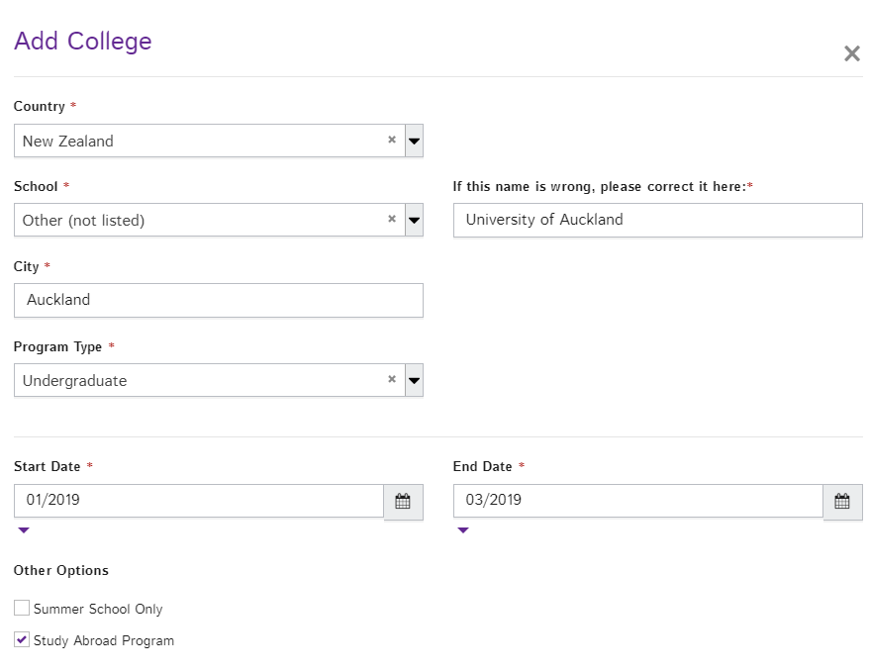
Schools Attended: Study Abroad
Notes:
If you have taken a study abroad, a transfer term, or any program that was affiliated with Dartmouth at which you studied at another institution, you will still add that as a separate school in the “Schools Attended” section. You will then check “study abroad” as the type of program.

Slide 6
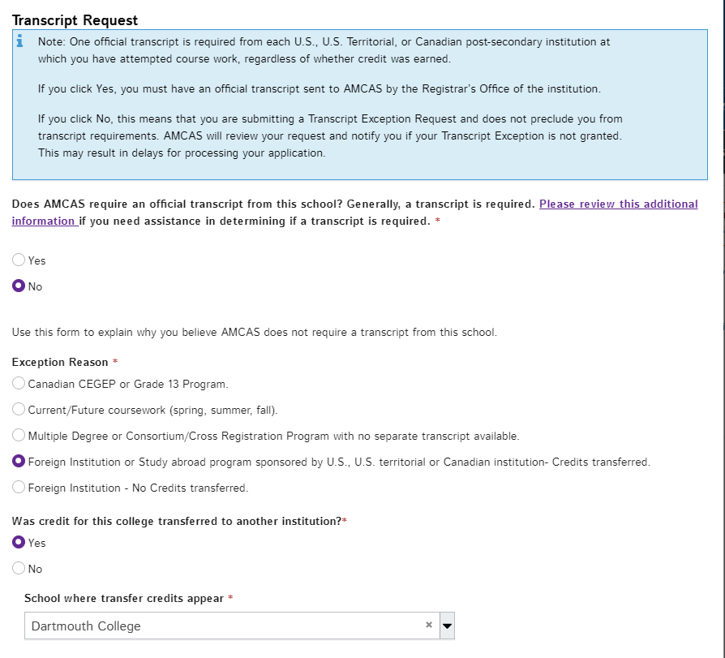
Schools Attended: Study Abroad
If your transcript shows a grade: Transcript is NOT required
If your transcript does NOT show a grade: Transcript is required
Notes:
You will not get a separate transcript from that institution. Instead you will check “No.” When this is selected, additional questions will open, and for “Exception Reason” you will select “Foreign institution or study abroad program sponsored by US-credits transferred.”
However, if your official transcript does not have a grade for your study abroad coursework, you must get official transcripts from the institution that hosted you. This is most common with exchange programs and study abroad programs not affiliated with Dartmouth through non-profits like CIEE.
Approved transferred courses give you Dartmouth credit, but those grades are not part of your Dartmouth record, and so a separate transcript is required.
To reiterate: If your transcript shows a grade, a transcript is NOT required from the host institution. If your transcript does NOT show a grade, a transcript IS required from the host institution.

Slide 7
Course Work: Before You Begin
You will need the following:
All official transcripts
This HPP guide
HPP AMCAS FAQ page: https://www.dartmouth.edu/prehealth/applying/amcas/faqs_2020_2021.pdf
The AMCAS Course Classification Guide: https://students-residents.aamc.org/applying-medical-school/article/course-classification-guide/
Your full attention
Notes:
Please follow these Dartmouth-specific instructions about adding coursework. It’s incredibly important to be accurate when adding your courses. When entering courses, you will always need your official transcript from the registrar in hand, a copy of the HPP AMCAS FAQ’s and/or this tutorial, and the AMCAS Course Classification Guide.
Entering your courses requires attention and accuracy. Make sure you are focused when working on it.

Slide 8
Course Work
Applicants should use a personal copy of their official transcript to complete this section.
Notes:
For AMCAS, the academic year starts in the summer and goes until the following spring. This means that your Sophomore Summer will be the first term of Junior year.

Slide 9
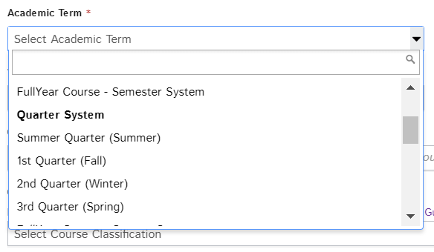
Course Work
Notes:
For Dartmouth, our registrar has communicated to AMCAS that we are on a quarter system. Please scroll past the top options which are for “semesters” and make your selections under “Quarter System.”
You indicate when you’ve had a leave term by not entering courses for that term. You do not need to do anything else.
“Year in School” is self-explanatory.

Slide 10
Course Work
Applicants should use a personal copy of their official transcript to complete this section.
Sample:
Course number: Chem 005
Course Name: General Chemistry
Notes:
You will enter your courses exactly as they appear on your transcript. Again, make sure you are using your official transcript. See the sample provided on the screen.
You will also write in the course name exactly as it is on the transcript. For instance, with Chem 005 as the example, it will go in as General Chemistry. If a course name is too long to fit, put in a logical abbreviation that can be interpreted correctly.

Slide 11
Course Work
Applicants should use a personal copy of their official transcript to complete this section.
https://students-residents.aamc.org/applying-medical-school/article/course-classification-guide/
Notes:
You will need to have the AMCAS Course Classification Guide open as you add courses.
Most of your BCPM courses—which are your biology, chemistry, physics, and math courses, will be straightforward.
There will be some courses for which you will need to make a judgement call.
Classifications don’t always match Dartmouth Academic Departments. Medical schools understand variation in coursework, so do your best.

Slide 12
Additional Tips on Classification
First-Year Seminar and Writing 5 are English courses
Statistics is always classified as math, no matter which department taught the course.
BCPM (Biology, Chemistry, Physics, Math)-based Neuroscience or Engineering courses can be counted as BCPM.
Have a syllabus ready for verifiers
Check your application and e-mail frequently during verification
Errors rarely happen, but sometimes occur.
Notes:
Here are some additional frequently asked questions and some tips.
First-year seminar and writing 5 are English courses.
If you took statistics in a non-math department such as Psychology, Sociology, or Economics, you will still classify it as Math.
If you took a BCPM-based Neuroscience or Engineering course, you can classify it as the corresponding basic science. If AMCAS needs you to verify a classification you will need a syllabus.
If your AMCAS verifier disagrees with any of your classifications, they will pause verification and alert you. Check your application and all your e-mail folders and tabs frequently during this time. You will have two weeks to petition for your original classification. The quicker you resolve it, the quicker your application completes verification.
On very rare occasions a verifier errs and disagrees with a First Year Seminar or Writing 5 classification as English. If this happens, we have instructions in the HPP FAQ’s on how to respond. Contact HPP if you meet a challenge fixing this.

Slide 13
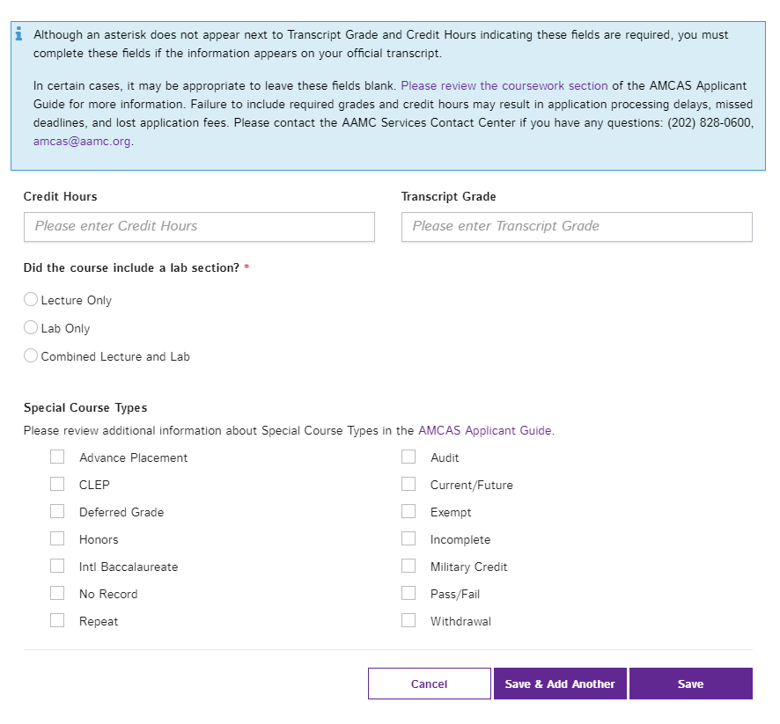
Course Work
Applicants should use a personal copy of their official transcript to complete this section.
Continue to enter credits as they appear in the transcript.
Notes:
All Dartmouth courses will go in as one credit, just as they are listed on the transcript. Continue to enter everything exactly as it appears on your official transcripts.

Slide 14
Course Work: After AMCAS processes coursework
Quarters convert to semester hours automatically
Credits convert to semester hours
Lab courses=4.5 semester credits
Non-lab courses=3.5 semester credits
Pre-requisites will be fulfilled
Continue to enter credits and grades as they appear in the transcript.
Notes:
AMCAS will eventually convert what you’ve entered automatically. After conversions are completed by AMCAS, Dartmouth “quarters” will be converted into “semester” hours. Any Dartmouth course with a lab will be granted 4.5 credits. Any course without a lab will be granted 3.5 credits.
If you see that a medical school requires a year or 8 credits of general chemistry with lab, remember that you actually have 9 credits.
If you ever see that a medical school requires 2 semesters of general chemistry or 3 quarters, you will still have the equivalent with two Dartmouth quarters. These are long established understandings between the Dartmouth registrar and AMCAS.
The conversion happens after your application is processed, so enter courses exactly as they appear on your transcript, choosing 1 credit per course. Enter your grades exactly as they appear on the transcripts.

Slide 15
AP, IB, and Exemptions
 | AP Credit | IB Credit
Credit Hours | 0 | 0
Grade | CR | EX
Special Course Type | Advanced Placement | Exempt
CHEM 10: List CHEM 005 credit as it appears (an EX or CR), and list 1 credit for CHEM 10
Applicants should use a personal copy of their official transcript to complete this section.
Continue to enter courses as they appear in the transcript.
Notes:
Some of you came in with AP credit, IB experience, or exempted out of a course through a placement exam. This chart highlights how to enter in AP and IB credit hours, grades, and course type. The result should reflect your official transcripts. The chart also indicates how to enter CHEM 10.

Slide 16
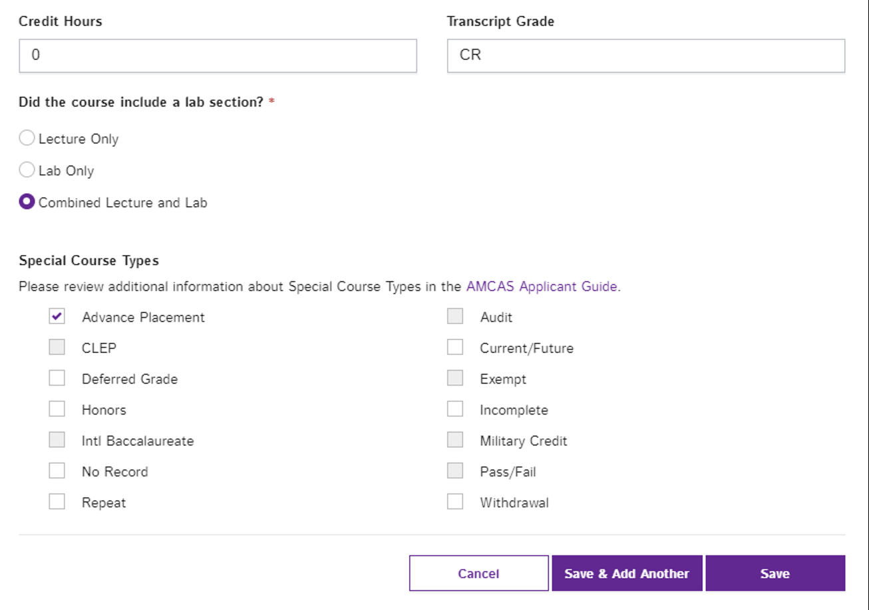
AP, IB, and Exemptions
Applicants should use a personal copy of their official transcript to complete this section.
Continue to enter courses as they appear in the transcript.
Notes:
It will be up to you to designate a course as “Lecture Only” “Lab Only” or “Combined Lecture and Lab.” Be accurate so that AMCAS can record your total credit hours. If you placed out of a science course like Chem 5 or Physics 3, you will select combined lecture and lab.

Slide 17
Final Dartmouth-Specific Instructions
NRO for a course: Under “Special Course Type” select “Pass/Fail”
Future coursework: enter it and select “Current/Future”
Honors coursework: example would be a course like Chem 57 and honors thesis research
Citations do NOT count as honors coursework
Withdrew from course: enter it and select “withdrawal.”
Check the HPP FAQs if you have more questions
Do a final check of your coursework for accuracy
Notes:
If you NRO-ed a course, under Special Course Types, you will check off Pass/Fail
For future coursework, write in courses you plan to take, and check off “Current/Future”
Citations do not count as honors courses. Chem 57 or honors thesis research are examples of honors coursework.
If you withdrew from a course, check “Withdrawal.”
The rest is straightforward.
If questions arise as you progress through this section, please check our FAQ’s first to see if the answer is there. If it is not, please don’t hesitate to contact HPP with questions or concerns.
Before you submit your application, go over your coursework and check for accuracy.

Slide 18
Contact Us
(p) 603-646-3377
E-mail: Health.Professions.Program@Dartmouth.edu
Or schedule a meeting on Calendly, links found on the HPP website: https://www.dartmouth.edu/prehealth/
Notes:
Please contact an HPP advisor if you have any additional questions about the process. We are available by phone or e-mail. You can also schedule an appointment via Calendly.

