Slide 1
Activities and Essays Contact us: (p) 603-646-3377 Health.Professions.Program@Dartmouth.edu Or schedule a meeting on Calendly, links found on the HPP website: https://www.dartmouth.edu/prehealth/
Notes:
Welcome to HPP’s tutorial on “Activities and Essays” in AMCAS. If you have questions about other health professional program applications such as AACOMAS, AADSAS, or others, please contact an HPP advisor.

Slide 2
Work/Activities
Maximum of 15 entries
Applicants can enter 3 additional date ranges for repeated activities
Maximum of 3 “Most Meaningful”
Notes:
As you’ll see here, AMCAS gives you space to write about a maximum of 15 Experiences. For each you will have 700 characters including spaces. You will also designate 3 experiences as your most meaningful. This allows you an additional 1350 characters to expand upon the experience.

Slide 3
Work/Activities
Choose the best fit
An “Other” category is available
Notes:
Under “Experience Type” you will choose from a drop-down menu.
In some cases, you may need to consider which type best fits if it could fall under more than 1 category.
If nothing really fits any of the drop-down choices, there is an “other” category.
You can use the Experience Name to quickly alert the reader what the core experience was, and possibly save space for your limited 700-character description. For example, instead of merely saying “Trip Leader” you might say “Beginner Hiking Trip Leader: First Year Pre-Orientation Trips”
Sometimes you can then dive into your description without repeating yourself.

Slide 4
Work/Activities
Multiple date ranges are possible
Notes:
You can enter multiple date ranges: If you interrupted an experience and then returned to it, you can reflect that in choosing multiple date ranges.
You will estimate how many hours you were involved in each experience. It’s hard to be exact but do the best you can. Be as honest as you can without exaggerating.

Slide 5
Work/Activities
Do your best with “contact title.”
Notes:
A “Contact Title” is required for each experience.
This is someone who could verify that yes, you did this experience. If your experience was a personal accomplishment such as running a ½ marathon, you can be the contact. Limit the times you are the contact.
You may have been part of a student organization for which there were no staff or faculty supervisors. You could put down someone in the executive group of the organization.

Slide 6
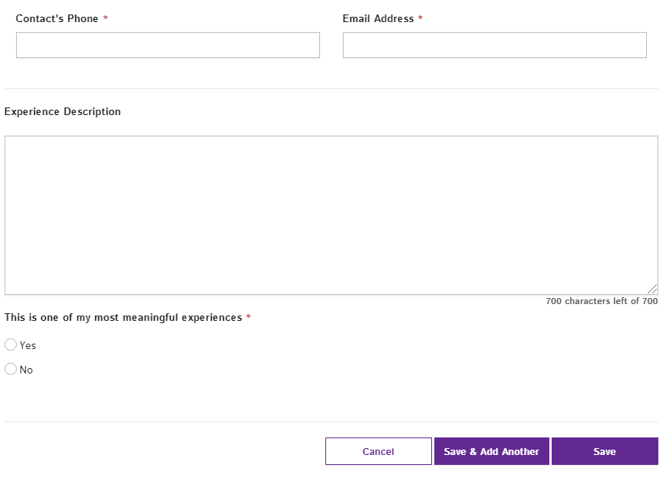
Work/Activities
Remember that if an experience was important to you, then it’s important to the medical programs.
Feel free to consult with HPP
Notes:
Be thoughtful and take your time with your descriptions. While some are straightforward and may only need bullets, effectively crafted prose can be compelling, and offer personality.
Brainstorm your list of experiences early. For each, list what you did, responsibilities, the impact it had on you, and what you learned. As you decide what you wish to convey, the crafting begins. A tight, well-written paragraph can convey a great deal when done well.
Don’t dismiss seemingly unrelated experiences that have been formative for you. Value all experiences that have had an impact or were important for other reasons.
As an example, you may have worked as a server during interims. Medical schools value job experience and respect the need to work. Other potential examples could include study abroad or personal interests such as athletics or playing an instrument.
If you’ve had experience as a primary caretaker for a family member, this is another kind of experience you’d want to include.
If you have an activity or experience that you’re uncertain about, please feel free to consult with us.

Slide 7
Additional Tips:
Combining experiences can be an effective strategy.
Stay honest, write with integrity.
Draft in NotePad (PC) or TextEdit (Mac)
Or draft in Word, copy and paste to one of the above programs, finalize, and copy and paste from NotePad/TextEdit into AMCAS
Give yourself time
Notes:
Here are some additional tips for this section:
A few types of experiences lend themselves to being combined such as similar tutoring experiences or shadowing experiences. Don’t go overboard in combining but do it if it makes sense.
Stay honest. Don’t overstate or oversell anything. Don’t undersell yourself either.
Draft in text-only word processing software such as Microsoft Notepad or Mac TextEdit. This will stay accurate if you copy and paste. Microsoft Word will convert punctuation and spacing strangely, so try to avoid using Word. Alternatively, use Word to draft, but transfer to Notepad or Textedit, do a final check, then copy and paste from those programs directly into AMCAS.
Give yourself enough time. People are frequently surprised at the time it takes to refine this section.

Slide 8
Essay
https://www.dartmouth.edu/prehealth/applying/amcas/app_essay.html
Notes:
As you can see, the essay allows for up to 5300 characters, including spaces. The prompt says, “Use the space provided to explain why you want to go to medical school.”
Please feel free to refer to the HPP application website for ideas about how to get your writing started.
HPP Advisors are willing to review your drafts and ideas with you and provide feedback.

Slide 9
MD/PhD Additional Essays
MD/PhD essay: 3000 characters
Significant Research Experience Essay: 10,000 characters. Include the following:
Research supervisor information and affiliation
Duration of Experience
Nature of the problem studied
Your contributions to the research
Notes:
If you are applying MD/PhD, there will two more essays to complete. To access additional essays for any combined degree program you must go to the “Medical Schools” section of the application. Add schools and select the correct combined degree program. You will then see additional essays appear in the essay section.
For MD/PhD applicants, you’ll be asked to write two additional essays: the first asks why you are choosing MD/PhD and the second to describe your research experience in detail.
HPP can assist with the MD/PhD essay, but we recommend that you have your “Significant Research” essay edited by your research supervisor.

Slide 10
Contact Us
(p) 603-646-3377
E-mail: Health.Professions.Program@Dartmouth.edu
Or schedule a meeting on Calendly, links found on the HPP website: https://www.dartmouth.edu/prehealth/
Notes:
Please contact an HPP advisor if you have any additional questions about the process. We are available by phone or e-mail. You can also schedule an appointment via Calendly.

