Slide 1
Learning PowerPoint
Biomedical Libraries
Dartmouth College
Dave Izzo
Aug 2016

Slide 2
Effective Presentations
PowerPoint is a presentation graphics program designed to help you produce screen displays, photographic slides, transparencies, and handouts useful in lectures, seminars, etc.

Slide 3
Tips for Effective Presentations
Focus
The most important rule in multimedia presentations is:
Keep It Simple. If your audience doesn't understand what you're saying, little else matters
Decide what information is absolutely essential, and trim down.
Notes:
Make an outline of the key points, using paper, note cards, sticky notes, or software like Word or PowerPoint. Think about the “background and knowledge” of the audience. Do you need to lower the jargon factor? Explain key concepts?

Slide 4
Tips for Effective Presentations
Space
No more than seven words across and eight lines.
No more than 4 bulleted items per slide.
No Bullets at all!
Empty space is good ...
Notes:
If you put too much text on a slide, PowerPoint will reduce the font size to make it fit. This results in slide with varying text sizes. Not a good design practice. Reduce the amount of text or split it across multiple slides.

Slide 5
Tips for Effective Presentations
Text
A combination of upper and lower case text is easier to read than all capitals. All caps should only be used for EMPHASIS.
Bold, non-serif fonts like Helvetica or Arial are often more readable than serif fonts like Times or Palatino.
Notes:
Use the less complex, easier to read fonts. These are not absolute rules. You can choose fonts that reflect the mood of the presentation. Comic Sans for a humorous presentation, Palatino for a more serious mood. Avoid typefaces with narrow line segments for projected slides.
Readability and style appropriateness are the most important elements

Slide 6
Tips for Effective Presentations
Illustrations
Textbook illustrations that look good on the printed page may require the following modifications:
Bolder lines
Larger Font
Less information
Notes:
If scanning illustrations use gray scale or color settings and scan a little bigger than you need. Enlarging a scanned image in PowerPoint can make it blocky, shrinking rarely looks bad.
Even in wide screen formats a display image is less than 1800 dots wide. Scanning to produce only the number of pixels needed to fit the space desired on your slide is usually adequate.
Use PowerPoint drawing tools to recreate complicated graphics and emphasize the important information.

Slide 7
Tips for Effective Presentations
Color
Limit colors to a “palette”
Create contrast between background and foreground, with the exception of black on white or white on black.
Use colors for effect and for emphasis.
Do not over do!
Notes:
PowerPoint includes several complimentary color palettes with each theme. You don’t have to use the default set of colors. Do try to stick to the Theme colors so changes in design options will change the colors of all objects to match the new design.
Look for the Colors drop down in the Design Ribbon.

Slide 8
Tips for Effective Presentations
Graphics
Maintain a consistent design throughout the presentation. Changing backgrounds, fonts and colors can distract from the message.
Use images and graphics that support the message.
Examples
Notes:
PowerPoint is designed to have a consistent look by using the pre-designed layouts, color schemes and themes.
New styles break the old rules using more graphics , different layouts, formats, and color schemes. Increased visual dynamics.

Slide 9
Sales Over 5 Years (in Millions)
Category 2009 2010 2011 2012 2013
Products 10 19 25 33 20
Services 7 11 17 26 20
Training 2 5 5 16 3
Rentals 4 6 8 16 6
Totals 23 41 55 91 49
Notes:
Example:
White background, black text. Too much contrast.
A bright screen in a dark room can be uncomfortable for viewing

Slide 10
Sales Over 5 Years (in Millions)
Category 2009 2010 2011 2012 2013
Products 10 19 25 33 20
Services 7 11 17 26 20
Training 2 5 5 16 3
Rentals 4 6 8 16 6
Totals 23 41 55 91 49
Notes:
Example:
Black background, white text. Too much contrast.
Text can appear to “bloom” and be hard to read.

Slide 11
Sales Over 5 Years (in Millions)
Category 2009 2010 2011 2012 2013
Products 10 19 25 33 20
Services 7 11 17 26 20
Training 2 5 5 16 3
Rentals 4 6 8 16 6
Totals 23 41 55 91 49
Notes:
Example:
Better contrast with cool and warm color instead of brightness differences. Use color to highlight important information.

Slide 12
2012 Sales Breaks Record! Sales Top $90 Million
Category 2009 2010 2011 2012 2013
Products 10 19 25 33 20
Services 7 11 17 26 20
Training 2 5 5 16 3
Rentals 4 6 8 16 6
Totals 23 41 55 91 49
Notes:
Example:
Add graphics to accentuate the most important information, change the title to reinforce the message.

Slide 13
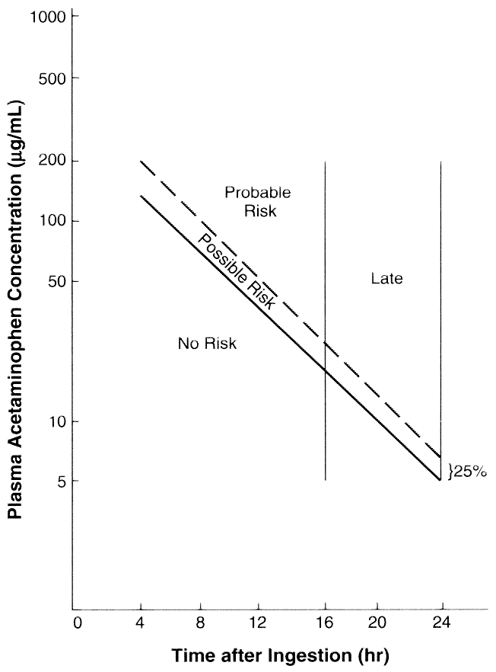
Notes:
Example:
Scanned image of a graphic. Too much contrast, thin lines and small text, vertical text, the scale is larger than needed.

Slide 14
Plasma Acetaminophen Concentration
(gm/mL)
200
Probable Risk
100
Possible Risk
50
Late
No Risk
10
5
25%
Time after ingestion (hr)
0
4
8
12
16
20
24
Notes:
Example:
Improved by tracing with the Drawing Tools, adding color and using color to illustrate key concepts.

Slide 15
Drill Baby Drill ?
The assertion slide
Notes:
Example:
Use bold graphics and/or images and simple statements to promote active thinking about key issues.

Slide 16
Good and Bad Example
Notes:
Example:
Good: use of color and italics to highlight important information. Include definition of key terms.
Bad: black background, white text, graphic not connected to content.
A clock face graphic would be better than a smiley face.

Slide 17
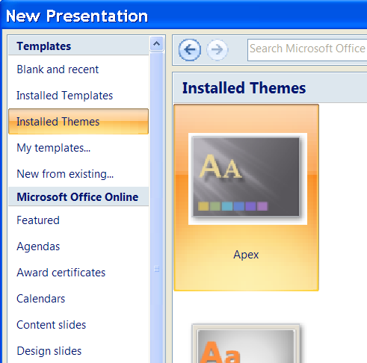
Creating a New Presentation
Create a new presentation
From themes & templates
From recent files
Using a blank design
Find templates online
Notes:
When you launch PowerPoint it opens a blank presentation using the default design theme. Within the program you can create a new presentation using many other options.

Slide 18
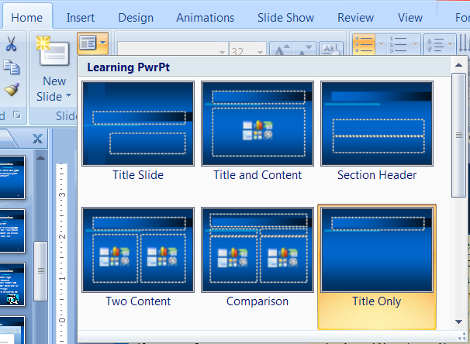
Slide Layout - Auto Layout
PowerPoint includes several types of slide layouts. Each offers a different format, depending on the content you want to put on the slide.
Notes:
A Title Slide is the default first layout, the default second slide is a Title and Content layout. Adding slides after that uses the layout of current slide. Use the New Slide dropdown arrow to select a layout and create a new slide
Use the Layout dropdown to select a different layout for an existing slide

Slide 19
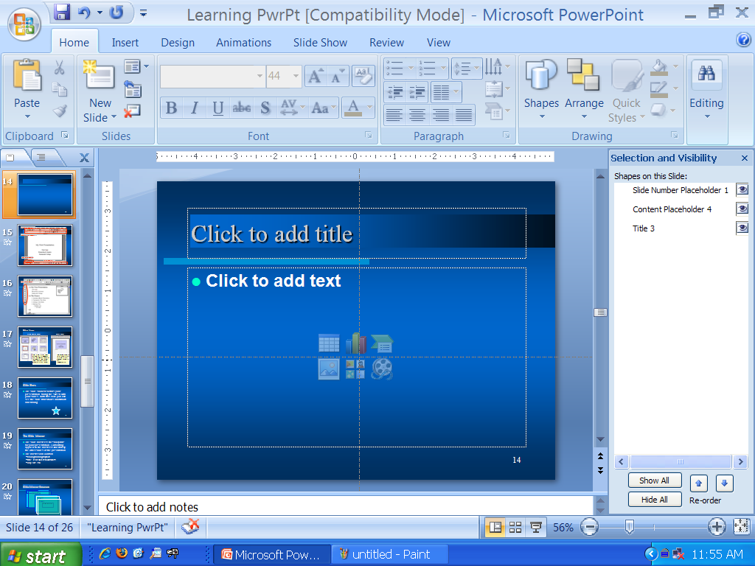
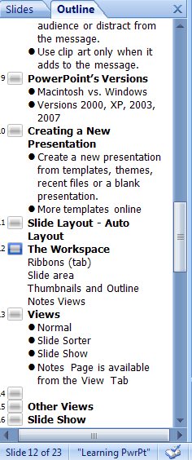
The Workspace
1
Ribbon tab
Slide area
Thumbnails & Outline
Notes Area
View Controls
3
2
4
5
Notes:
Each ribbon has its own tab. The central area is the main editing place. The left side column can display the text outline or slide thumbnails.
Click inside outlined boxes in the main editing area to add text.
The lower right corner has tools for switching between the different views and for zooming the view. The last icon on the right resets the view to fit the whole slide in the editing space.
Each area can be resized as needed.

Slide 20
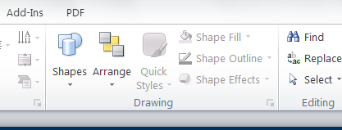
Inserting Objects
Use the Shapes drop down to select a shape then click and drag to draw the shape on the slide.
The Insert ribbon has buttons to insert other types of objects.
Notes:
Each object added to a slide is placed on its own layer in the order they were added. When an object is selected it can be moved, resized, and rotated using the object’s handles and formatted using the formatting tools. Use the Arrange dropdown to move objects up and down in the layer stack.

Slide 21
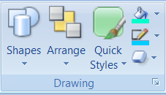
Formatting tools
Notes:
Use the Drawing, Styles and Format toolbars to format text, shapes or inserted objects.
Select text inside a textbox or shape to adjust typeface, font size, style, alignment, color, bullet, etc.
Clicking on the edge outline of an object will select the entire object and any formatting will apply to the entire object. A right mouse click on an object or the slide background will display a set of actions and formatting options for that object.

Slide 22
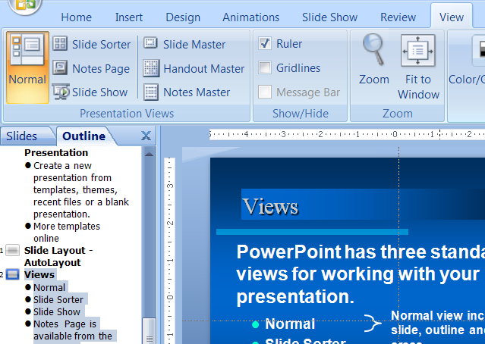
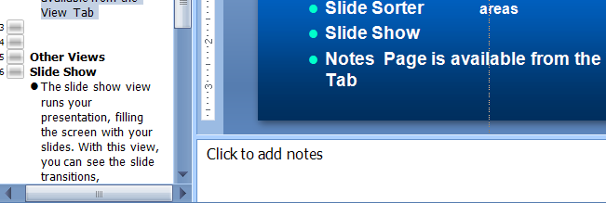
View Ribbon
1
2
3
Change views
View masters
Show ruler & guidelines
Notes:
Use the View Ribbon tab to change your view of the slide or access masters and layout options like rulers and guidelines.

Slide 23
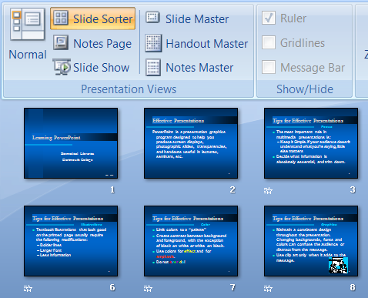
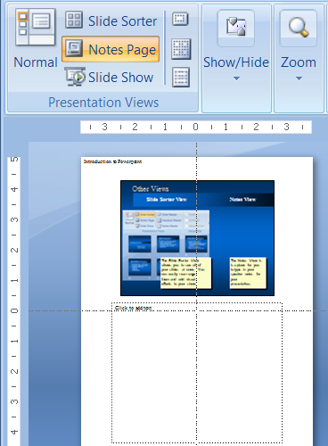
Other Views
Slide Sorter View
Notes View
The Notes View is a place for you to type in your speaker notes
The Slide Sorter View allows you to see all of your slides at once. You can easily rearrange them by dragging individually or in groups.
Notes:
Shift click to select multiple slides in the slide sorter view. Icons in the slide sorter indicate that animation effects have been applied.
The Notes view provides a place to enter your speaking points and can be printed to use during your presentation.
Notes is also a good place to record references to materials used in the presentation. Web addresses, source of images etc.

Slide 24
Slide Show
The slide show view runs your presentation, filling the screen with your slides. With this view, you can see the slide transitions, animations and timing.
Notes:
Enter the Slide Show by using the Slide Show view button in the lower right of the main window or use the functions on the Slide Show Ribbon.
In the Slide Show use the Enter Key, Space Bar, or Mouse Button to Advance the slides. Arrow Keys can move forward or backward. The Esc key will end the slide show mode.

Slide 25
The Slide Master
The slide master is the “blueprint” for your presentation. Formatting applied to the master is inherited by the other slides of the presentation.
The master can contain
background graphics
title, text and list containers
clip art, etc.
Notes:
The Theme Master is a good place to put your department logo so it appears on every slide.

Slide 26
Slide/Master Structure
Theme Master
Title Master
Title Slide
Slide 1
Slide 2
Layout Master
Notes:
Every slide uses the formatting of the Slide Master and its associated layout master. You can make formatting adjustments to any individual slide but then it becomes detached from the Master formatting. If you need to restore the default formatting for a slide use the Home Ribbon – Slides section - Reset to “reapply” the Master formatting of that layout.

Slide 27
Masters
Notes:
Displayed on the left side are all of the masters for the “Theme”. Each layout has a different master which can be customized. Any changes made to a layout will only apply to slides that use that layout. At the top is the overall design master. Changes made there will apply to all of the other layouts, unless they have previously been modified. Here the Title and Content master is selected and any changes made will only appear on slides that use this layout.

Slide 28
Printing a Presentation
Slides - This option prints one slide per page
Notes Pages - This option prints the notes pages for each slide
Handouts - Prints 2, 3 or 6 slides per page
Outline View - This option prints a copy of your presentation outline as it appears in outline view
Notes:
When printing multiple slides per page try telling PPT to print one slide per page and use your printer settings to print multiple pages per sheet. You might get better results.

Slide 29
Basic Steps Summary
Outline What You are Going to Say
Tell a story
Edit Textual Content on Each Slide
Add Graphics, Pictures, Sound
Refine the Presentation
Animation, Transitions and Formatting
Spell check and visual review
Notes:
When assembling your materials for a presentation it is best to copy all images, and other documents to one folder and save your PPT file there as well. That will allow you to move the presentation to another location and without breaking any links.

Slide 30
Future Topics
Advanced PowerPoint
Slide Transitions and Animations
Advanced Drawing and Graphics
Importing [Word and Excel]
Posters
Templates
Movie and Sounds Clips
Individual assistance

